Slide 1
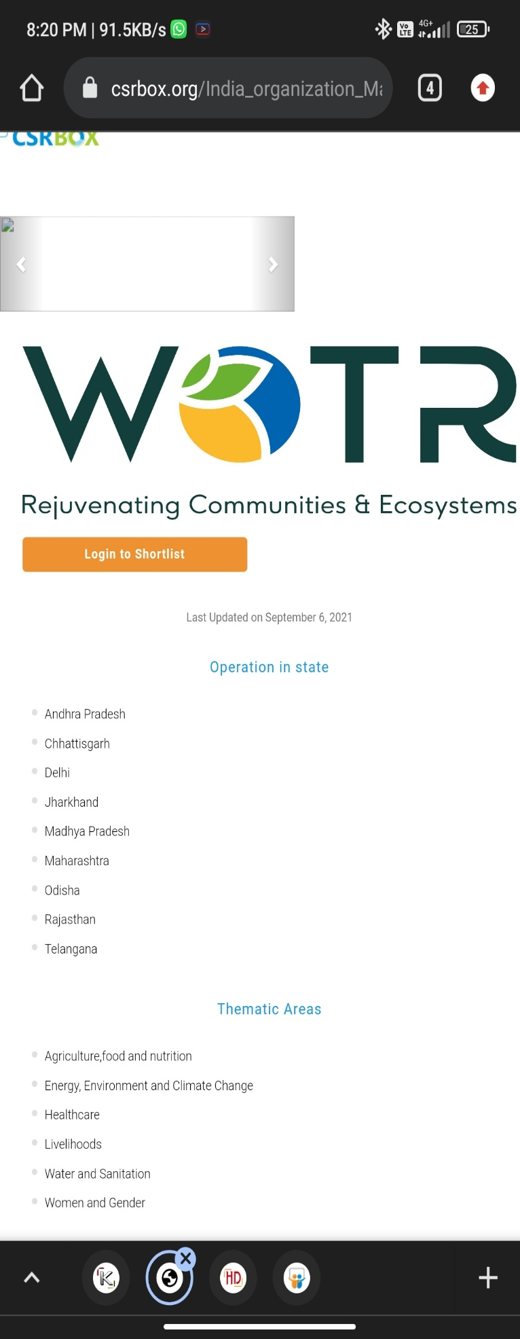

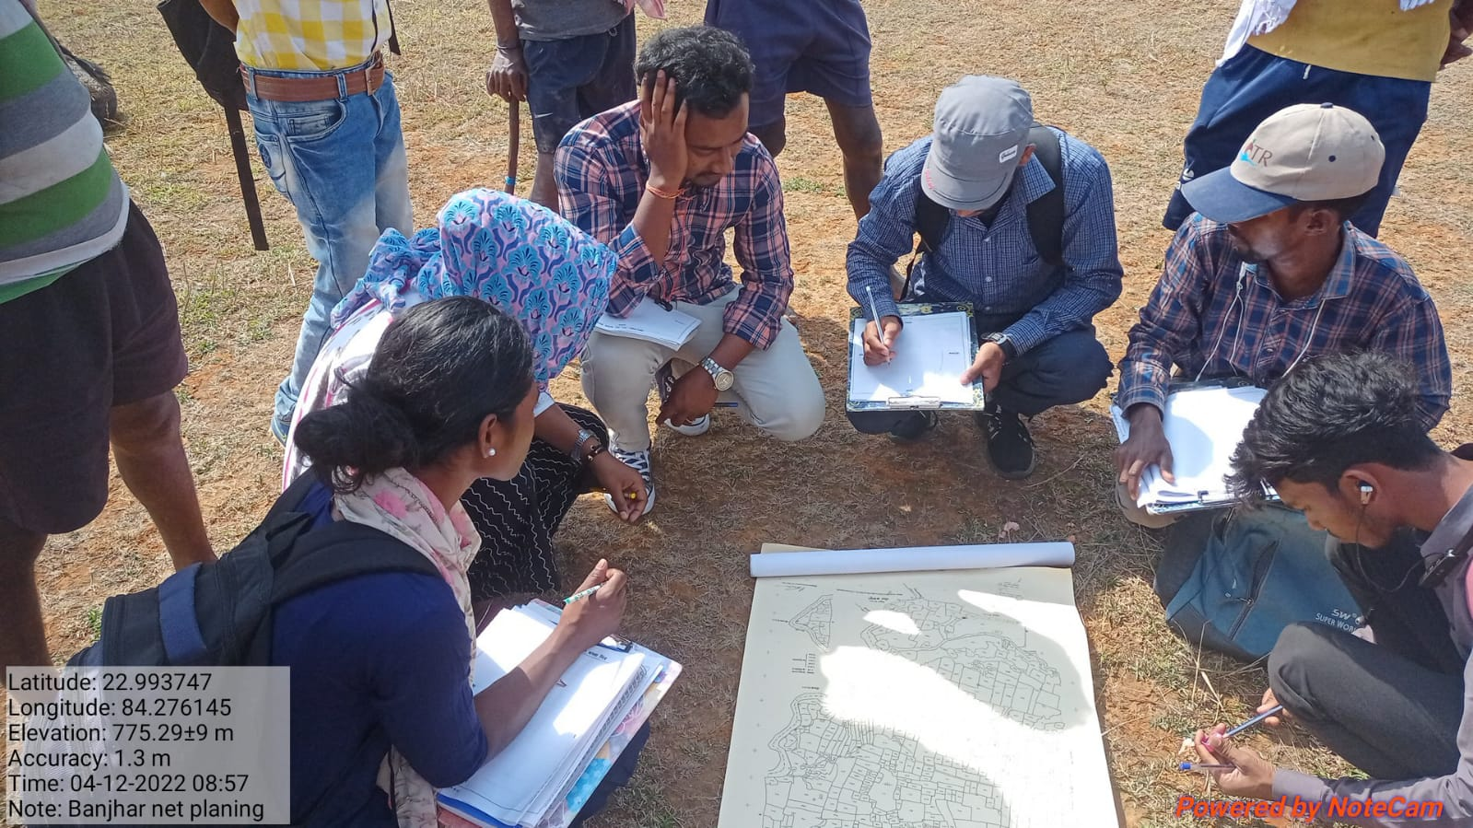
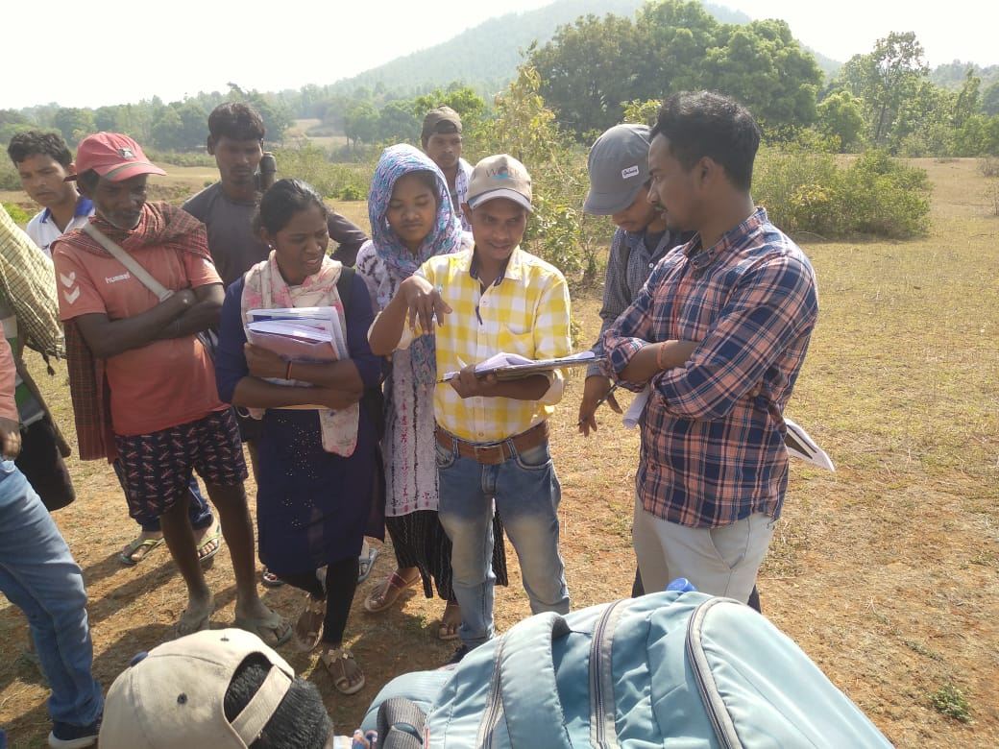
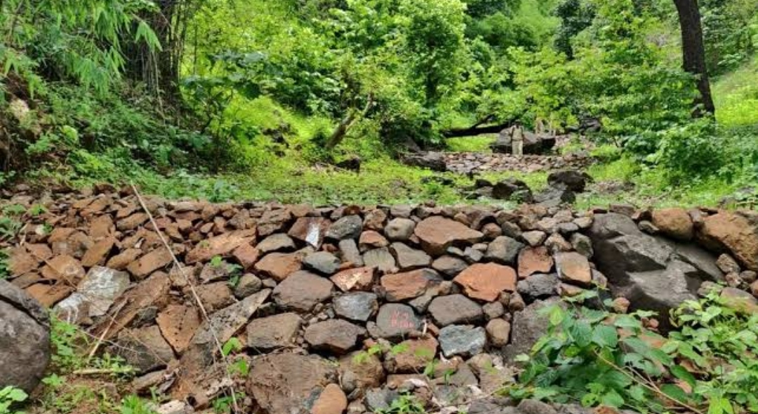
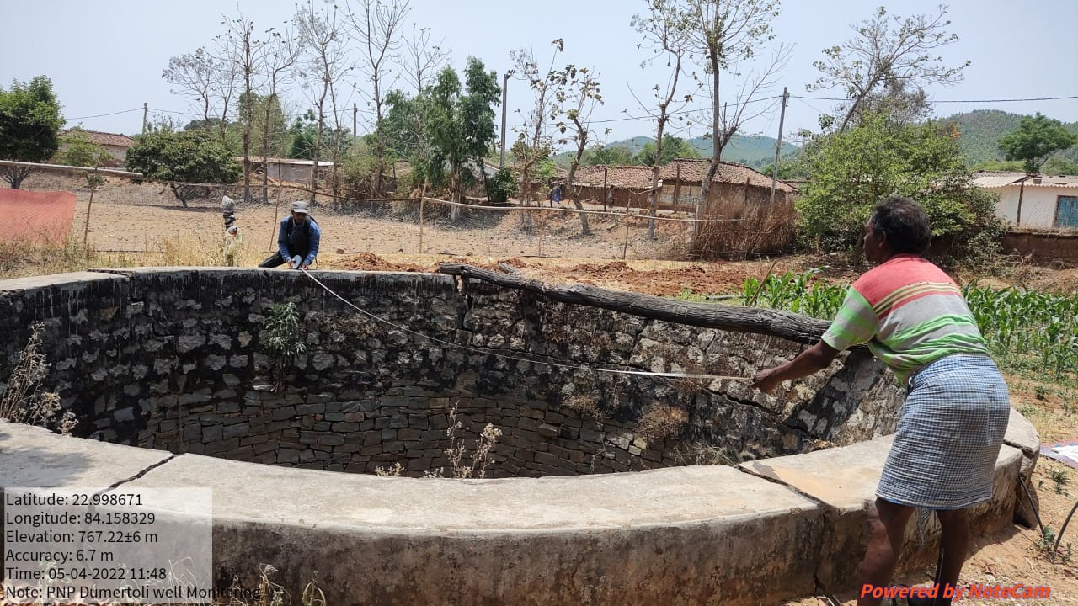
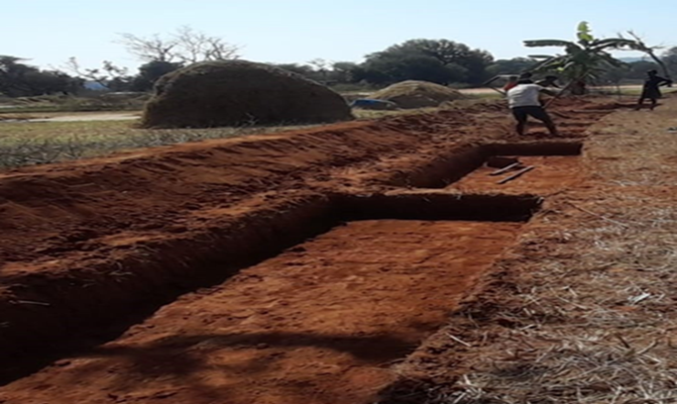
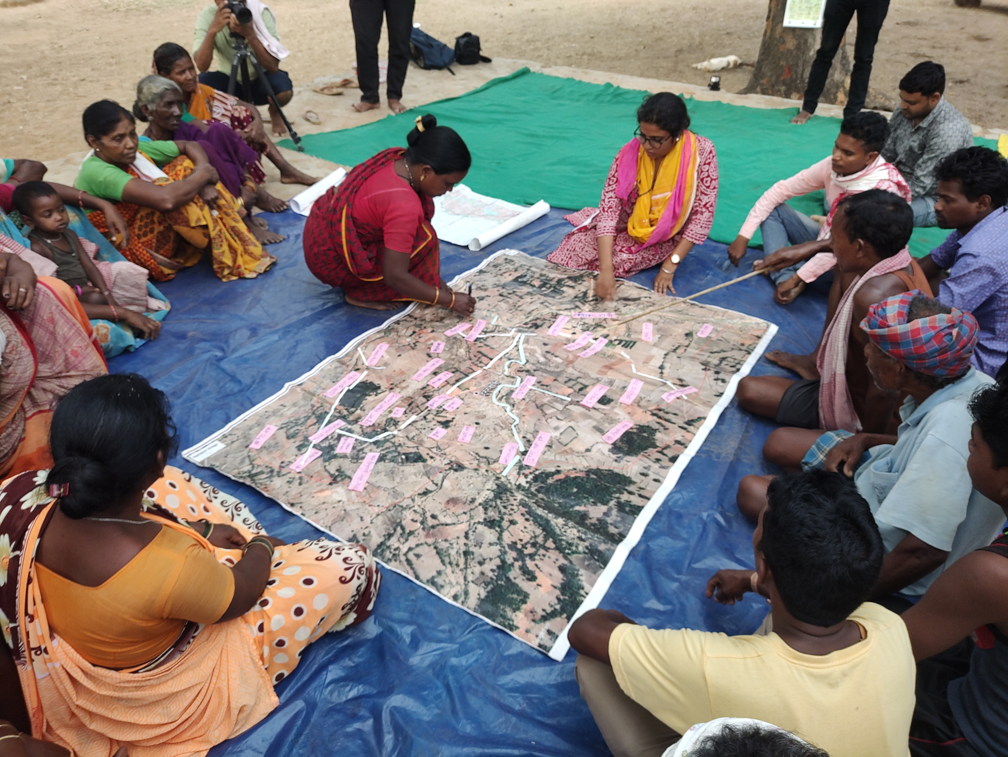

WOTR (Watershed Organization Trust)
Established 1993, WOTR ( Watershed Organization Trust) is a non – profit organization that engages at the intersection of practice, knowledge and policy across scales and in collaboration with various stakeholders across sectors.
Vision - Communities, especially the poor within, are empowered to live in dignity and secure their livelihood in sustainable ecosystems.
Mission - To provide committed development support that motivates, energizes and empowers individuals, groups, communities and other organizations to undertake integrated ecosystems development for enhancement of well-being on a sustainable basis.
Goal - To ensure food, water, livelihood, and income security together with a growing quality of life to vulnerable and disadvantaged communities on a sustainable and equitable basis.
WOTR (Watershed Organization Trust) Chainpur, District- Gumla, State- Jharkhand
Theoretical work
Panchayati Raj Institution Training (PRI)
Detail Project Report Participation (DPR).
Gram Sabha Approval
Practical Work
Gram Sabha
E-PRA
ODK
PNP (participatory Net Planning)
Well Inventory
Reengage Monitoring
Brief Description about the project (Jiwi Daah Hasa)
Jiwi Daah Hasa project is about revitalise life in earth resources and livelihoods in the most deprived geographies of Jharkhand. The project attempts to build capacities of Gram Panchayats in planning and implementation of MGNREGA for a comprehensive eco-system revival based on watershed development principal.
Challenges faced during this Internship
Gathering villager’s for the meeting.
Communication and interaction with villager’s.
Language problem.
Learning and Value Addition
Understand the water harvesting and project (Jiwi Daah Hasa).
Understand the livelihoods of the villager’s.
Explored the new research topic.
SOWT Analysis
Strength | Weakness
Economic, New Technik to reduce the land erosion, Direct benefit to landowners | Dilly in implantation, Laziness in field work, Decision making.
Opportunity | Threats
Employment, Livelihood security, Promote the agriculture. | Lake of participation from field expert, Poor management.
WOTR Structure
Executive Director
District Manager
Executive Director
Management Groups
Thematic Coordinators
Junior Manager
Support Teams
Field Expert
Usefulness of internship
I have experienced the villager’s life, where people have paced so many challenges in their livelihood, and interacting with them is my prosperity.
I learned the farmer’s and his importance toward the farming .
Suggestion
For better implementation the project, we must make people aware, about MGNAREGA because the villagers are not aware of the benefit of MGNAREGA. And that way they not participating on this project.
Organization Name – Watershed Organization Trust (WOTR)
Title of the Poster – My experience with WOTR
Name – DHARMENDER LAGURI
Roll No – IIHMR-U/10/2021-23/0004
Organization Mentor Name – Miss Hanski Kumari (Social Development Officer)
Faculty Mentor Name – Dr. Tripti Bisawa
MBA Development Management, IIHMR University, Jaipur

