Slide 1


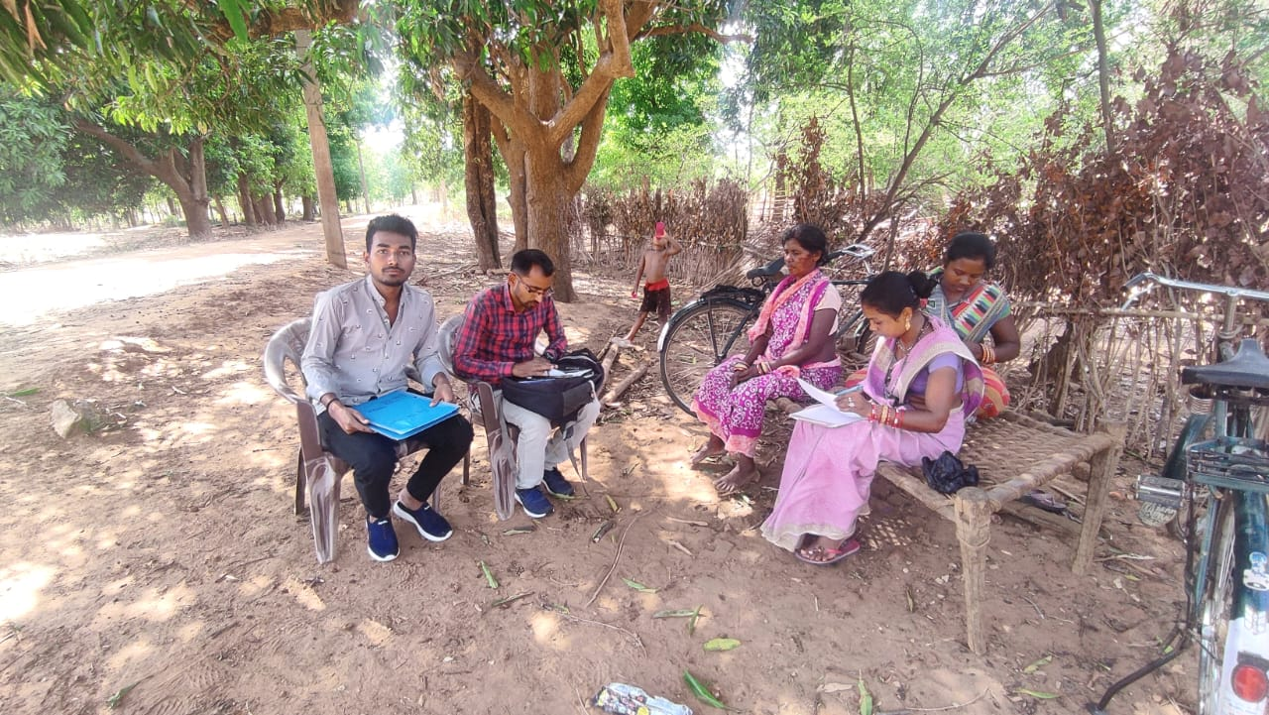
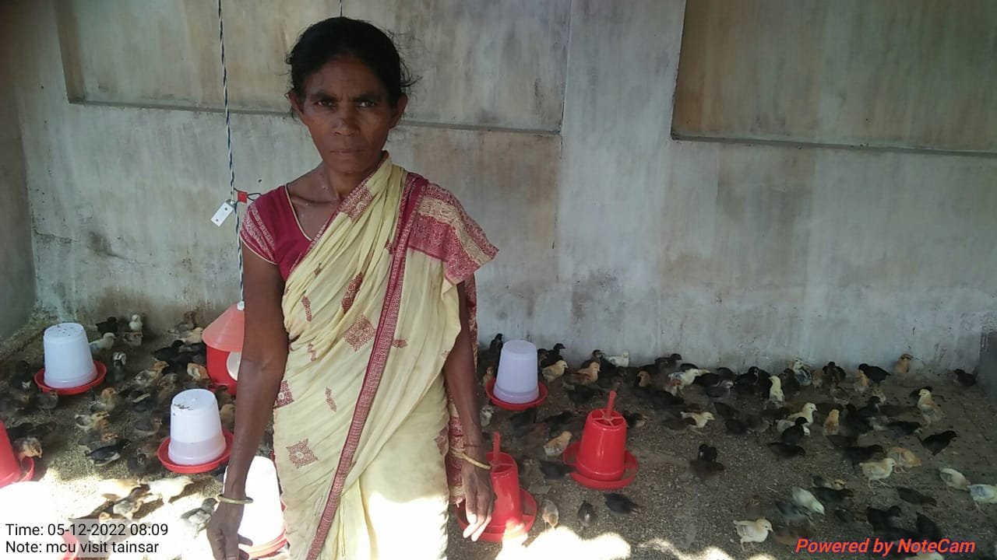
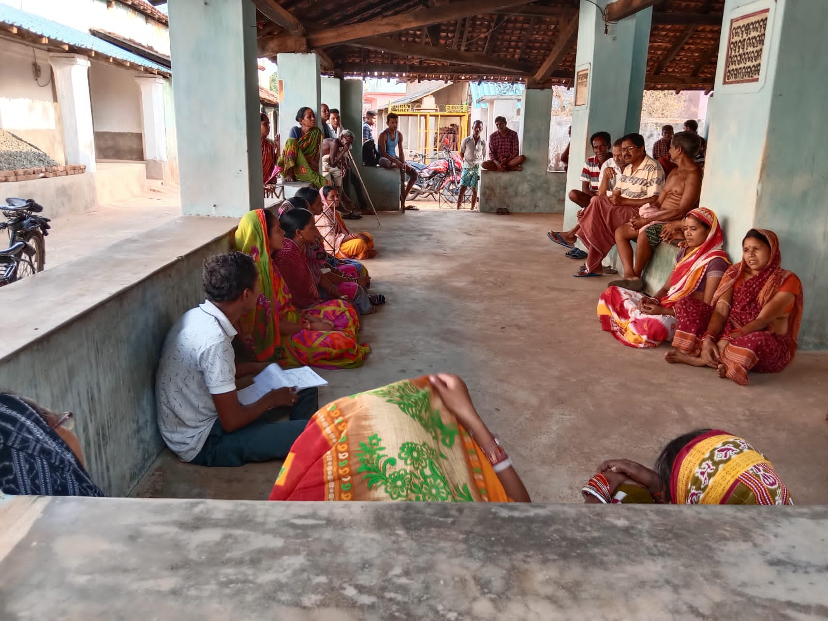
Producer group-minimum 20 members
-maximum 50 members
SAMBALPUR INTEGRATED DEVELOPMENT INSTITUTE, ODISHA
HISTORY OF SIDI
SIDI, established on 1st June 1990 is registered under the Societies Registration Act (SRA), 1860. It is also registered under the Foreign Contribution Registration Act (FCRA) under the Ministry of Home Affairs, Govt. of India, New Delhi and under 12 A & 80 G of IT Act. SIDI works with the partner community of Sambalpur and Deogarh district.
APC STRUCTURE
LEARNING AND VALUE ADDITION
Understanding working culture at the field.
How to reach out people through project details.
Explore new research topics.
How to establish communication and action learning.
Secretary
Program manager
Subject matter specialist
Cluster coordinator(3)
Management information system
Community mobiliser(2)
Producer company
Producer group
Producer group
Target families-2400
Families covered-2372
VISION
Healthy and self-reliant community life with dignity, where everybody enjoys equal opportunity, rights, liberty, justice, participation, informed decision making and ability to resolve the issue. -
MISSION
Empowering the marginalized sections of the community to bring the community forward for the assertion of basic rights.
CHALLENGES
Language constraint for communication.
Migration of educated people.
Less participation of community due to lack of interest.
Participation of women in decision making was low
1 producer group= 50 – 150 members
USEFULNESS
Clarity regarding livelihood - how projects are executed.
Interaction with people - leads to understanding implementation challenges
Give us a new area or new topic for research.
Different environment gives a unique platform to learn.
Understand the working environment which brings success.
Quick decision to solve issues.
DESCRIPTION OF ORGANISATION AND PROJECTS RUNNING IN THE ORGANISATION
APC (AGRICULTURE PRODUCTION CLUSTERS)
OTELP (ODISHA TRIBAL EMPOWERMENT LIVELIHOOD PROJECT)
STAR SCHOOL
SWOT analysis of APC Project
Strengths- High income generation through agriculture and livestock management. Women are financially empowered. Open market for farmers. | Weakness- Vendors and suppliers arbitrarily buy vegetables from PC. Household work along with farming, dual work burden. Less knowledge of fertilizers. The division of work creates a lot of confusion.
Opportunities Availability of cold storage Involvement of rural people in self income generating activities. Creative mindset of business to women. More productive along with amenities and environment. | Threats Heavy Rainfall, snowfall damage vegetables and crops Machine Failure or technical problems takes time to repair. Expensive machinery equipment. Expensive to transport water to field
BRIEF DESCRIPTION OF PROJECT
APC aims to trigger growth in farm sector with the objective of sustainably double the income of 1- Lakh small and marginal farmers in the backward highland regions of the State. APC aims to establish the model of Agriculture Production Cluster (APC) in 40 backward Blocks of the State, as an effective method to organize production system and services of markets. a production cluster program implemented for 6000 small and marginal farm families in Jamankira and Kuchinda block.
24 Producer groups formed with 2400 families till date and focused on cultivation of winner crop,
input supply through a single window system,
integrated farm management through scientific practices,
promote organic farming.
SUGGESTIONS
Should focus on the monitoring system.
Senior management should do regular field visits.
Management of facilities at the time.
Monthly inter-departmental meeting review.
Increase collaboration with partners.
Encourage farmers for organic farming.
To understand the farmers in a better way, we can show them a
documentary.
Divide work on a weekly or monthly basis and submit reports.
Partner organizations should visit the working field to see progress.
THEORETICAL WORK
Deals with documentation of file.
Problems are not discussed deeply.
Working conditions of stakeholders are not well discussed.
PRACTICAL EXPOSURE
Deals with the implementation of work.
Experienced Grassroot level challenges
give us new ideas or new methods.
teach how to adapt to working conditions.
Name: Mr. Gitil Tiriya
Roll no: 0005, Course: MBA-DM (2021-23)
Organisation Mentor: Shri. Apurvakanti Mondol
Faculty Mentor: Dr. Hemanta Kumar Mishra

