Slide 1

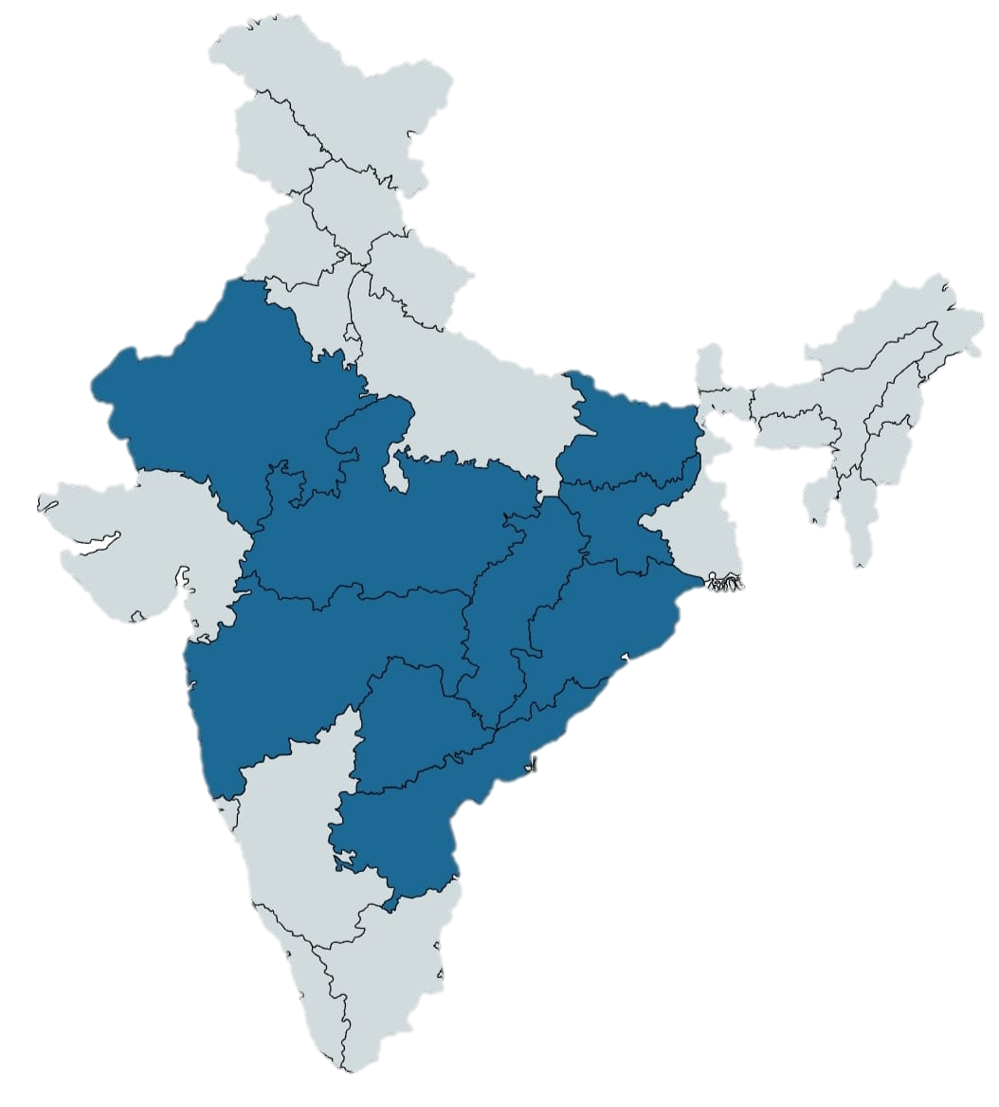
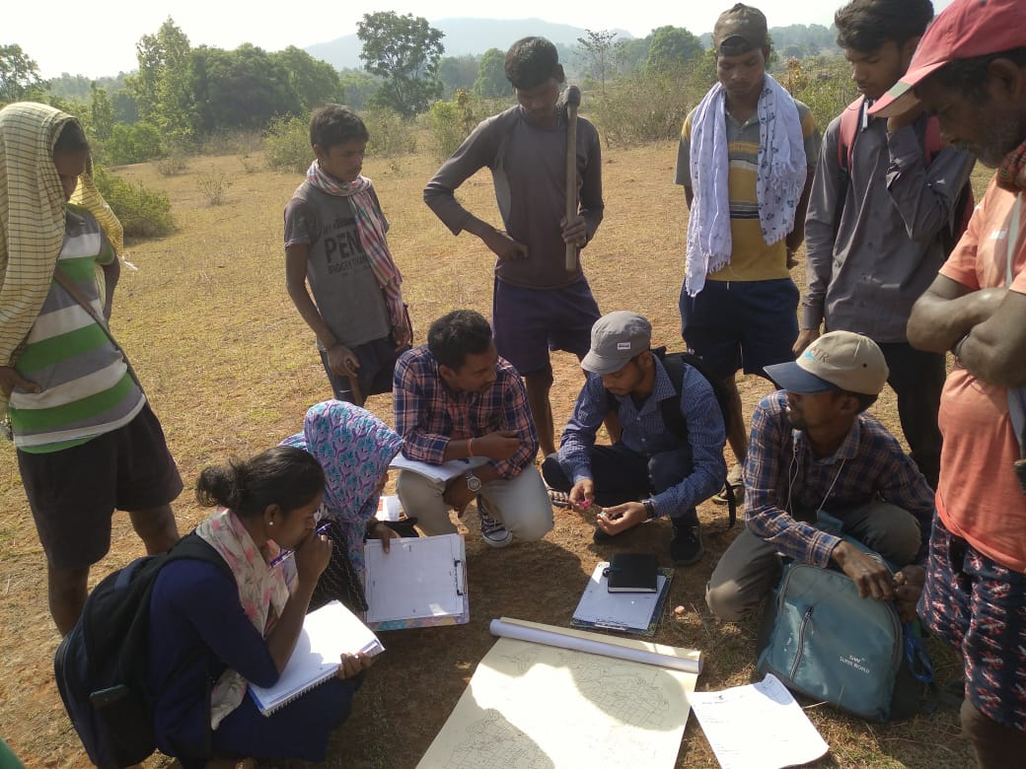
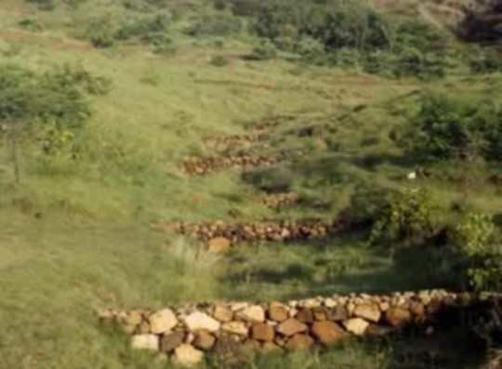
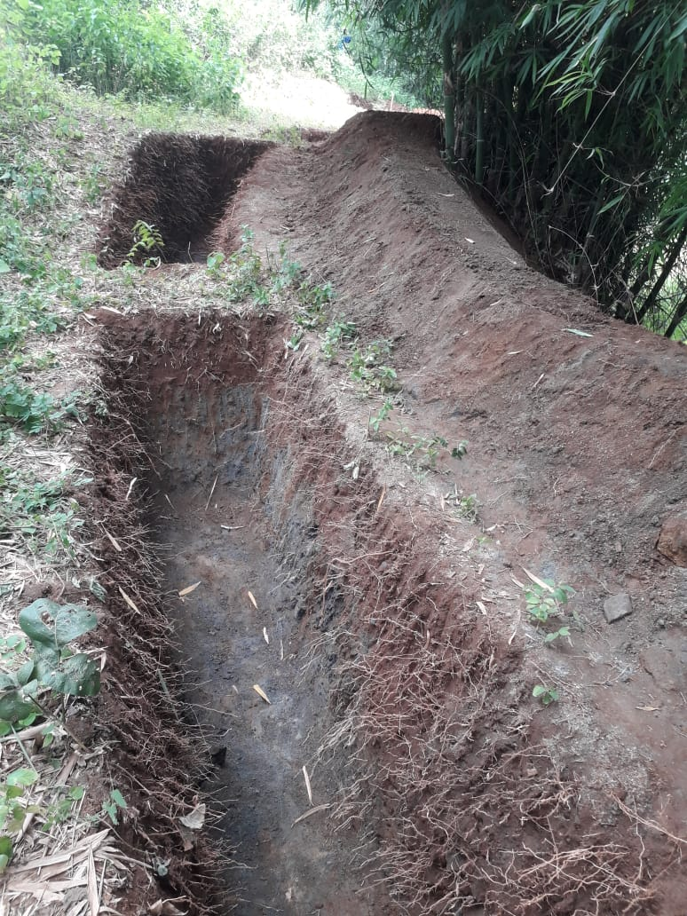
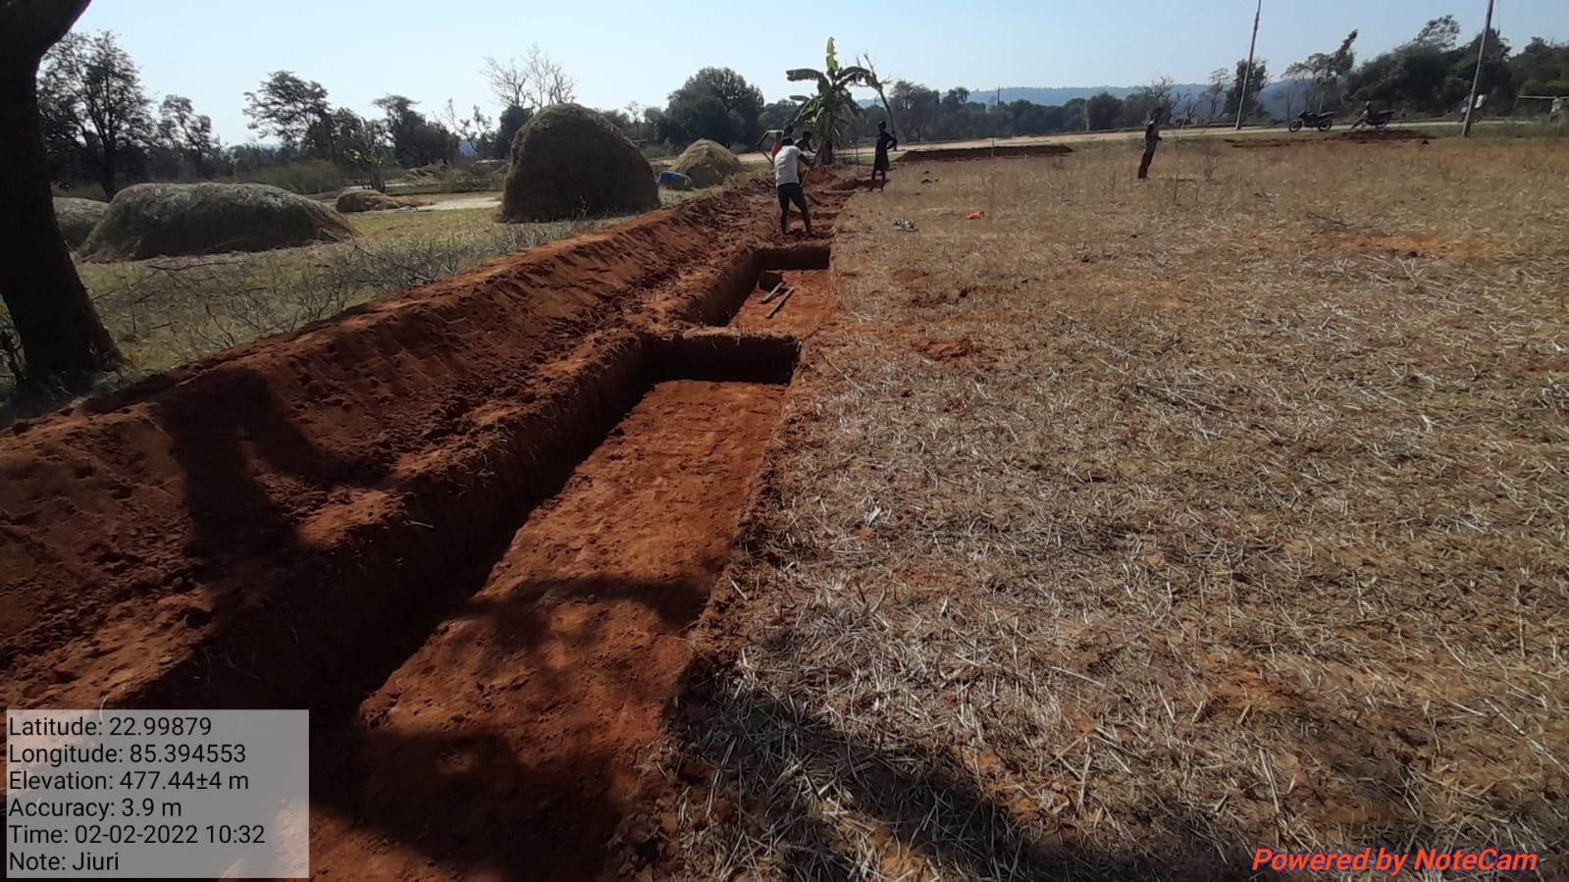
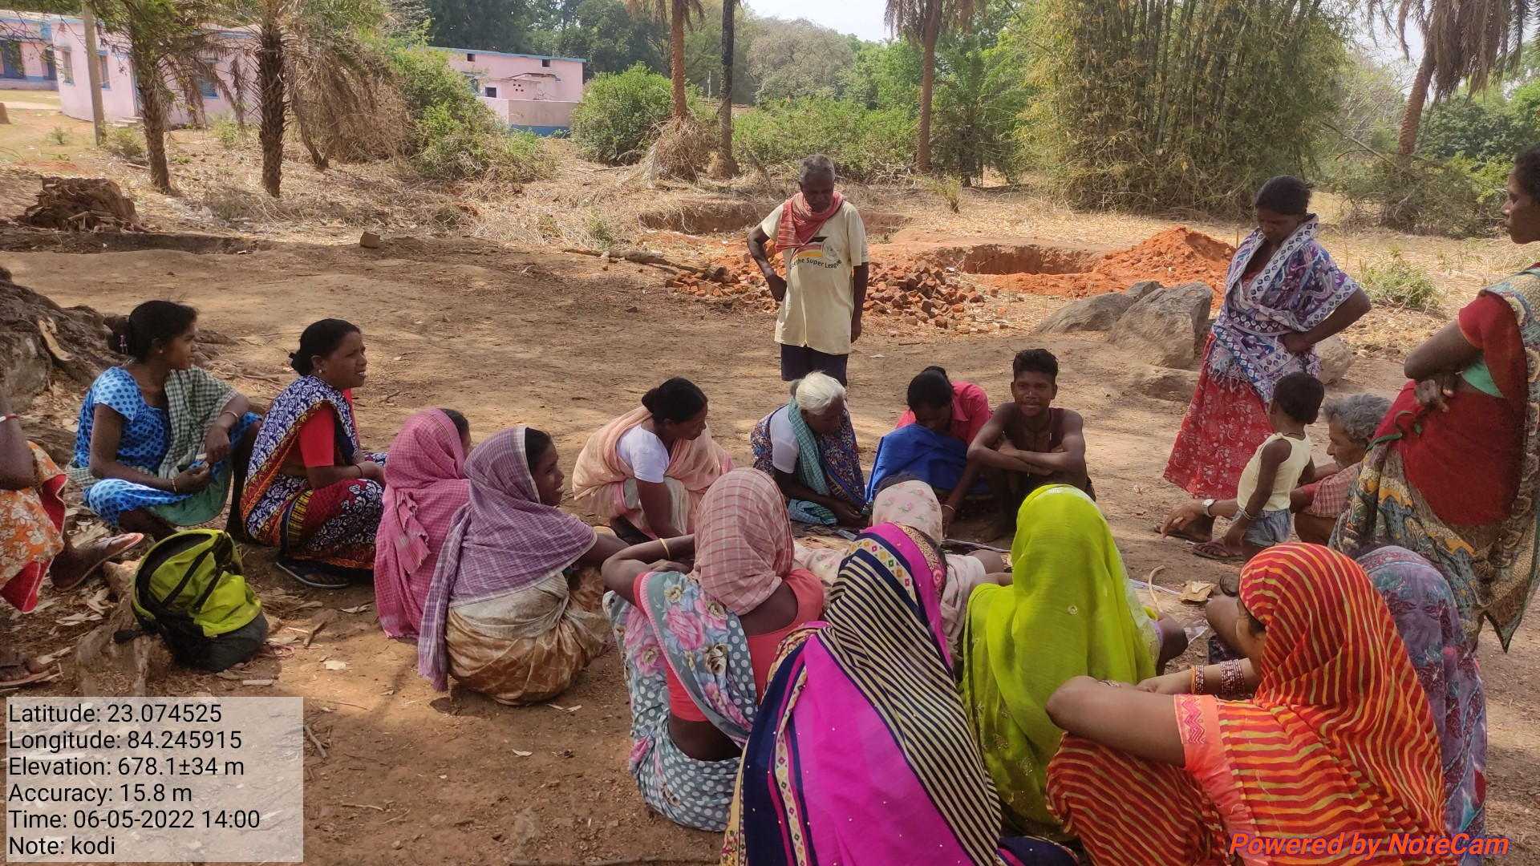
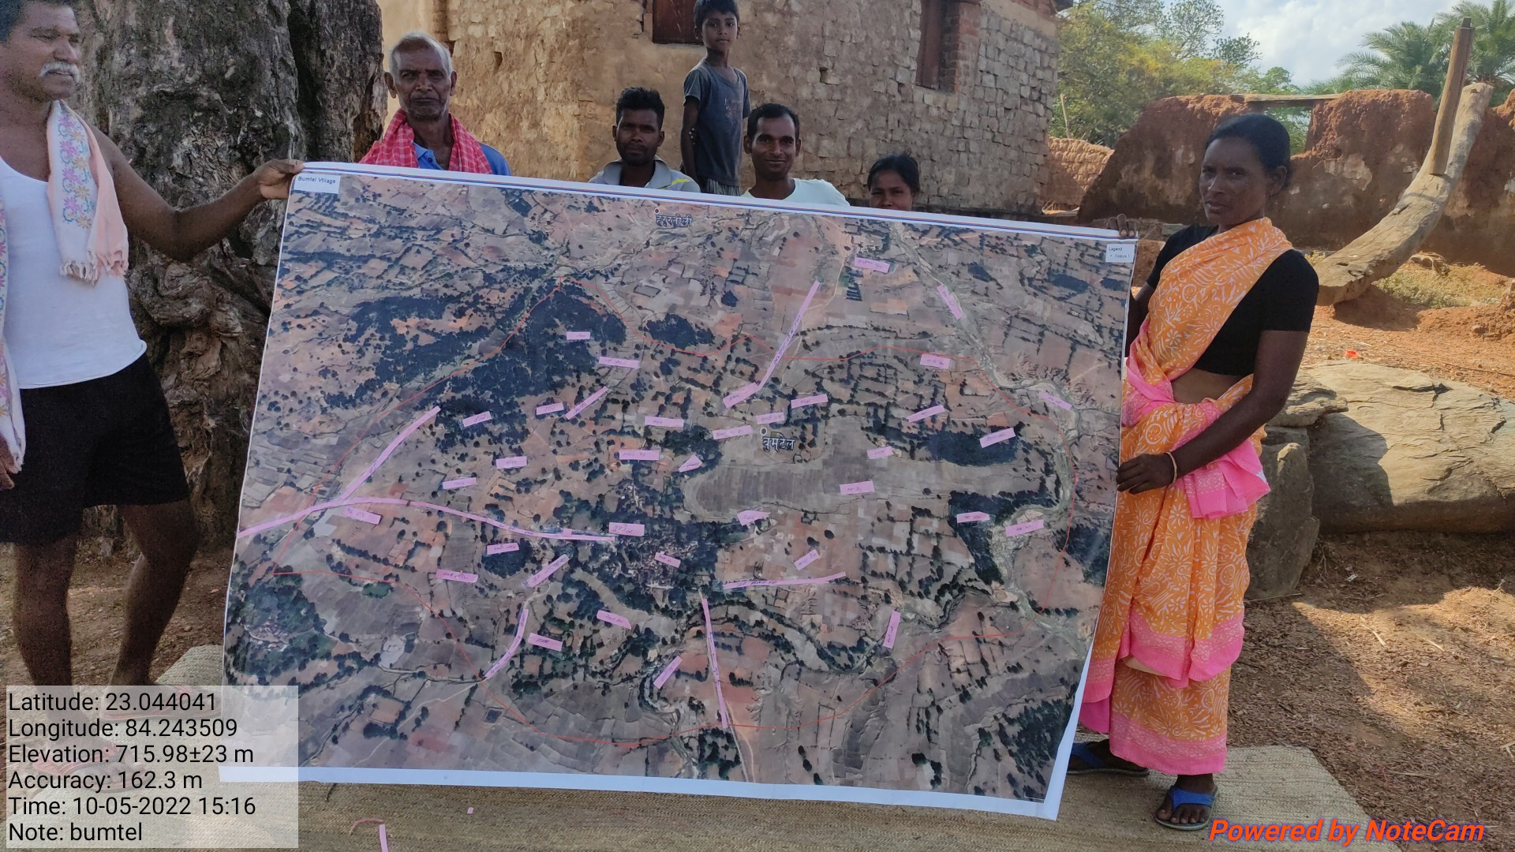
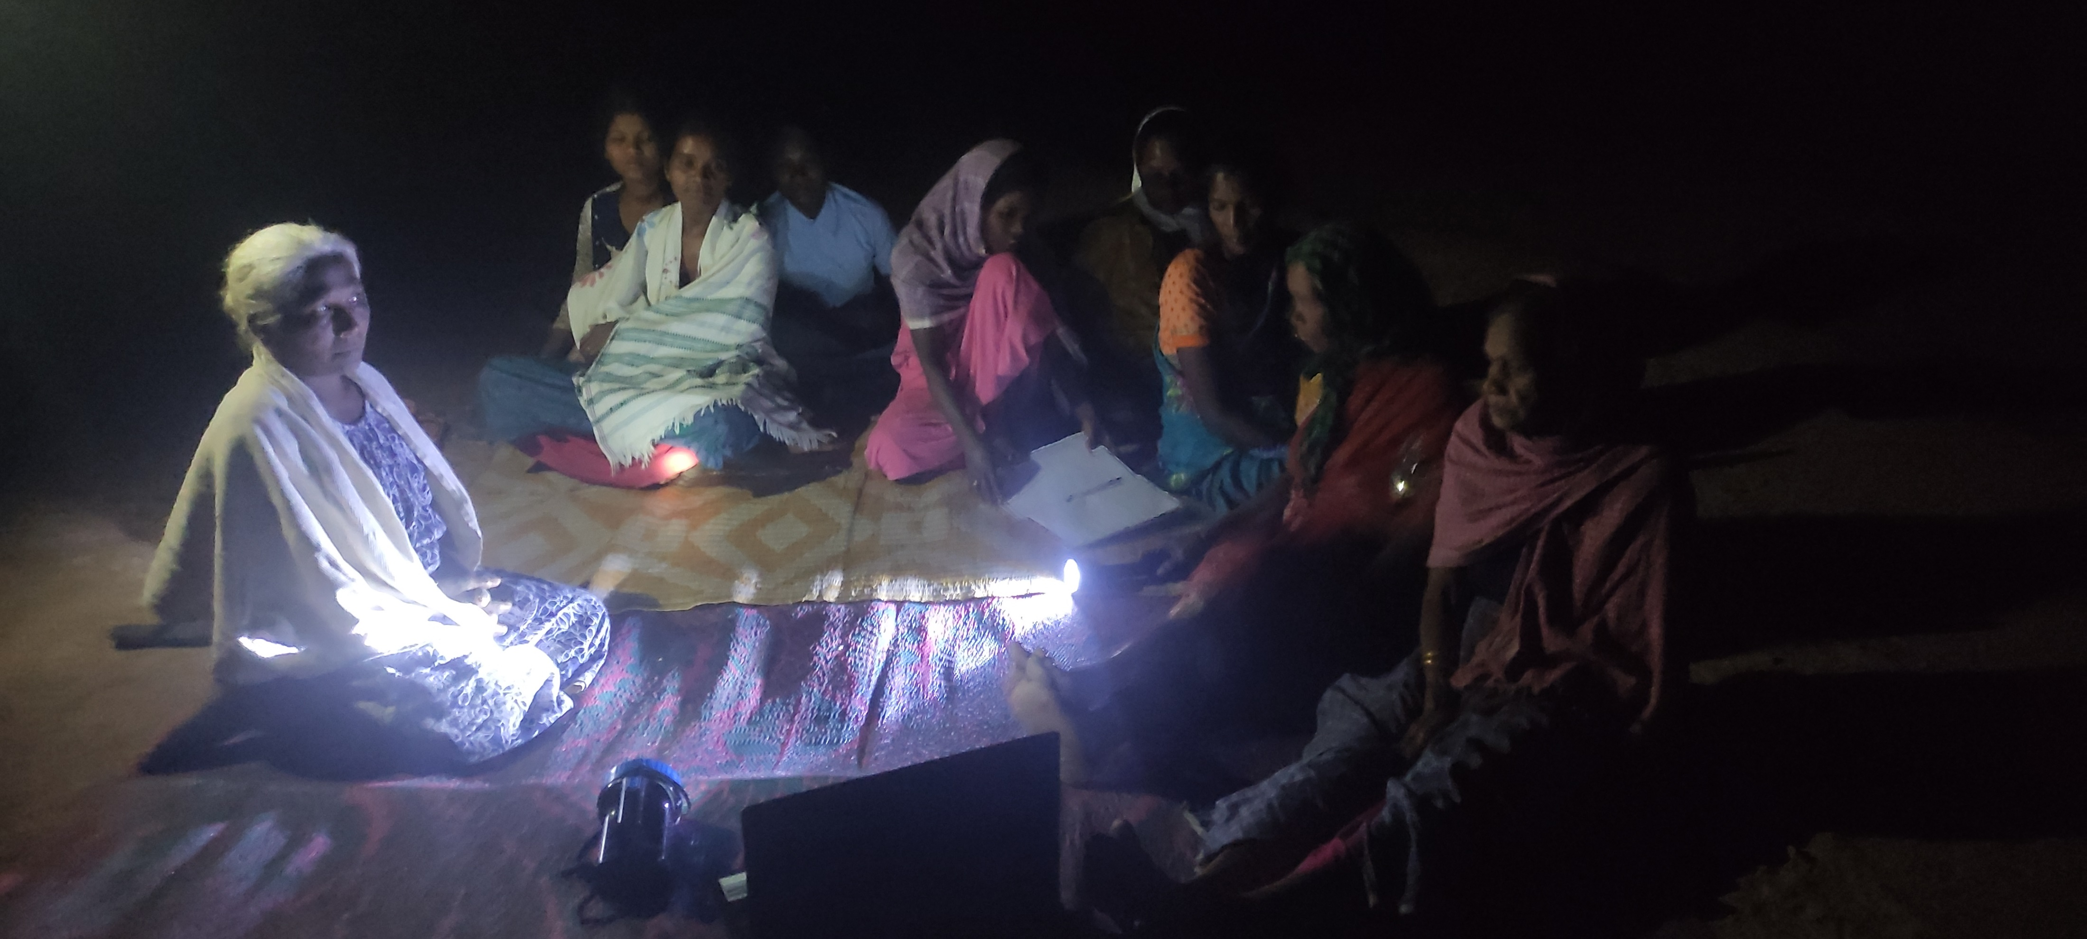
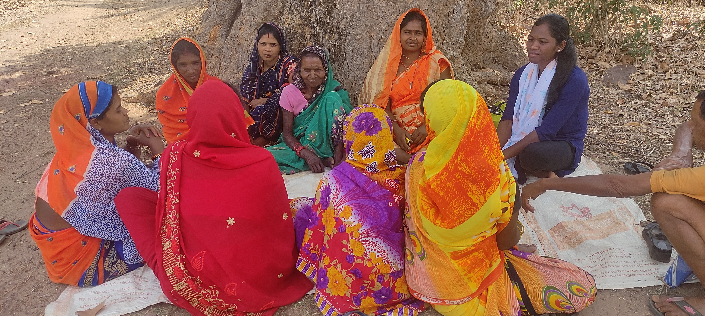
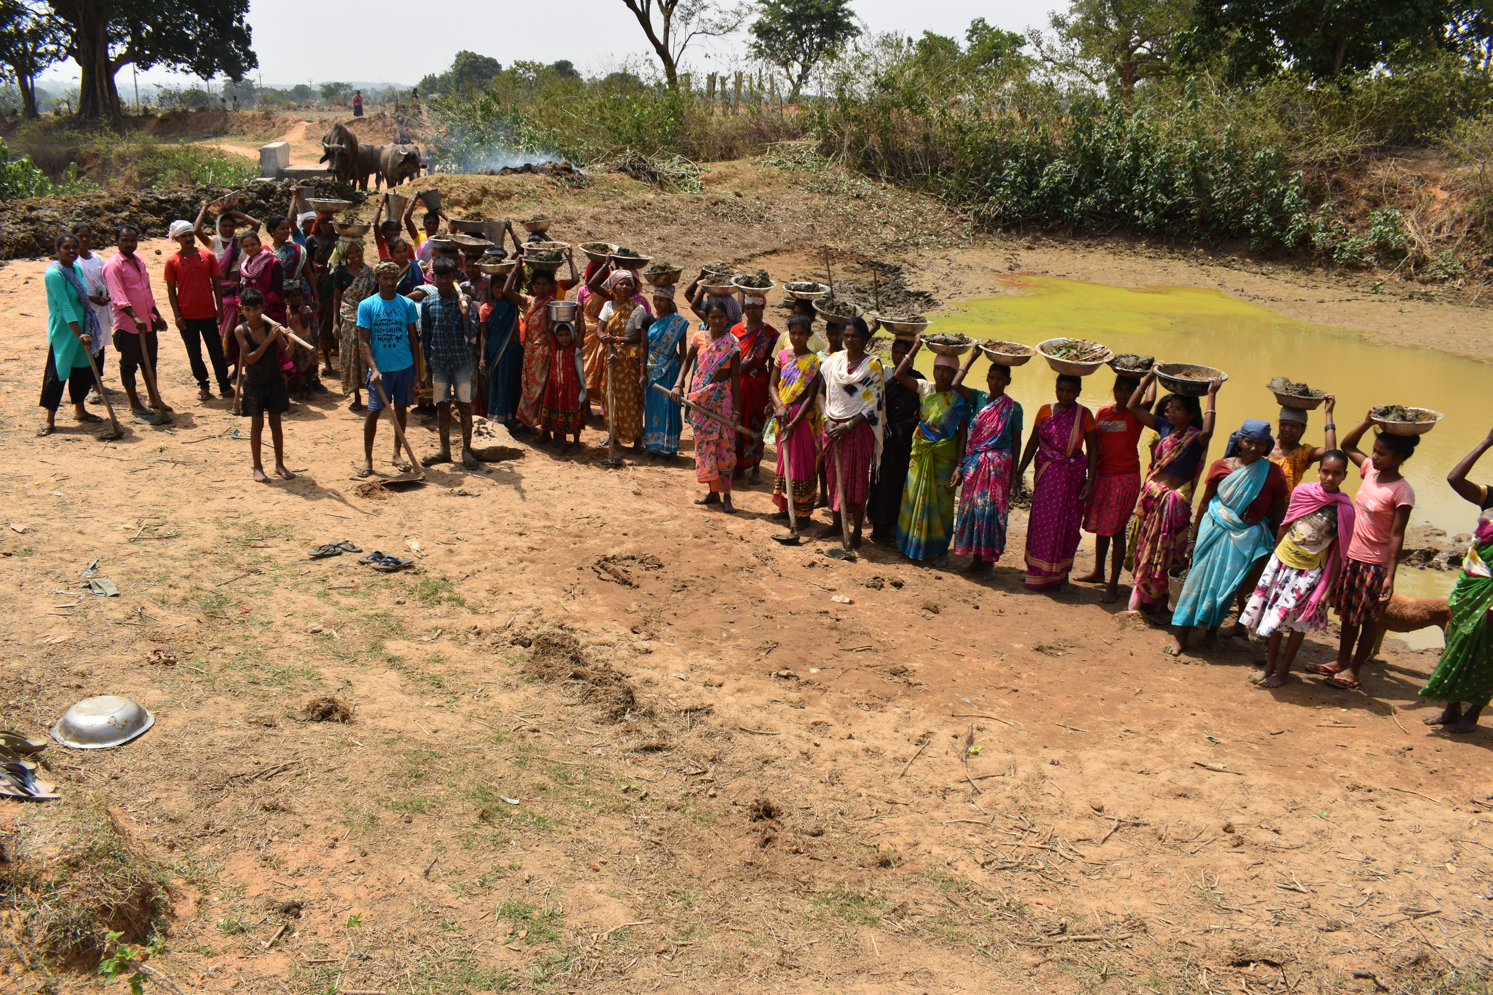
Non-profit organisation
Established 1993
under work (water harvesting, soil consersation)
Net planning – odk collect app
Trench cum bund (TCB)
Earthen cum bund (EFB)
Watershed absorption trench (WAT)
Continous contour trench (CCT)
Organisation that engages at the intersection of prectice, knowledge and policy across scale and in collabortion with various stakeholder across sector.
Drainage line treatment
Loose boulder structure
Diversion drain (kacchanala)
Jiwi,daah,hassa - Life, water, soil
Vision-To make the life of the rural community resilient and sustainable to improve the business of the farmers as well as to enjoy the life of the villagesto a fuller quality within the ecosystem.
Mission -WOTR aims to end major causes of rural poverty by rejuenating ecosystem and building community resilience to climate change, we aim toincrease the availability of water increase the productivity of land and agriculture, diversity rural, livelihood, empower and strengthen rural women and improve the health well being of vulnerable rural communication
Theoretical work
Organisation and project
(jiwi haad hassa)
PRI ( panchayati raj institution)
DPR
DPR approval
Practical work
Gramsabha
E-PRA
Sharamdaan
Plantation
Well inventory
raingage
Strengthen; Good communication skill Women empowerment Opportunity; employee implement Working at the grass root level in rural area | Weekness ; Low level of participation Lack of collaboration Threat; Time management Technological barrier Lack of team work member
Difference between theoretical and practical
Learning implement skill
Knowledge gain confidence level high
Understanding group work
organisation structure.
Board of director
Excutive
director
Programme
Manager-2
State manager
Reigonal manager
Projecter
manager
Cluster officer
Learning and value addition;
Mobilizing MGNERGA.
Knowing WOTR project.
Understanding the village and observising daily activity or staying village livelihood
Usefulness;
Learning, understanding
Mobilization skill
Social behaviour
communication
Challanges ;
Mobilizing farmers – net planning odk collect app.
Lack of electricity
Khatyani langusges
Suggestion;
They can should on better implement.it can bring big change in the life of people allover the villages,so that the student can gets a big learning opportunity.
Gaps ;
Low level of awarness
Limited insfrastructure
Low connectivity

