Slide 1


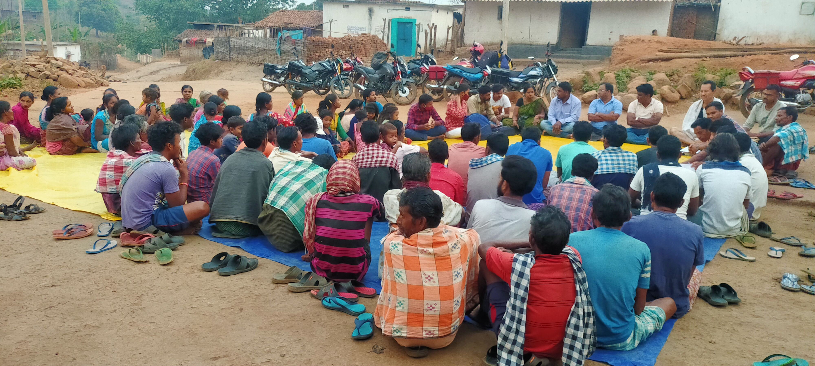
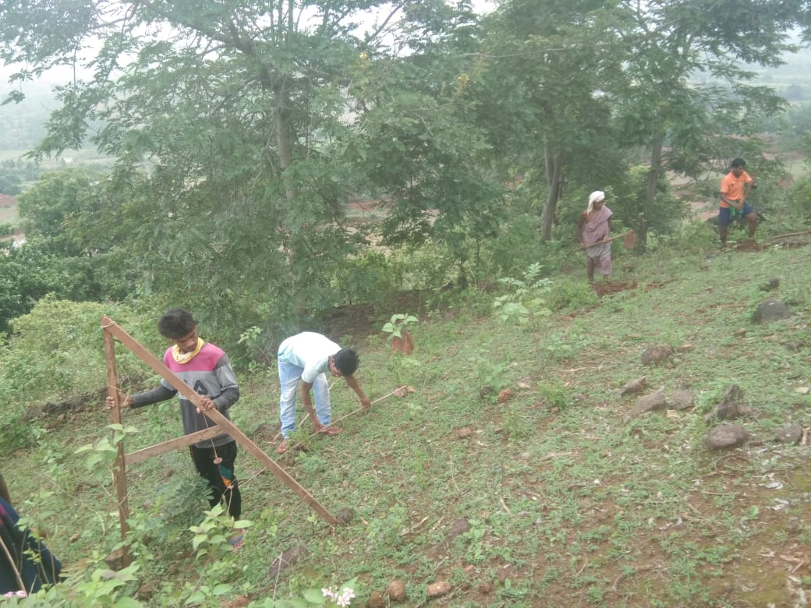
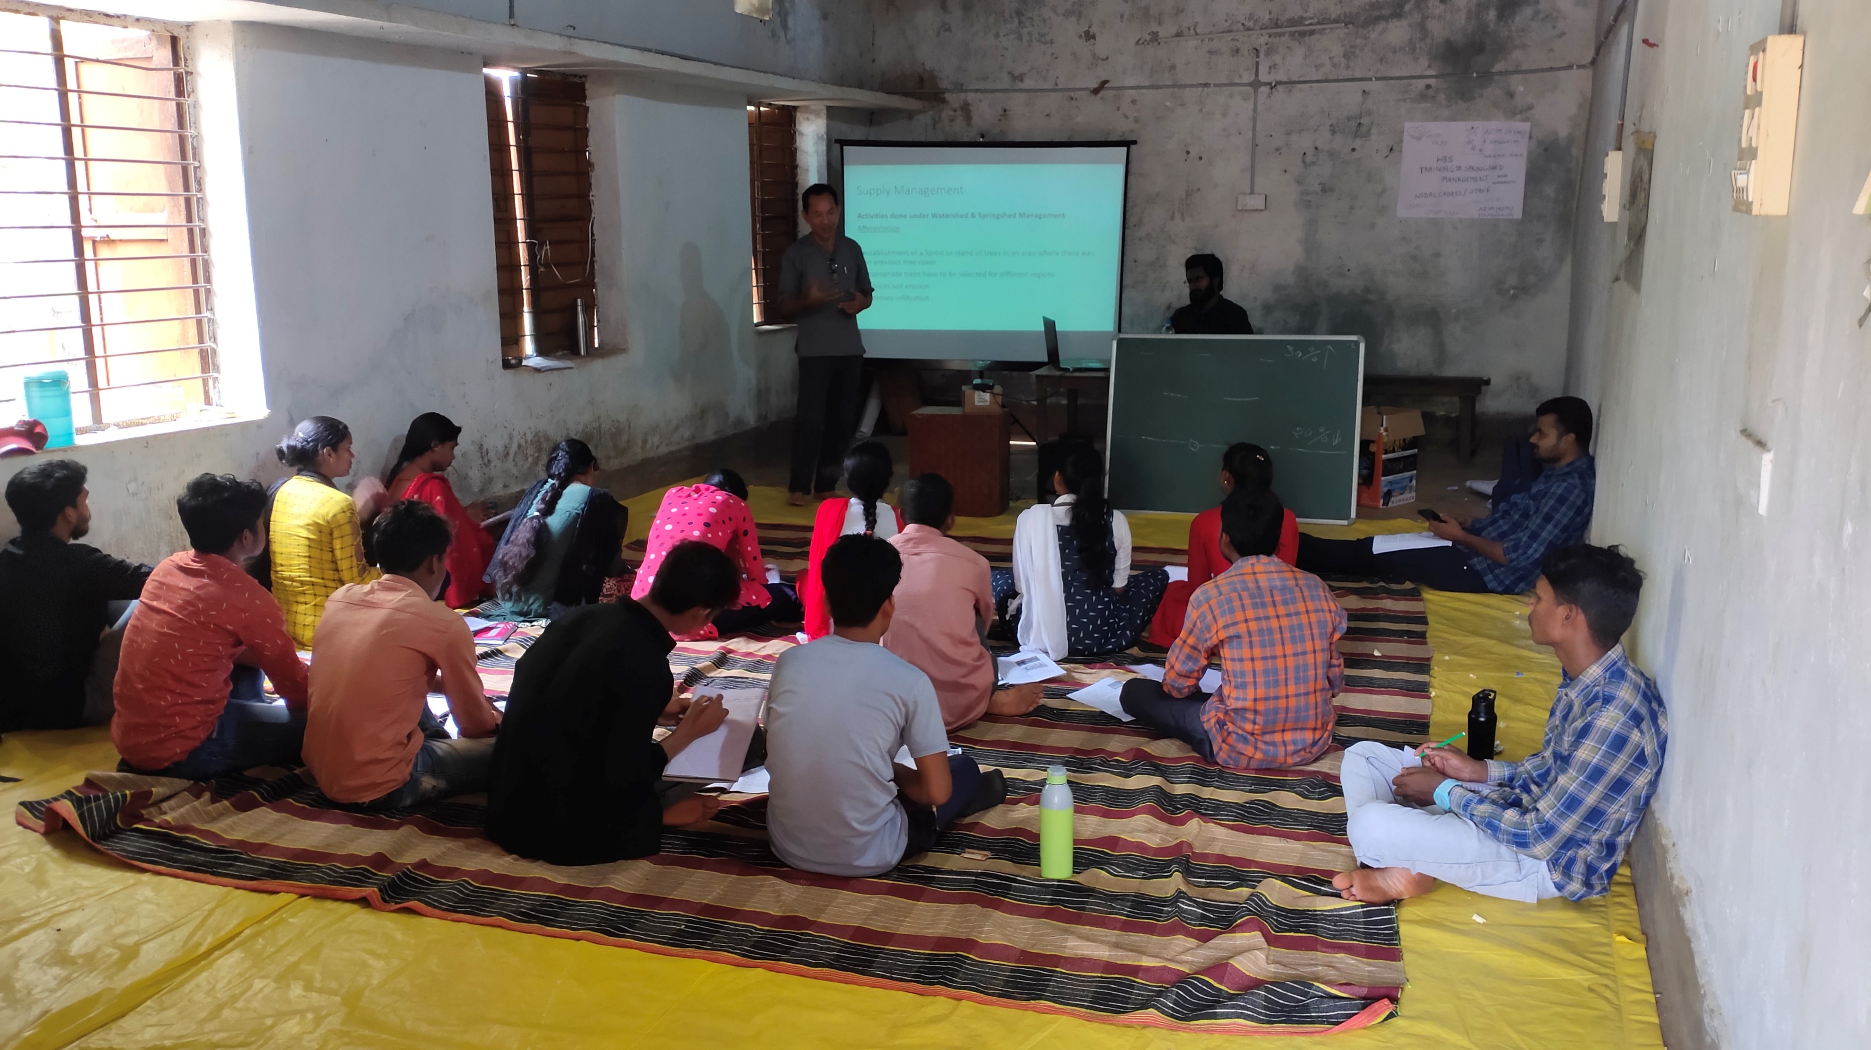
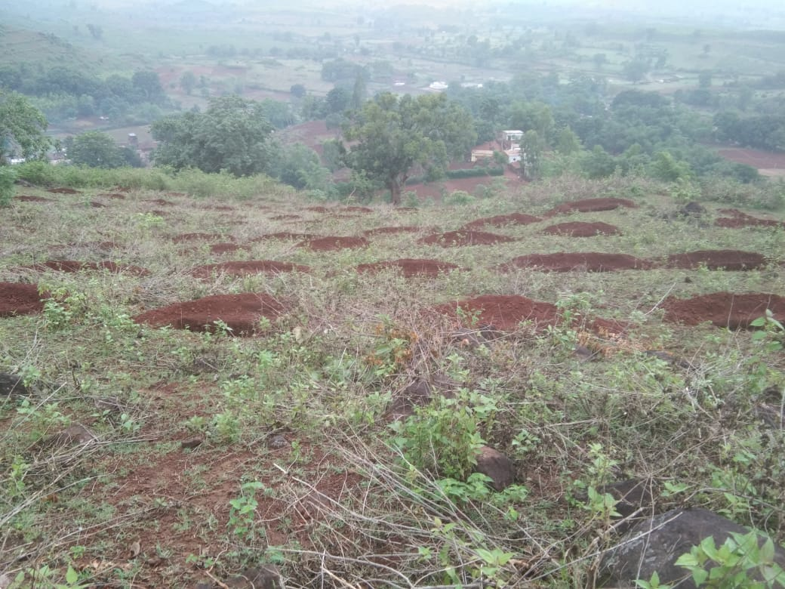
Description of watershed
The area where a river catches its water is called its catchment or watershed. A watershed can be visualized as a landscape shaped unevenly like a bowl or basin. When it rains, water flows down from the top of this bowl to collect at the bottom
Learning and value addition
Conservation of water and soil resources
Rainwater harvesting
Management of crops`
Ground water recharge
Spring shed management
Interventions in the Ridge Area
Interventions in the Drainage Line:
Project Cycle for Watershed Development
Brief History
Young Students Movement for Development, Chennai came to Odisha after the 1971 cyclone to undertake relief and rehabilitation work in the affected areas in villages in the Cuttack district developing lift irrigation projects.
Vision: The Vision of Gram Vikas is “an equitable and sustainable society where people live in peace with dignity”.
Theoretical and Practical exposure
Watershed principle is ridge to valley, but did not work under MGNREGA
Mission: The Mission of Gram Vikas is “to promote processes which are sustainable, socially inclusive and gender equitable, to enable critical masses of poor and marginalised rural people and their communities to achieve a dignified quality of life”.
Organization Structure
Strength Benefit to landowners common resources management strategy Innovative technology | Weakness Less knowledge about watershed work Inefficiently use & unequal distribution of water. Weak drainage sub-sectors infrastructure
Opportunity Improve livelihoods Recharge of ground water level Reduce Soil erosion | Threats Inappropriate measures to control soil erosion Deforestation and degradation of natural habitats.
Executive Director
Management Groups
Thematic coordinators
Junior Manager
Support Teams
Field Expert
District Manager
Challenges faced during internship
Language barrier.
Low participation of local at meeting.
Travelling Issues.
Name | Lokanath Majhi
Roll no | 0010
Stream | Development Management
Faculty Mentor | Prof. Ratna Verma
Org. Mentor | Anurag Sharma
Title Of Poster | Watershed Management
Suggestion
Create awareness among communities about Afforestation
Training of mushroom, livestock, fisheries, Agriculture
Capacity building of VDC to manage TBR.
Usefulness of internship
Gain confidence
Practical exposure
Network with professionals in the field.

