Slide 1
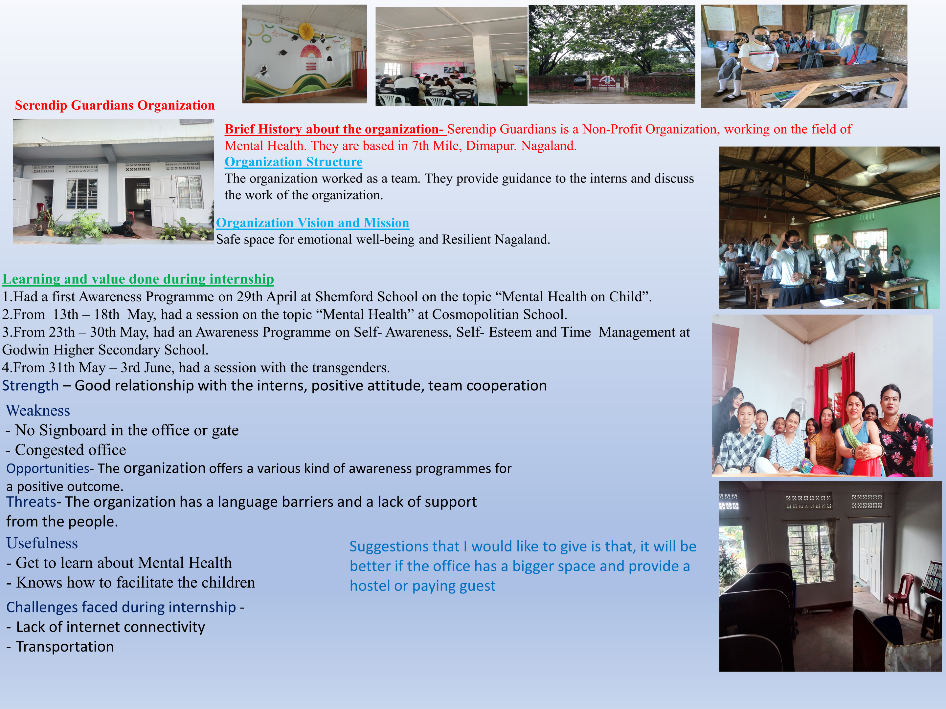
Summer Training at Serendip Guardians
Manphe Konyak, MBA-DM
IIHMR University

