Slide 1

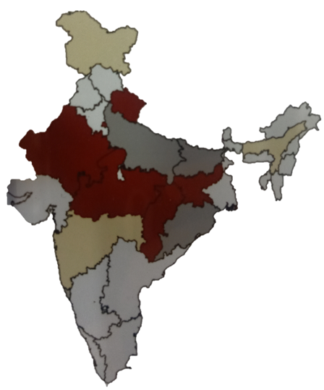
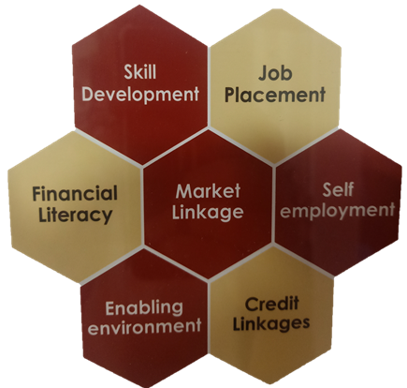
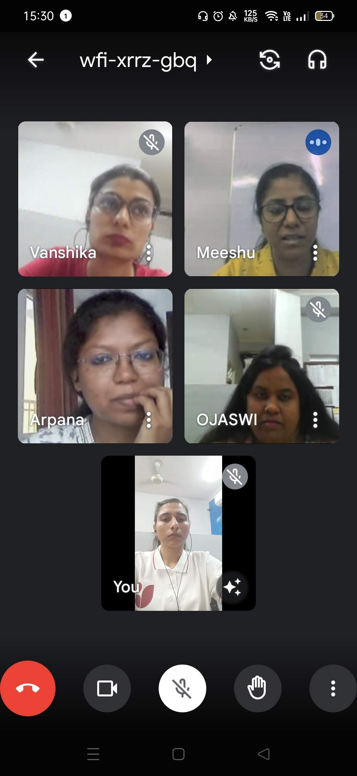

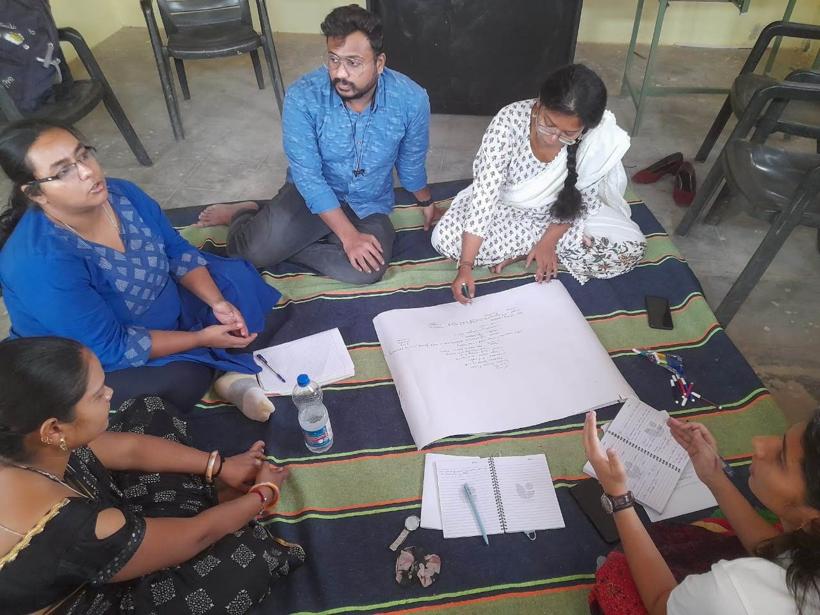
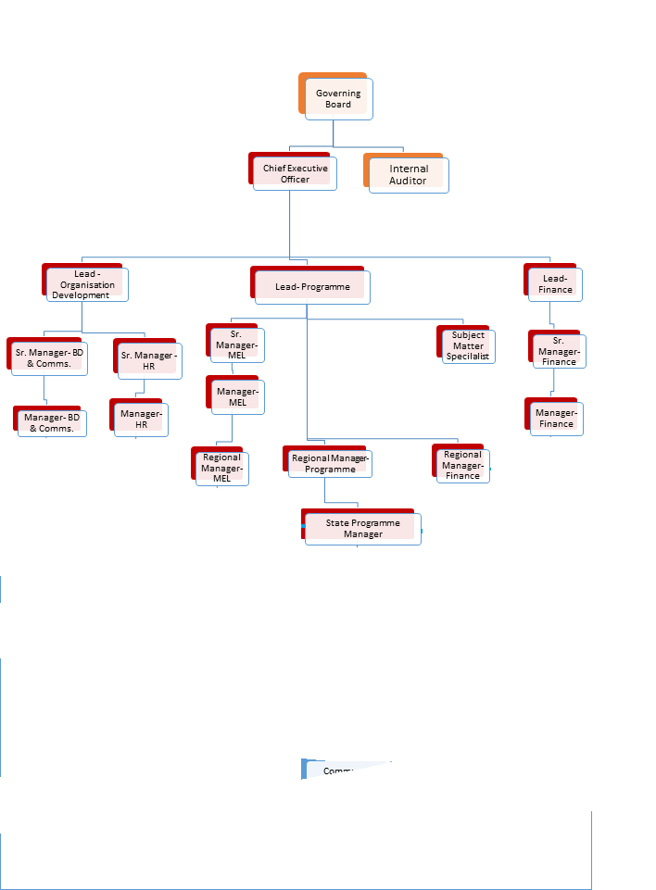
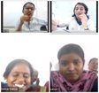
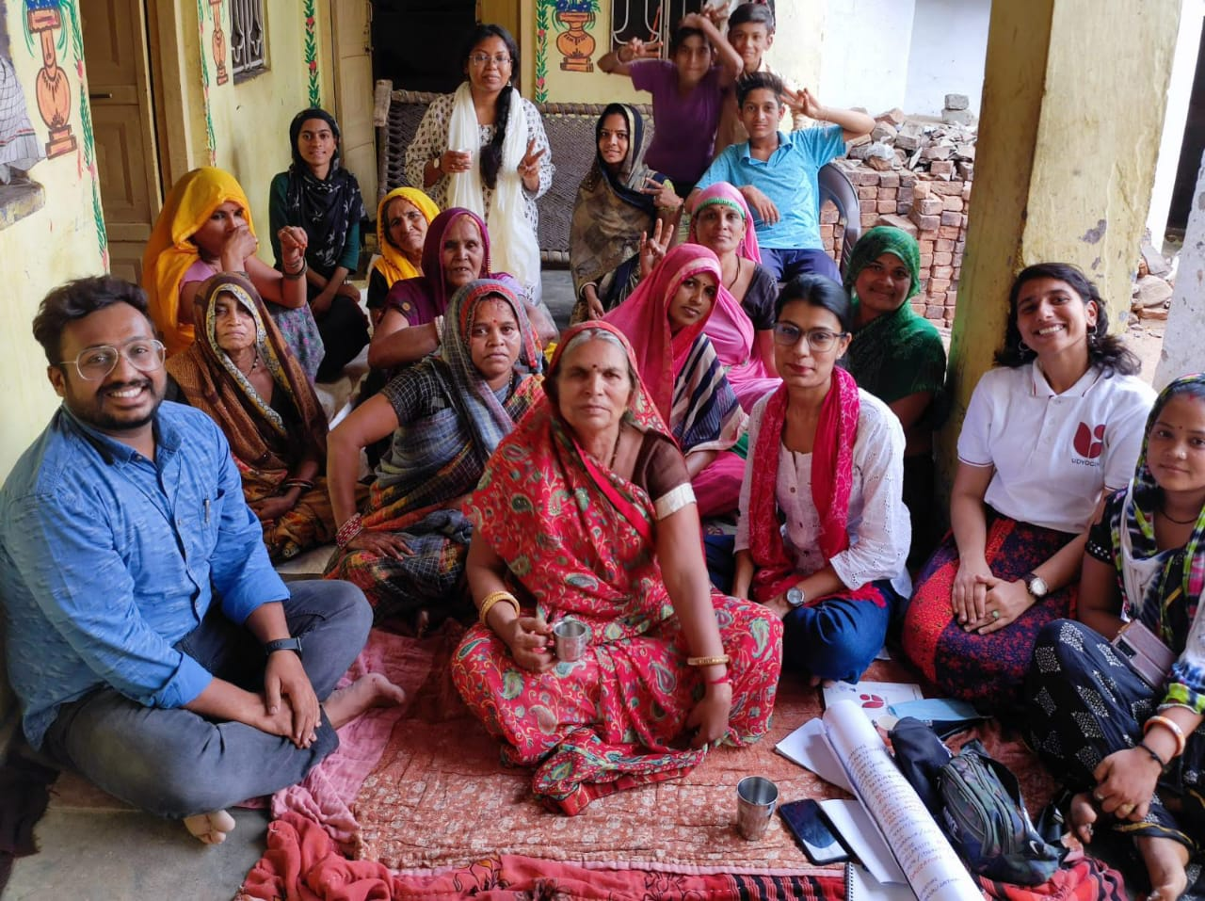

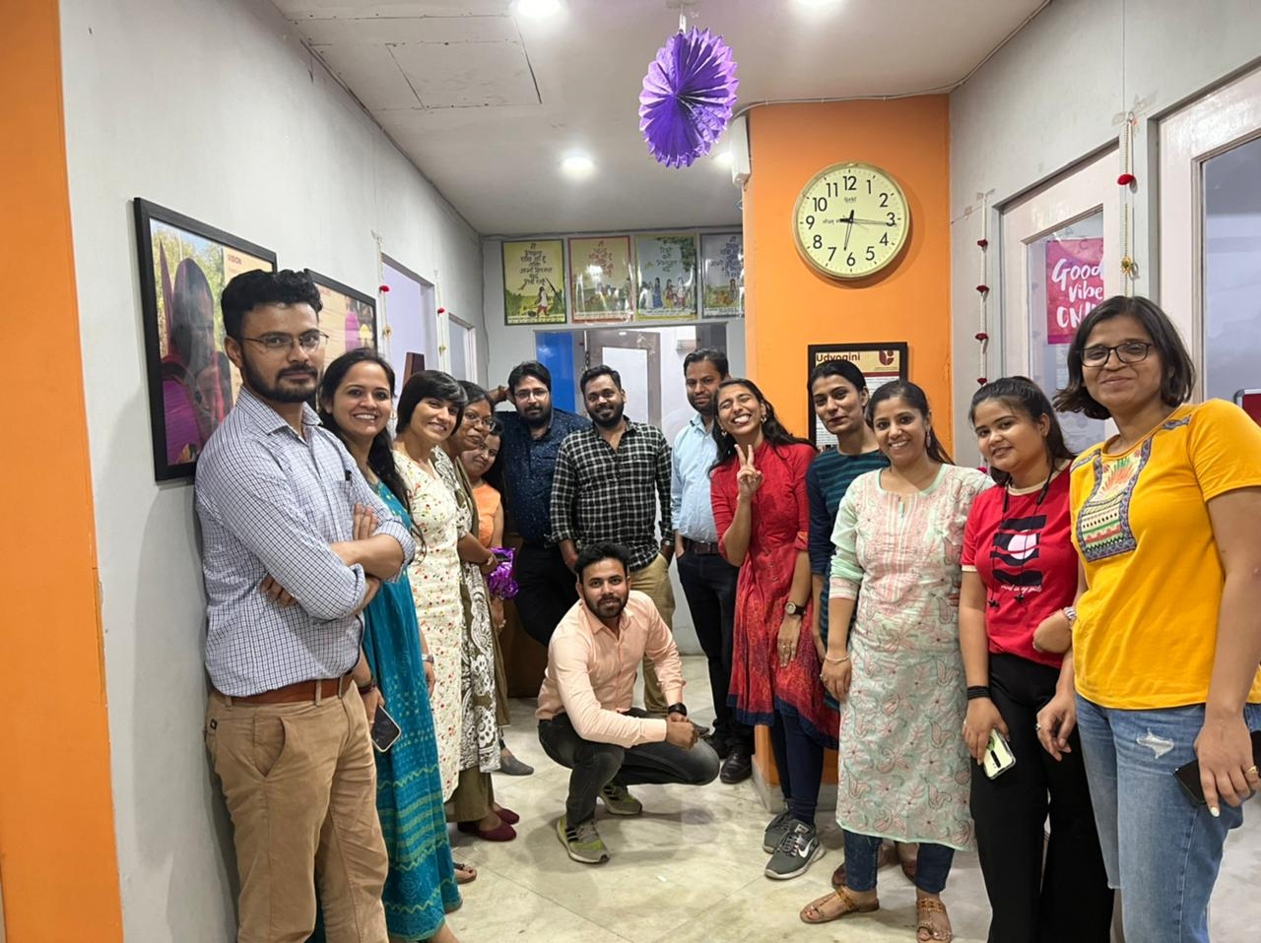
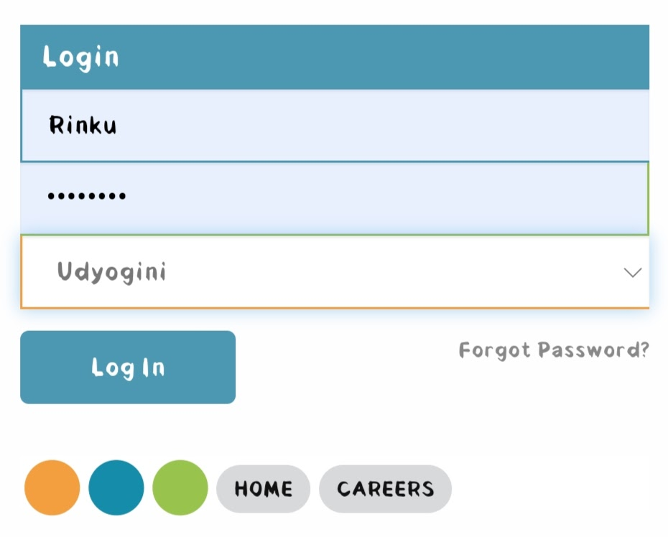
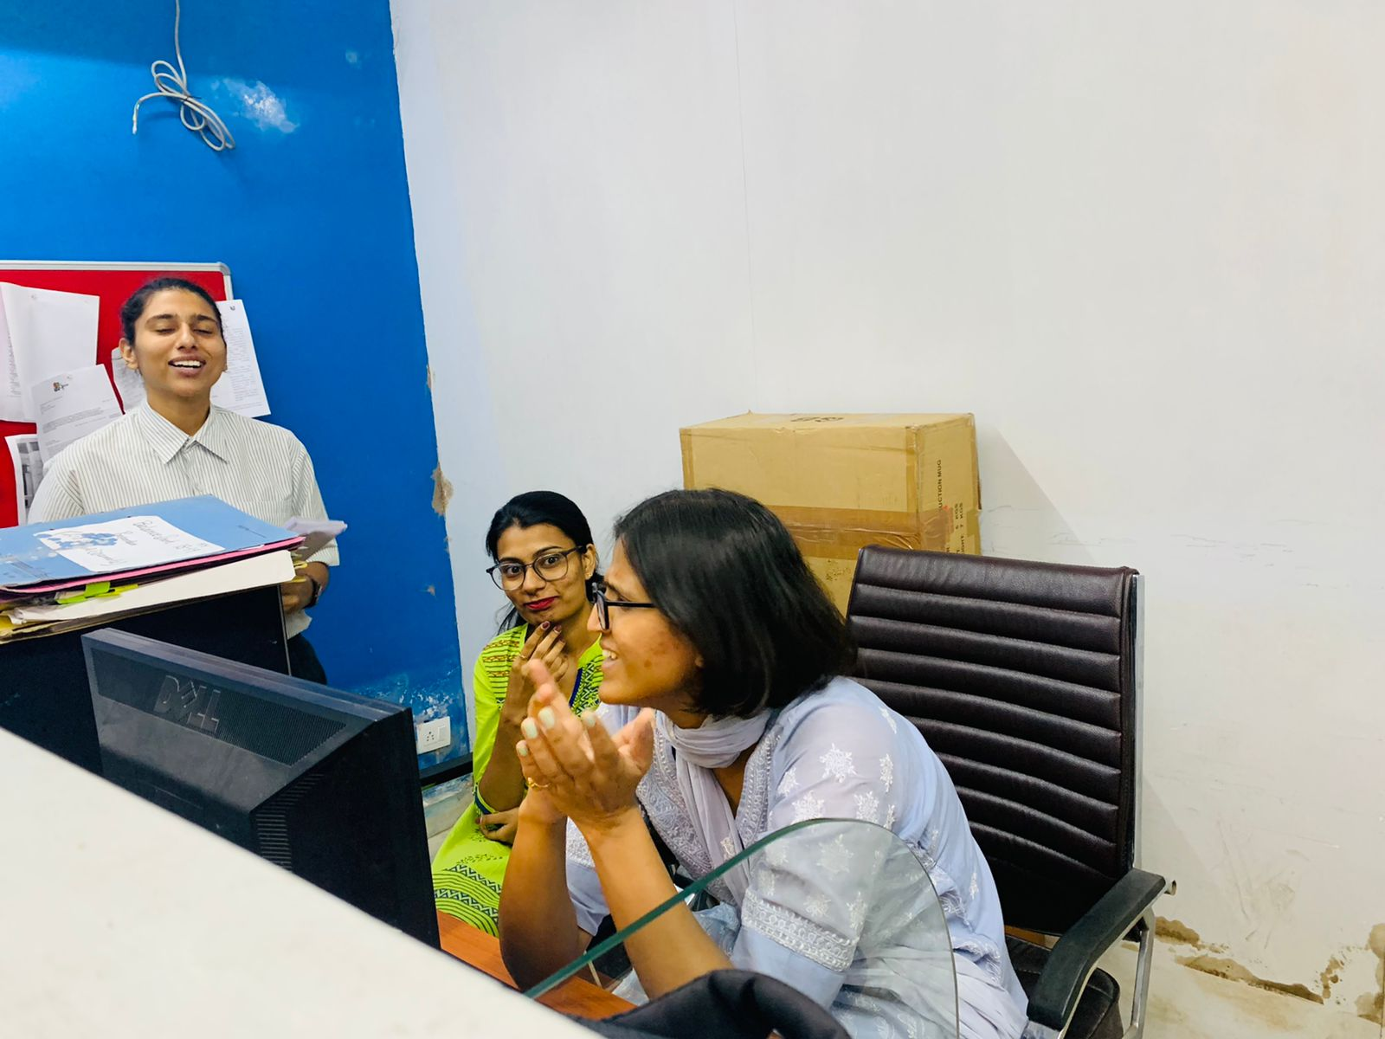
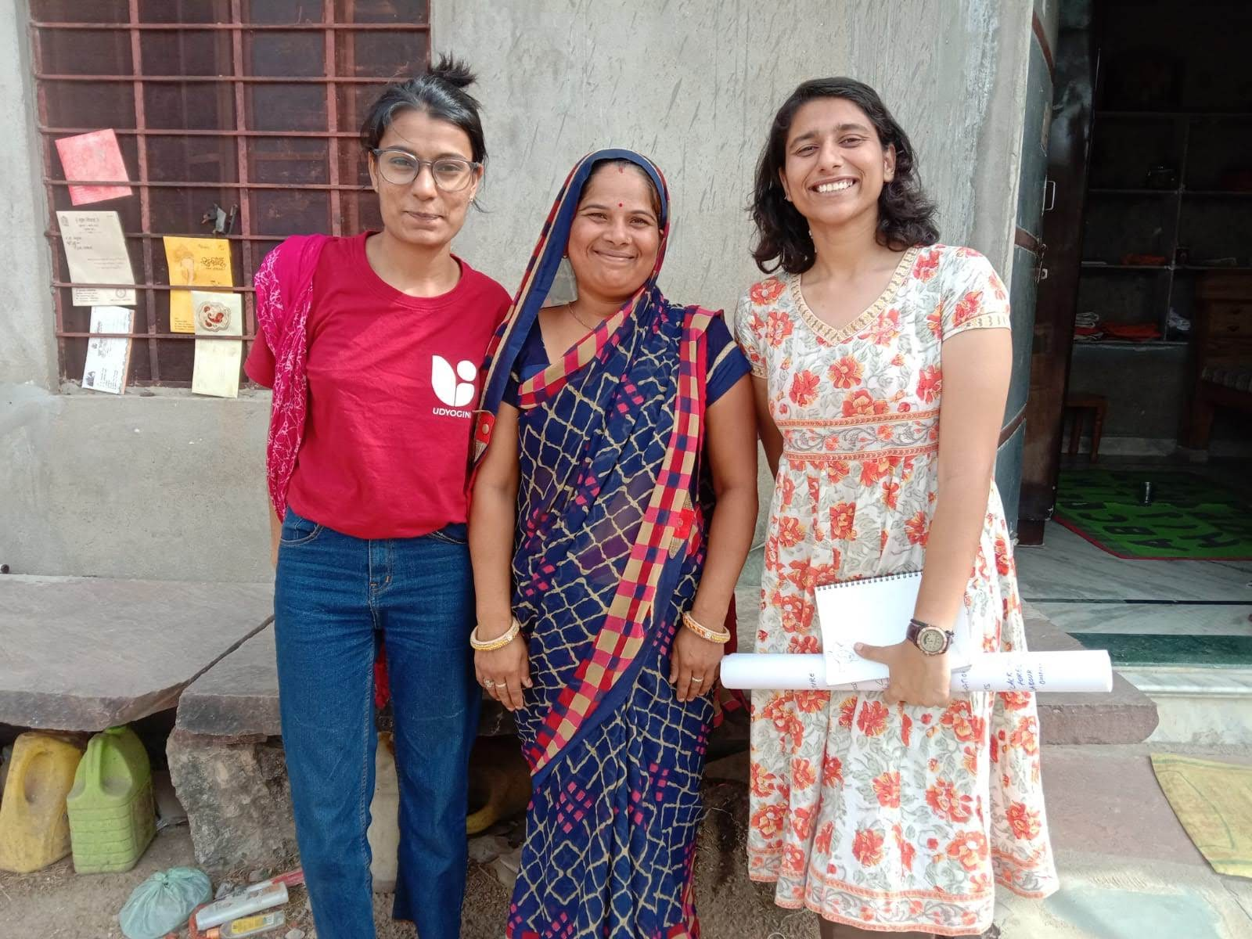
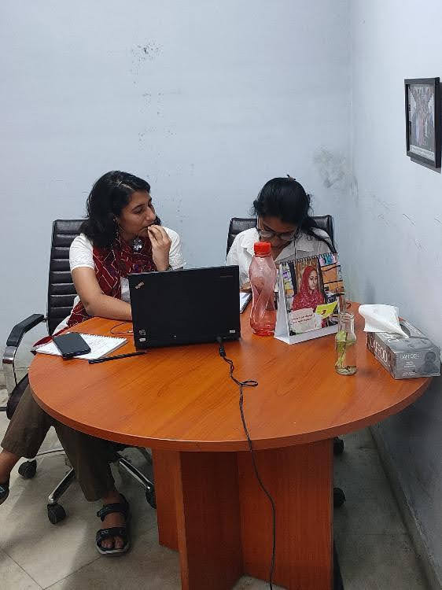
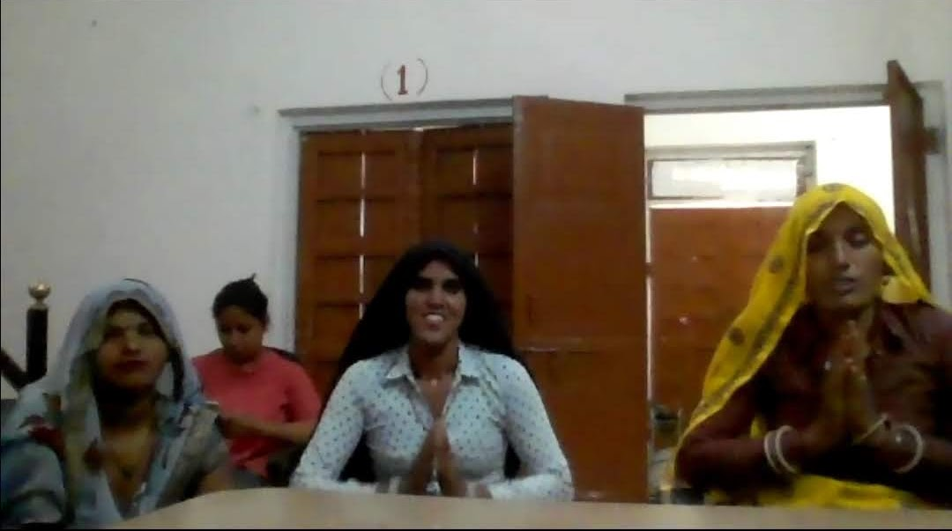
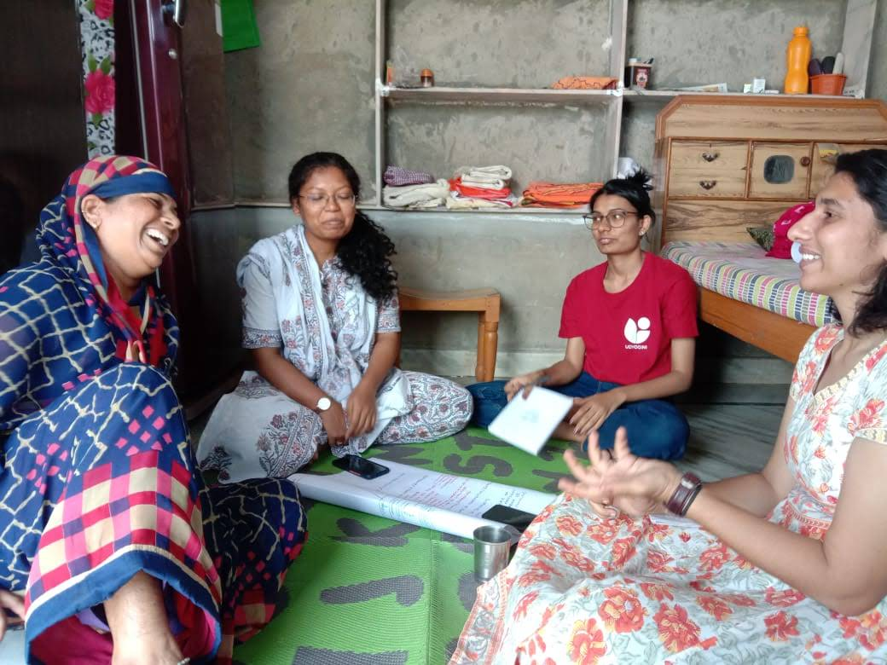
1. Brief History
Non-profit
Women Entrepreneurship/ WEE
1992 (completing 30 years)
By World Bank as Service provider
Emerged from a project
Theoretical Exposure | Practical Exposure
Framed questionnaire according to audience level. Practiced the sequence of the question perfectly. Planned and drafted research paper | Difficulty in explaining those questions in layman language. Difficulty in Rapo-building. Difficulty in arranging the collected data.
Presented BY-
Rinku
0016
MBA DM (Batch 10)
IIHMR UNIVERSITY
Jaipur, Rajasthan
7.
2. Vision
Foster gender equality by improving socio – economic status of women to fully participate in decision making in domestic and public spheres.
3. Mission
Provide customized quality business development services to enable women to enhance their income, access better education and health services for their children with a special focus on girls.
8.
Strength Adaptability Handling pressure calmly Change of mentors Khandar exposure complications | Weakness Weak Rapo- building Missing flow in writing Missing deadlines Personal health
Opportunity Field exposure to Khandar, Rajasthan Working under two differently experienced mentor Learned documentation Created social media content too | Threat Keeping FGD on track Accommodation Complication Peer competition Missing deadlines
4. Organization Structure
5. Value Addition
Commitment to growth
Ability to engage
Taking ownership
Self-confidence
Adjustment
Pragmatic
6. Usefulness and Learning
Case study writing
Report writing
Research drafting
Tools for research
Adjustment practices
Taking ownership
Working of different department
9. Suggestion
Limited exposure is the restriction to suggest something.

