Slide 1






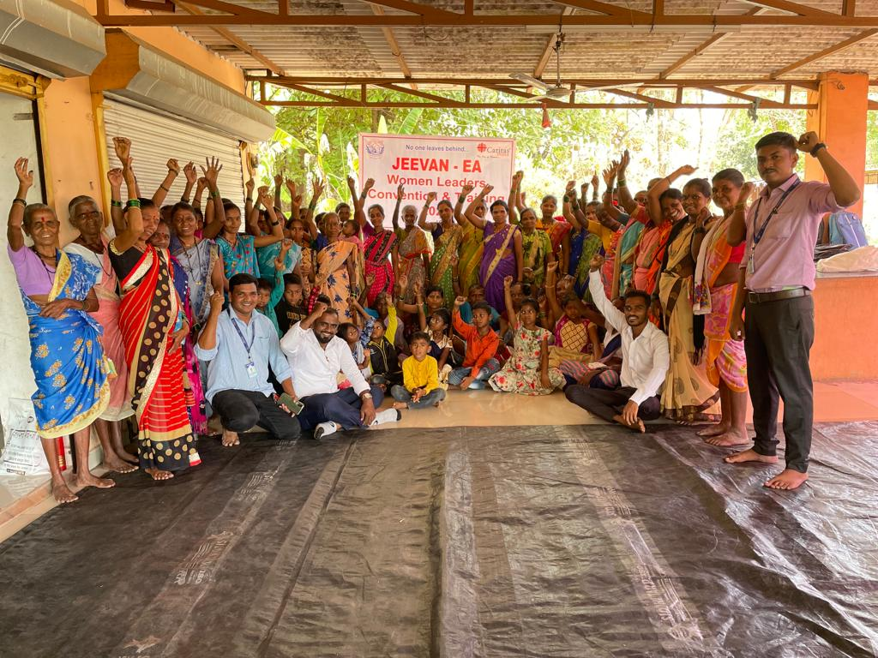
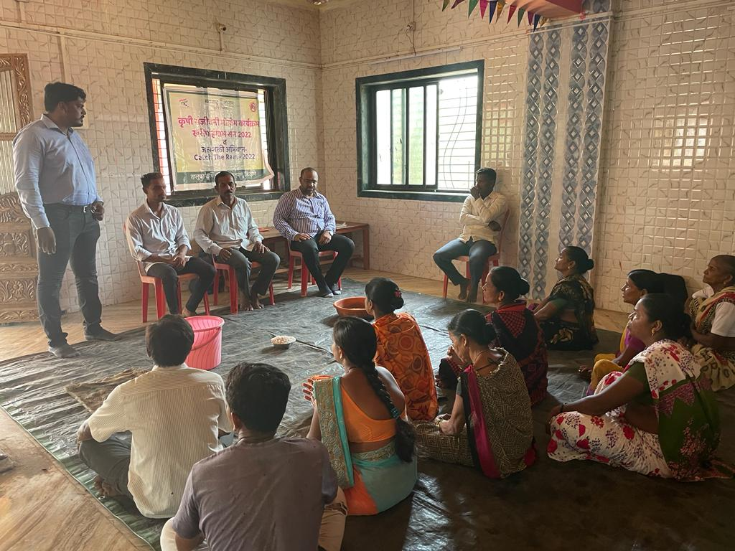
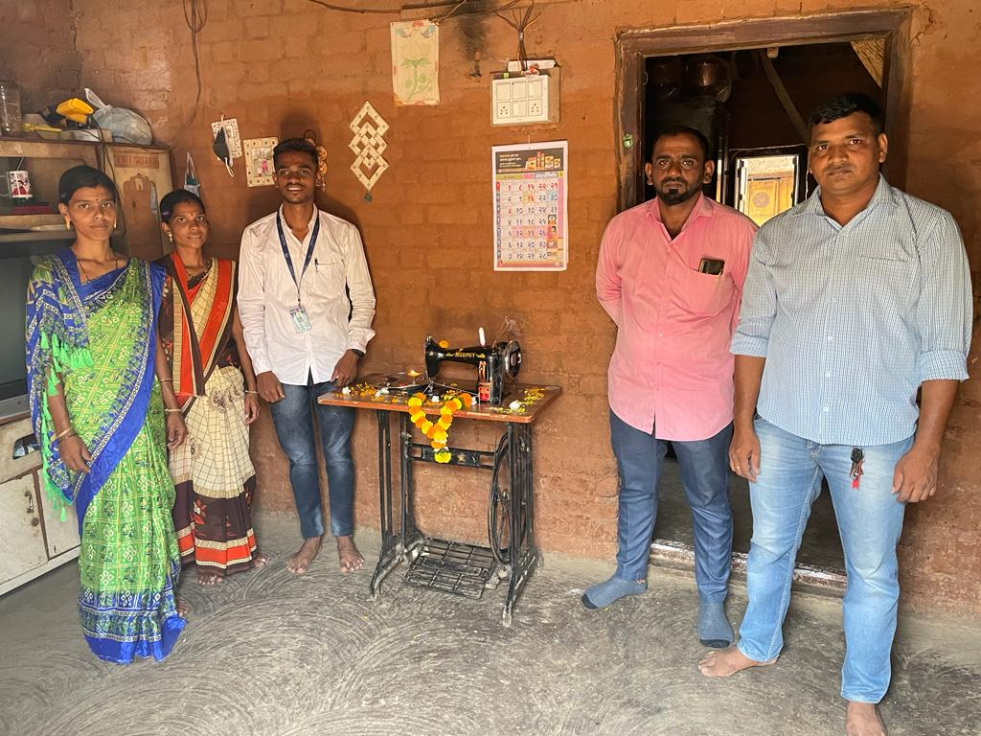
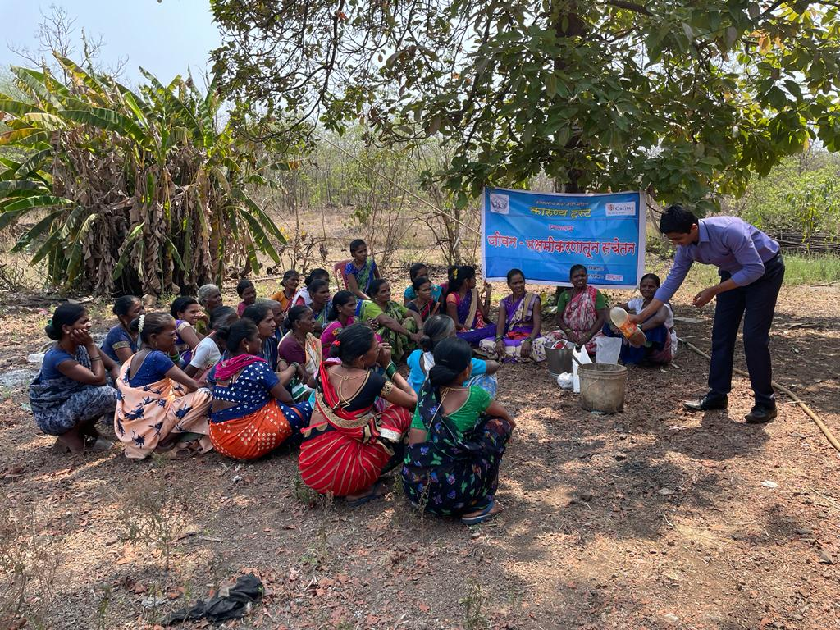
KARUNYA TRUST (Since 1998)
Presentation on learnings from Internship at Karunya Trust– Why we must understand holistic Development?
OBJECTIVE OF INTERNSHIP
To understand the contribution of the organization in the financial development of the family and community through vocational and income generation programs.
PROJECT WORKING ON
JEEVAN EA
Empowering the tribal community through good governance, sustainable agriculture, and tribal rights
CONCLUSION
It reflects organization is facing the problem of low accountability. Low knowledge of government schemes and policies is a drawback for the community and the growth of the organization
CHALLENGES FACED
Language barrier
Development is a time-consuming process and needs 100 % community participation
Lack of information on governance systems and programs
Team allocated to me was not focused on sharing information
Experience in a limited area
No MIS system properly functioning.
USEFULNESS OF INTERNSHIP
Field exposure to a better understanding of rural realities.
What should be done to bring sustainability was learned.
SUGGESTIONS
To create market linkage immediately to address sustainability and promote digitalization.
Need efforts to increase accountability among staff.
Dissemination of knowledge about good governance to people and different schemes.
Inclusion of social audit in the program.
Inclusion of convergence through health and education-based linkage program.
Objective of projects must be shared with stakeholders at the beginning.
KARUNYA TRUST aims at providing a ‘safety net to the poor, particularly to disadvantaged children like rag pickers, HIV/AIDS infected and affected, tribals and women. NGO is registered under the Bombay Public Trust Act 1950 (Reg No. E-18021)
VISION
“A just and harmonious society rooted in the gospel value of love, freedom and peace”
MISSION
“To restore the dignity and potential of marginalized individuals and communities by facilitating access to education, health, livelihood and stable shelter.
SWOT ANALYSIS
STRENGTHS
Strong presence for the last two decades in the area.
Involved Community in the participation process.
Stable organization.
Smooth fund flow from Christian-based donor
Well-trained staff
WEAKNESS
Low accountability among staff.
Illiterate community
Lack of women’s participation in program
Lack of market linkage in the programs.
Migration of community
Organogram
Board of trustees
Exe. Director
Advisory board
Operations
Finance
Central Function
HR
Central Administration
Monitoring & Assessment
Project In-charge
Coordinator
Animators
OPPORTUNITY
Possibility of convergence through government schemes and programs.
Expansion to other areas
Collaboration with other partners.
Acceptance of government officials for promotion of schemes
THREATS
Lacking Innovation and digitalization for scaling up
Poor awareness level regarding government policies
Closure of funding agency, if happens
PROJECTS engagement
Project BHARARI
Project JEEVAN EA
Project SUJAL
Shelter PROGRAM
NAME: SAHIL MOHAPE
COURSE: MBA DEVELOPMENT MANAGEMENT
BATCH: 2021-2023
ROLL NO: 0017
INDUSTRY MENTOR: Mr. KIRAN WAGHMARE
UNIVERSITY MENTOR: Dr HEMANT KUMAR MISHRA

