Slide 1


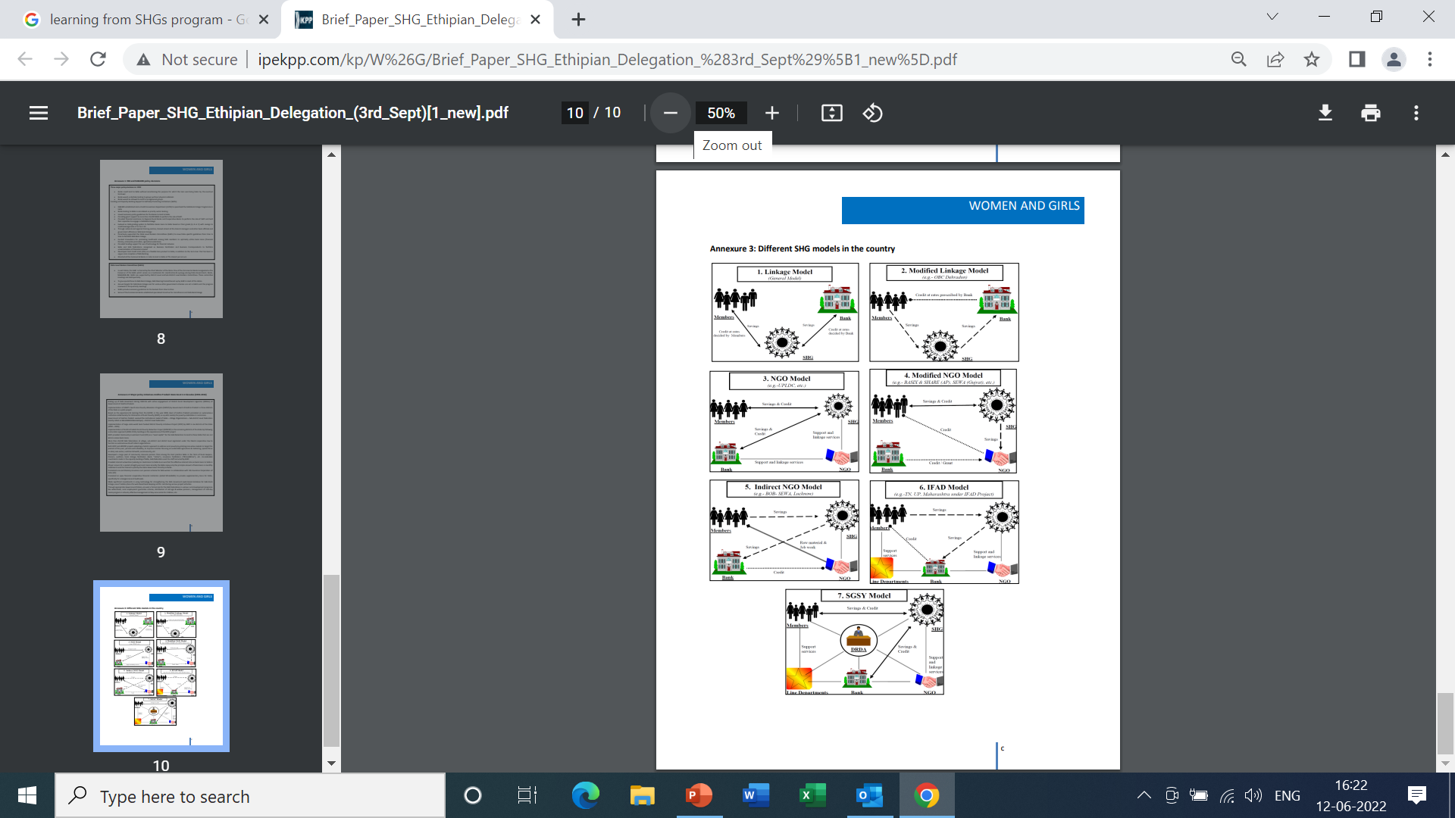
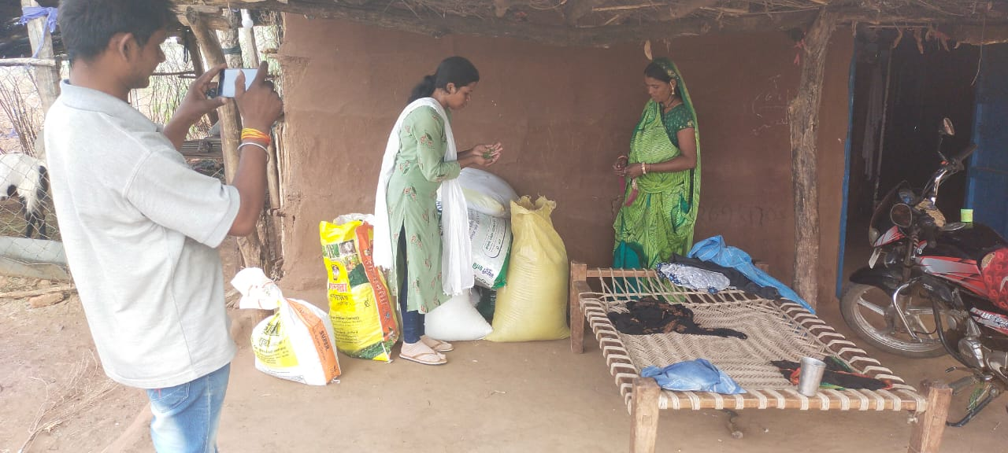
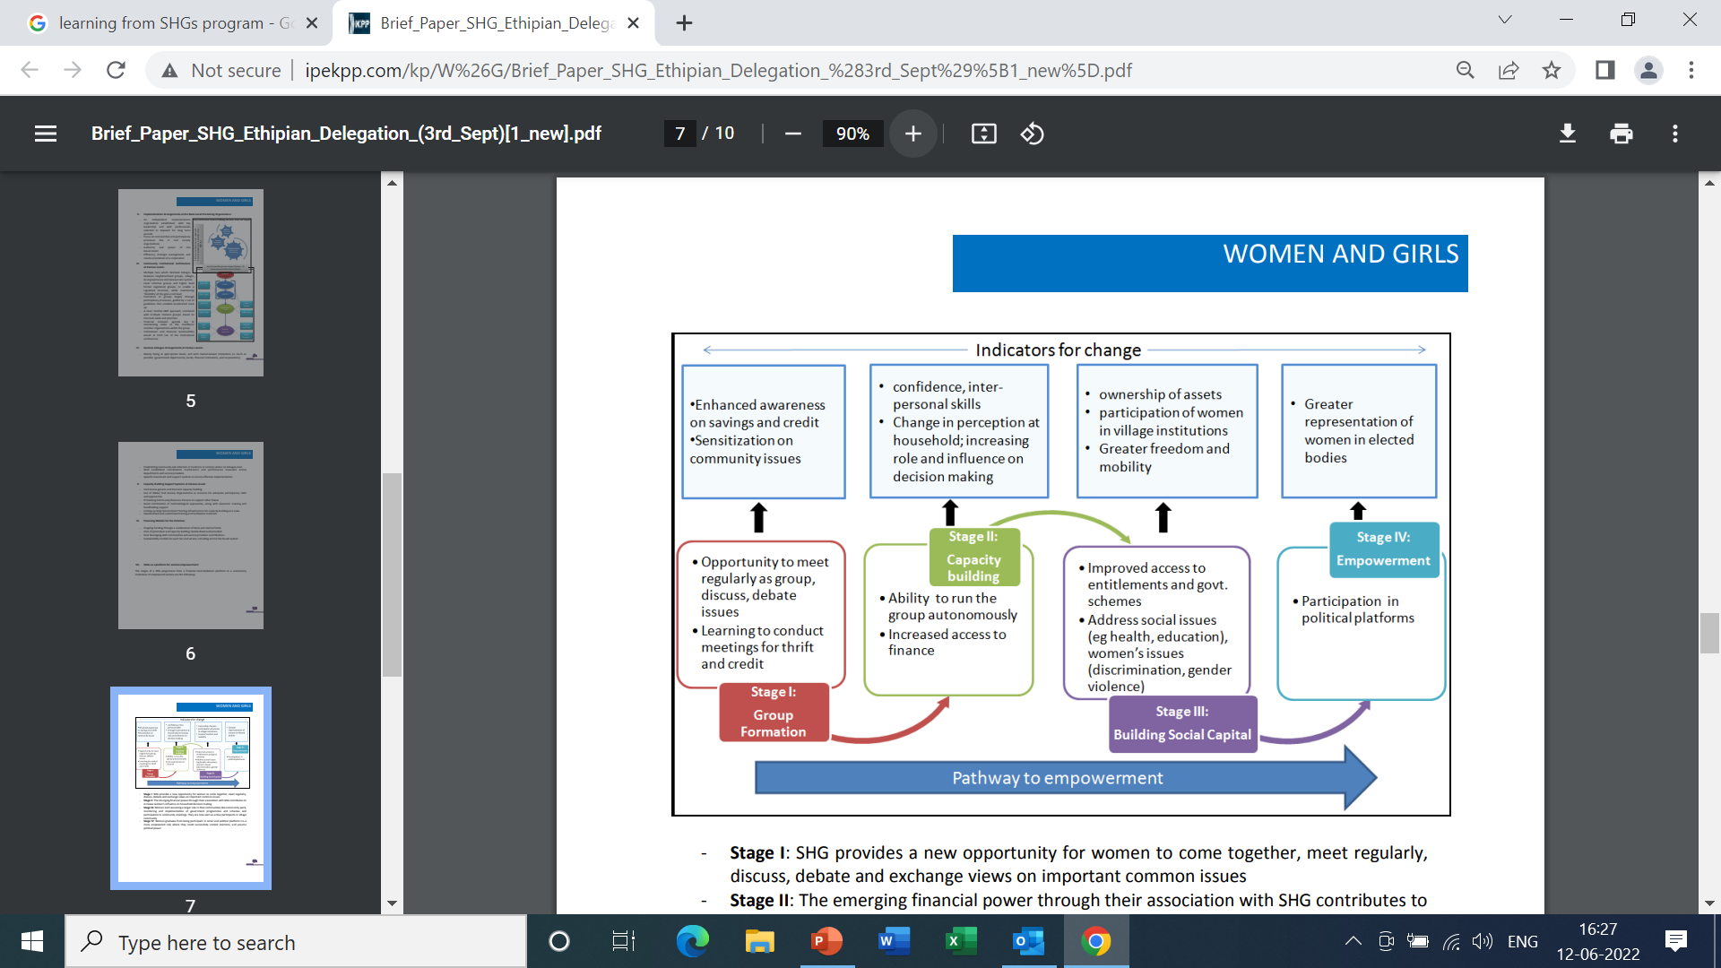

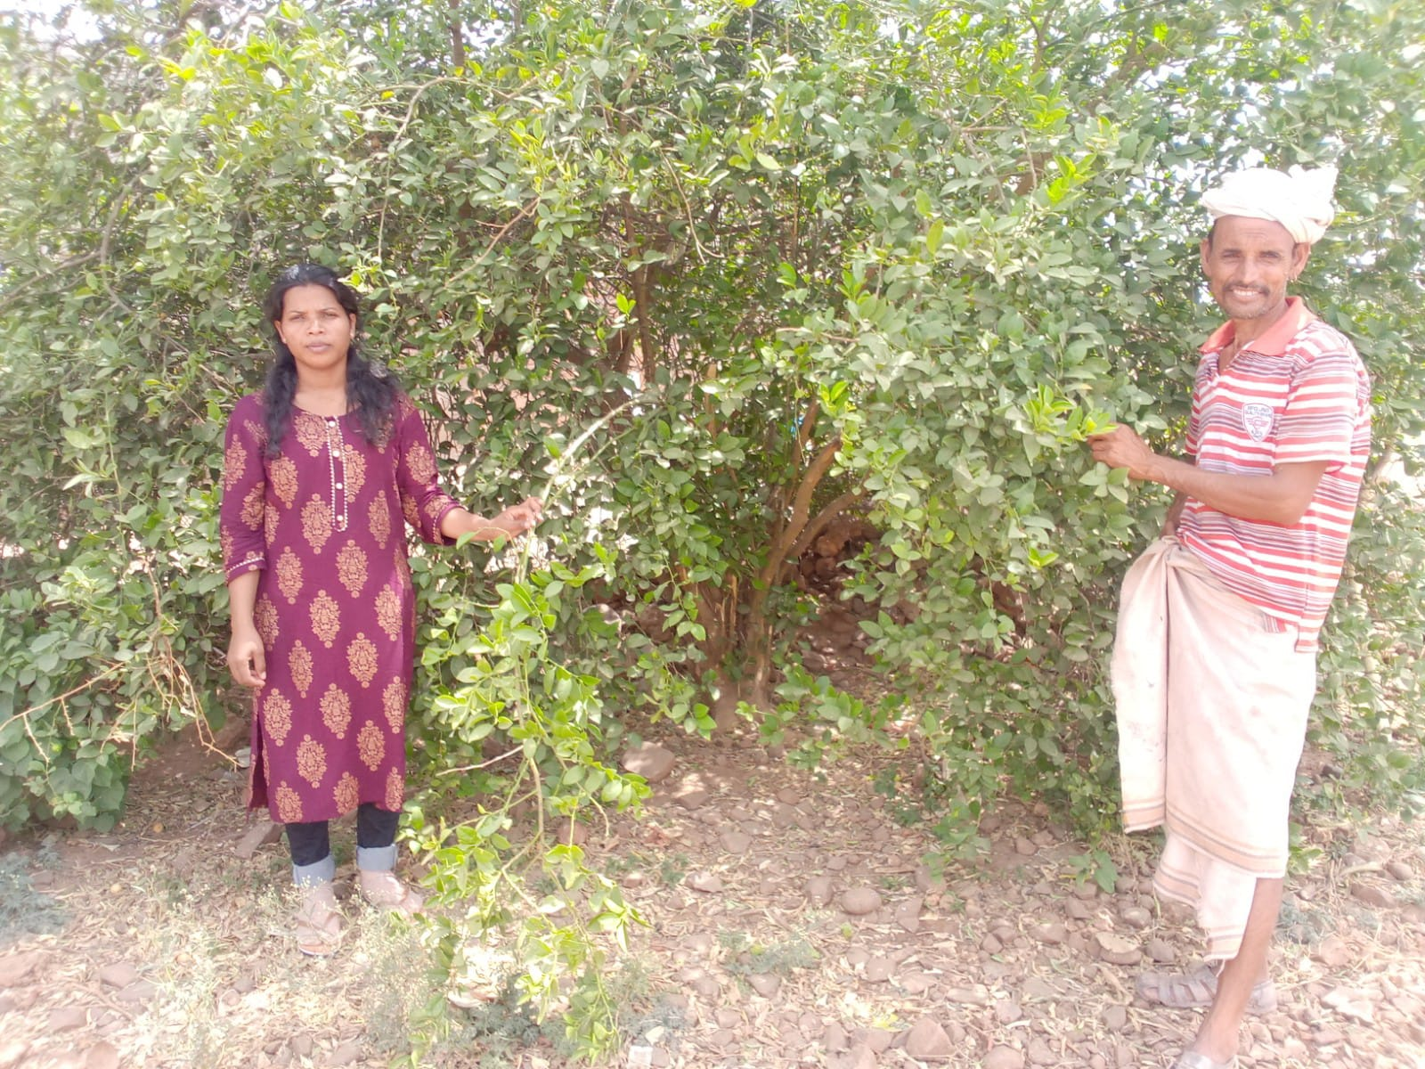
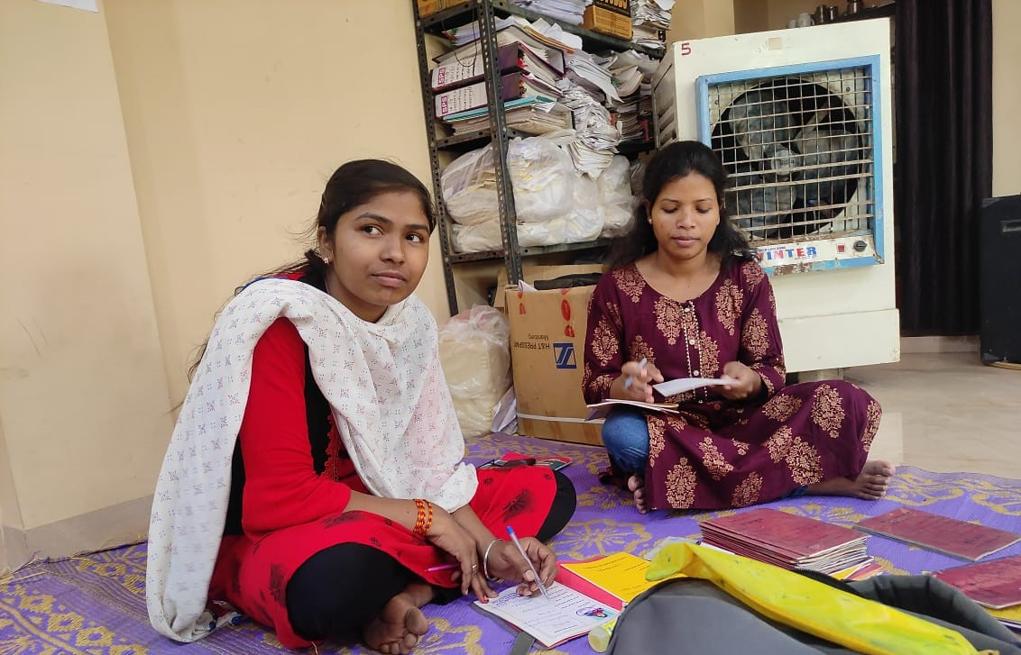










Understanding of SHGs-Livelihood Program at Samaj Pragati Sahayog, MP
Brief History
SPS is an organization registered under the Societies Registration Act, 1860. Working on water and livelihood security since 1990 Over the last three decades, Samaj Pragati Sahayog (SPS) has grown to be one of India’s largest grass-roots initiatives for water and livelihood security, working with its partners on a million acres of land across 72 of India’s most backward districts, mainly in the central Indian Adivasi belt.
Vision
Promoting poverty-free, value based, equitable ecologically sensitive and just society.
Mission Enhancing the availability of water , increase the productivity of land and agriculture , diversify livelihoods, empower women and strengthen the health and well- being of vulnerable rural communities. And corporations are crucial in providing favourable market opportunities to farmers.
Brief Description
Samaj Pragati Sahayog has been majorly working for tribal community. 574 Villages and towns in 8 blocks of 3 districts ( Dewas, Khargone and Amravati ) in the States of Madhya Pradesh and Maharashtra. They are working in project eight which is Watershed, Self-Help Group, agriculture, livestock, kumbaya, health and nutrition, Ram Rahim Pragati Producer Company Limited, Media.
Practical Helped people by providing stationery equipment's . Participated in Self – help group meeting Digital Moisture Meter Sample collection of the agricultural produce | Theoretical Maintaining the record of passbooks given to beneficiaries who associated with any social group.
Internal Factor External Factor | Strength | Weakness
 | Availability of skilled manpower Availability of raw material Low capital Investment Availability of DRDA and NGO assistance Market potential employment opportunity Family advice NGO encouragement Employment opportunity for family members | Lack of group coordination Conflict between the group Problems with financial dealing Autonomy of leaders Insufficient loan from SHGs Default on loan in SHGs Delay in getting loan SHGs.
Opportunity | SO strategy | WO strategy
Self- confidence Hopes for better standard of living. Communication skill Enhancing leadership skill Knowledges of credit management | Creates homogenous and cohesive group Focus on expansion Going ahead with the target and goal seeking Linking monetary incentives with quality aspect Effective monitoring and evaluation system with clear fixing of responsibility Recognition for good performing SHGs | Periodic grading of SHGs by external agency Support for both individual as well as economic activity Avoid compulsion to go for group economic activity where there is lack of group consensus, common interest, and skills. Concept of activity-based groups to be explored for likeminded members across different groups Orientation to cover newgroups as well as new members in existing groups.
Threats | ST | WT
Lack of coordination Not result oriented Time management lacking Tendency to utilize money for others purpose. Personal problems Social problems | Need for standardization of certain SHGs system and processes while maintaining flexibility auditing formats of final account. Guidelines on certain aspect-tenure of office bearers’ regularity of election | Combination of external and internal monitoring Additional in terms of capacity building, Linkage, and know-how
Organization Administration
Program incharge
Location Incharge
Professional
Field supervisor
Senior Mitaans
Mitaans
Challenges
Problem in accessing location of SHG meetings.
Usefulness of Internship Problem in accessing location of SHG meetings. Smooth interaction with tribal community. Learned about livestock and agricultural aspects of employment. Farmers are benefitted with seeds through Ram Rahim Pragati Producer Company Limited (RRPPCL) Gain practical knowledge of livelihood program
Learning The SHGs help the borrower to overcome the problem of lack of collateral. They can get timely loans for a variety of purposes and at a reasonable interest rate. The advantages of SHGs are Combating social evils: The SHGs play a crucial role in overcoming social evils like alcoholism, drug addiction, gambling, etc. Women empowerment: Women SHGs make their members independent from social constraints and allow them to make independent decisions
Suggestion
NGOs, play a significant role in empowering women entrepreneurs by providing basic education, motivation training, and financial help and so on.
Frequent awareness camps can be organized to create awareness about the different schemes of assistance available to the participants in the SHGs.
Arrangements may be made by the financial institutions for providing adequate financial assistance to the SHGs strictly on the basis of their actual performance without any discrimination of caste, politics etc.
Name- Seema Khalkho, Roll- 0019, Faculty Mentor- DR. Goutam Sadhu. Industry Mentor- Shubham Golani

