Slide 1


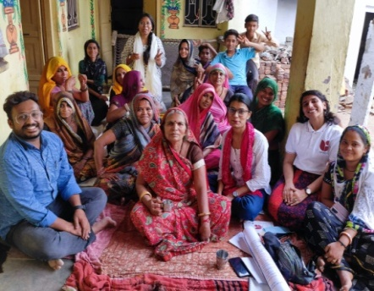
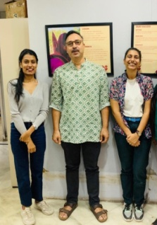
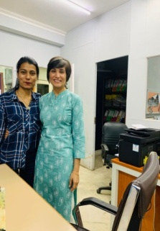
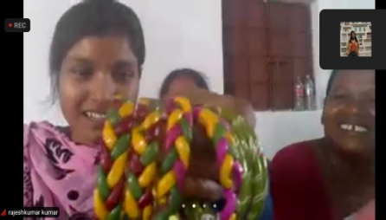
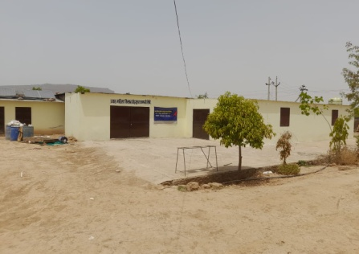
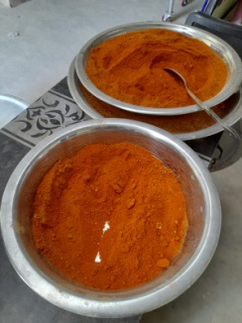
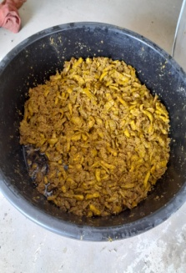
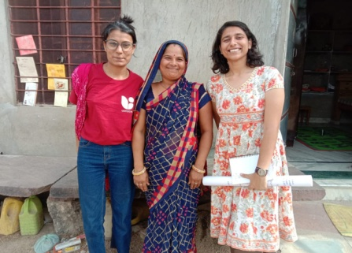
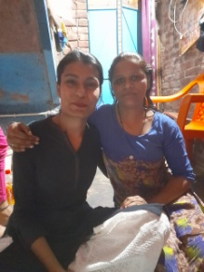
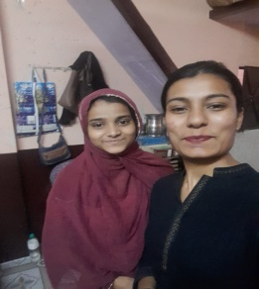
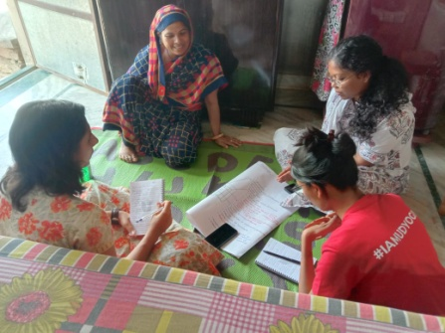
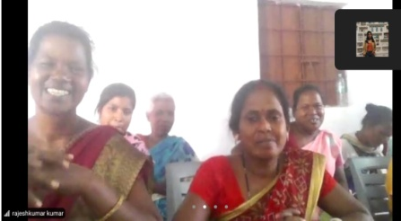
Summer Internship
Internal Challenges of women-led FPOs in Jharkhand and Rajasthan
Udyogini
History
Established by the world bank in the year 1992, Udyogini was a major service provider and resource agency to NGOs and government bodies.
In 2002, Udyogini started focusing on the concept of women’s empowerment from the lens of entrepreneurship.
About
A women’s economic empowerment-based non-government organization. They are majorly working on women creating employment opportunities for themselves and others, by providing them adequate skill-building training and escalating their entrepreneurial capacities.
Vision
Foster gender equality by improving the socio-economic status of women to fully participate in decision-making in domestic and public spheres.
Mission
Provide customized quality business development services to enable women to enhance their income, and access better education and health services for their children with a special focus on girls.
Organizational Structure
STRENGTHS
WEAKNESSES
Determined to nourish their skills and participate actively in employment generating trainings.
Awareness about upcoming training requirements for skill-building and growth of FPO
Lack of foresightedness causes problems in assessing the past performance and making modifications for upcoming events.
Responsibilities of home and FPO simultaneously drains energy in unwanted manner.
S
W
SWOT
O
T
OPPORTUNITIES
THREATS
Governing Board
CEO
Internal Auditor
Head Organization Development
Lead - program
Lead - Finance
Sr. Manager BD &Communication
Manager BD & communications
Sr. Manager HR
Manager HR
Sr. associate HR
Associate HR
Sr. Associate BD & Communications
Associate BD & communication
Sr. Manager MEL
Subject Matter Specialist
Manager MEL
Regional Manager MEL
Sr. Associate MEL
Associate MEL
Regional Manage Program
Regional Manager Finance
Sr, Manager Finance
Manager Finance
Sr. Associate Finance
Associate Finance
Growth of FPO from a small group organization to a retail store in nearby city, hence recognition of product in formal markets.
Exposure to new entrepreneurial aspects and employment chances, to social groups like SHGs, WEGs.
Lack of active participation might lead to collapsing of FPO structure.
High chances of risking women mobilization in terms of socio-economic development.
Methodologies
For data collection methods FGD and KII were used, Because – FGDs helped in gathering detailed information about the current situation of the FPOs, opinions from different people in a short period and Key Informant Interviews helped in learning in-depth entrepreneurial aspects or reality of those villages, from the influential person of that area.
Challenges
Data collection from FPO women for refining internal challenges. Less exposure to rural sites because of staying in urban setup. Disruption in flow of internship due to change of reporting officers in organization.
Usefulness
Rural women have way more potential of entrepreneurship than portrayed. Major difference between ground reality of rural side and theoretical assumptions in urban setups. NGOs have a detailed analytical approach towards sustainability of their beneficiaries. Functioning of NGOs is according to atmosphere, social, cultural, and economical state of the aimed area.
Learning and Value Additions
Practical Exposure Initiated conversations with women of slums and villages, for learning about their aspirations. Learned how to write literature reviews and citations for the same. Conducted FGDs and KIIs through online and offline modes. Field visit to Khandar for understanding the internal challenges of women FPO. Accessing the identified beneficiaries with the help of Udyogini’s field team | Theoretical Work For knowing the aspirations and recording proper data, questionnaires were framed. Read research papers for background of literature review. Prepared tools like HHs, FGD, and KII for primary research. Prepared case study and literature review highlighting the findings from field visit. Identifying the beneficiaries through their current performance analysis.
Suggestions to the organization -
Exposing women to several employment options, which helps them in maintaining stability towards one chosen aspiration.
Time to time skill-building and monitoring sessions by market and consultancy experts.
Interventions through trainings, market analysis, modifications in production and marketing levels for self-sustainability of FPO.
Name – Vanshika Agarwal Branch - MBA-DM Roll.no – 0020 University Mentor – Dr. Kajal Sitlani Organization Mentor – Namita Dimri

