Slide 1


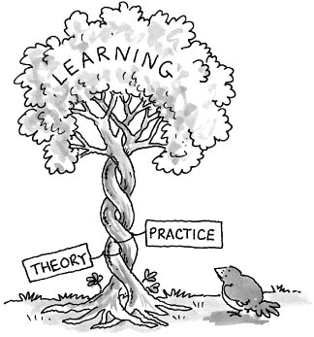
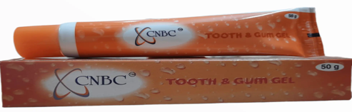
Name: Amol Patil
Roll no: 0287
Stream:Pharmaceutical Management-13
Name of faculty member: Dr. Saurabh Kumar Banerjee
Name of the industry mentor: Kapil Mudliar
Organization Name: NECS Pharma LLP
INDUSTRY SECTOR PROFILE
Training field force –
Between my internship period company hired new sales officers for various states, and company scheduled training programme for 6 days. The locations were lonavala and lucknow. Particularly for lucknow I got selected. In the training days I taught product knowledge as well as detailing to the sales officers.
It was very knowledge and exciting experience for me, got a real corporate experience.
Detailing of products –
Detailing of products is very important factor in the pharma marketing. In the training days we focused on the detailing too because it plays crucial role to convince the doctors.
So, we took repeatedly detailing, focused on proper pronunciation, speed technique, quiz etc., after the training programme we found that sales officers still lagging in detailing. But we could not give up, we got strict warning from our head of the sales and marketing that every sales officer should pass the detailing test and then only allow them to join field. then again reaching to home we had started to take online calls and had detailing test.
Brief History
Company was started in 2016 under Rachit Dave and Shankar Moorthy as API traders PAN India.
Initiated another segment in 2020 as stockist for Dupen Laboratories, April 2022 overtake marketing rights of Dupen laboratories and purchased 22 brands and initiated own marketing and sales with 10 people staff in head office and 150 sales officers and managers in field
Mission –
High Quality Products at affordable price.
Company was already working in API. So, company started on their mission.
NECS Pharma was established with the objective of providing sustainable & affordable healthcare for better tomorrow.
To make high Quality products at sales at affordable price.
Vision –
Good Health for Brighter Tomorrow
Difference between practical exposure and theoretical work
Organisational structure
Head Office
Marketing and sales
HR and admin
Distribution
Purchase
Store
Accounts
Field
Business executive
Area Manager
Regional Manager
Zonal Manager
SWOT Analysis of CNBC tooth and gum gel -
STRENGTH- CNBC has unique formula and band there is no as such competitor in the market with same composition. Because of its unique formula CNBC stands different in the market CNBC tooth and gum gel is come under company’s highest selling product list. CNBC can be used during pregnancy in periodontal disease. | WEAKNESS – Required strong marketing strategy of product otherwise competitors will take over the market. Company should focus on brand name of the product, like product is unique but name is not that much effective.
OPPORTUNITIES – CNBC has the capacity to capture the market due its unique formula and indications. Used in the wide indications, so product has enormous growth potential. | THREATS – There is chance of copying of product because of its unique formulation. Chances to takeover the market by indirect competitors also.
Learning and Value Additions-
Competitive Analysis
Visual Aid preparation
Analysis of market
Cost cutting
Teamwork
Training and detailing to the sales officers
Communication
Competative Analysis of brands
Working on Highlighting on Brand Life Cycle
Training Field Force To Ensure Productivity Related to Profitability
Visual Aid Planning And other Promotional Input
Budgeting And Planning On Expenditure
Talent Retention And Acquisition And Process of Interviews
Leadership And Team Management
Challenges faced during internship –
Competitive Analysis
There is always difference in online and offline learning, we got online internship. (Except 6 days training programme)
We did not get that much corporate level exposure comparing with offline internship.
Market Survey Report (Competitive Analysis)
CNBC Tooth And Gum Gel
DIRECT COMPETITORS -
S.No | Competitor Brands | Company Name | Composition | Pack size | Price to Patient - (INR)
1 | CO-Q- Dent Toothpaste | LUPIN Pharma | Coenzyme Q10 + Neem+ Beta carotene | 50 gm | 29.9
INDIRECT COMPETITORS -
1 | Dental care Gel | Dr Willmar Schwabe India Pvt Ltd | Neem+ Chamomilla + Calendula | 100 gm | 75
2 | Curenext oral gel | Abbott | curcumin | 50gm | 131
3 | SBL Homeodont Gel | SBL Pvt Ltd | Calendula+ hamameli + aniseed oil+ sodium fluoride | 100 gm | 65
Usefulness of internship –
Got an idea about how company works, how they launch product, how they make strategy even big players are standing in the market, how to do cost cutting, so and so….
Suggestions –
I want to suggest to the organisation is that organisation should focus on brand name of few products. Product should be easy to remember by the customers.
Nowadays every customer wants every facility at home delivery. There are online healthcare platforms like 1mg, Pharmeasy so, company can tie up with these platforms and sale their products.

