Slide 1


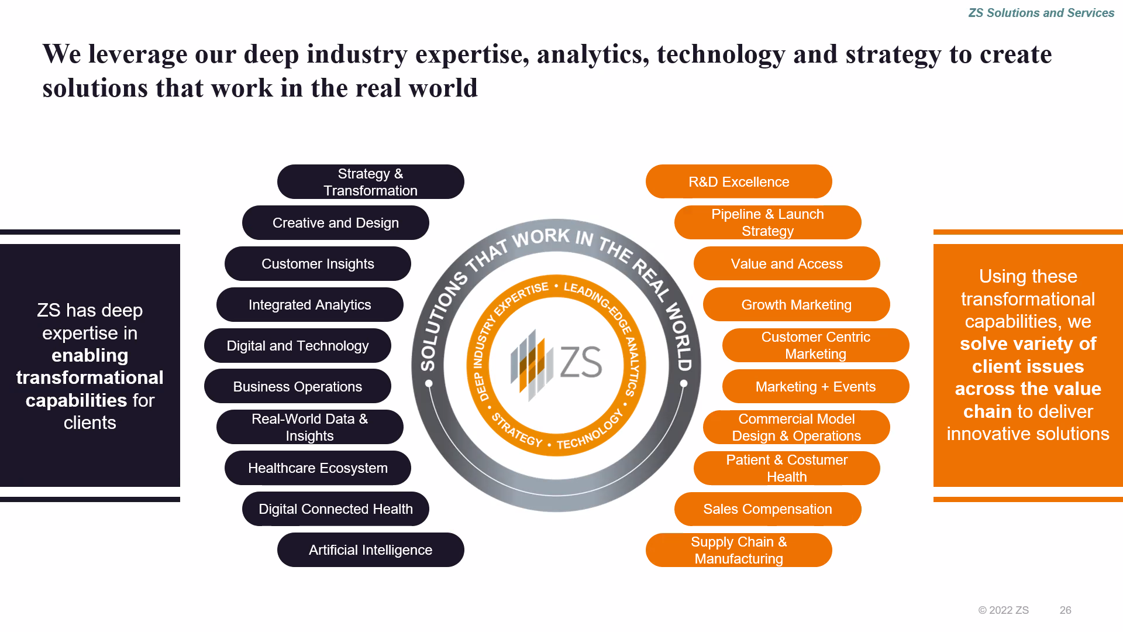
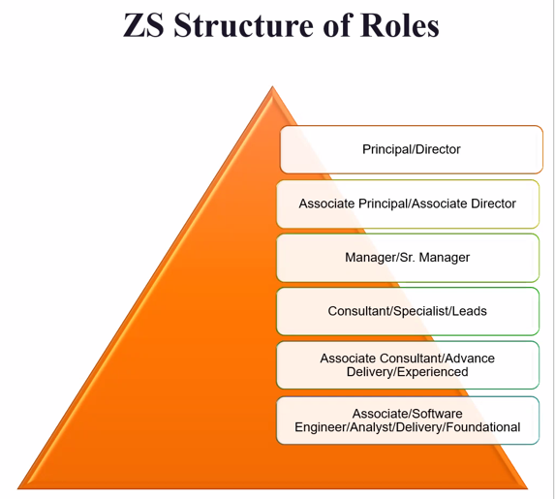
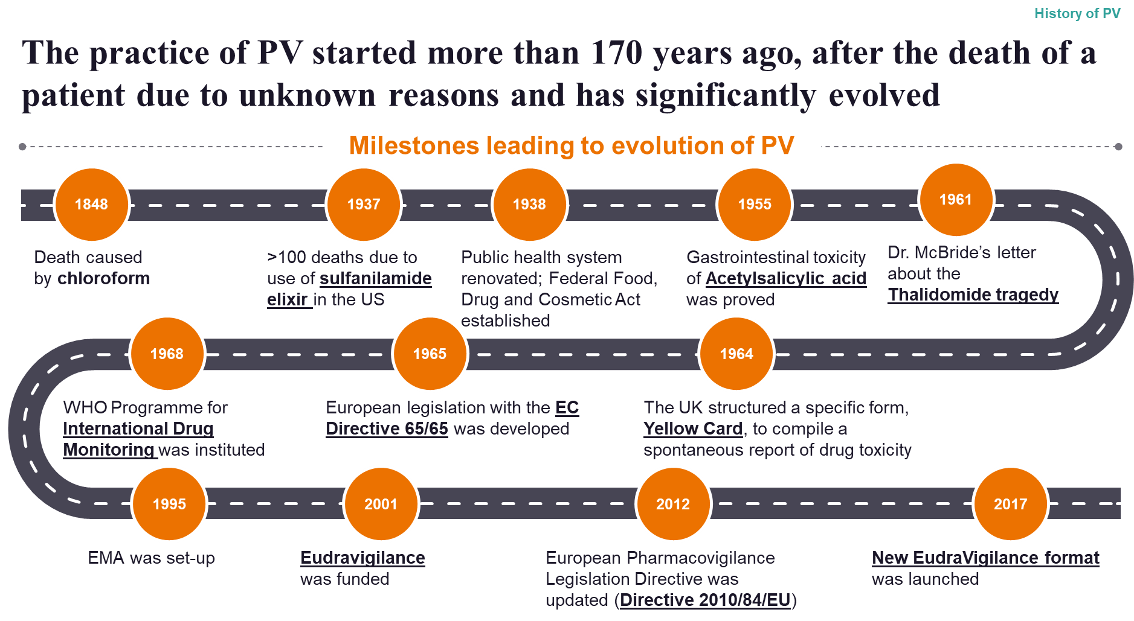
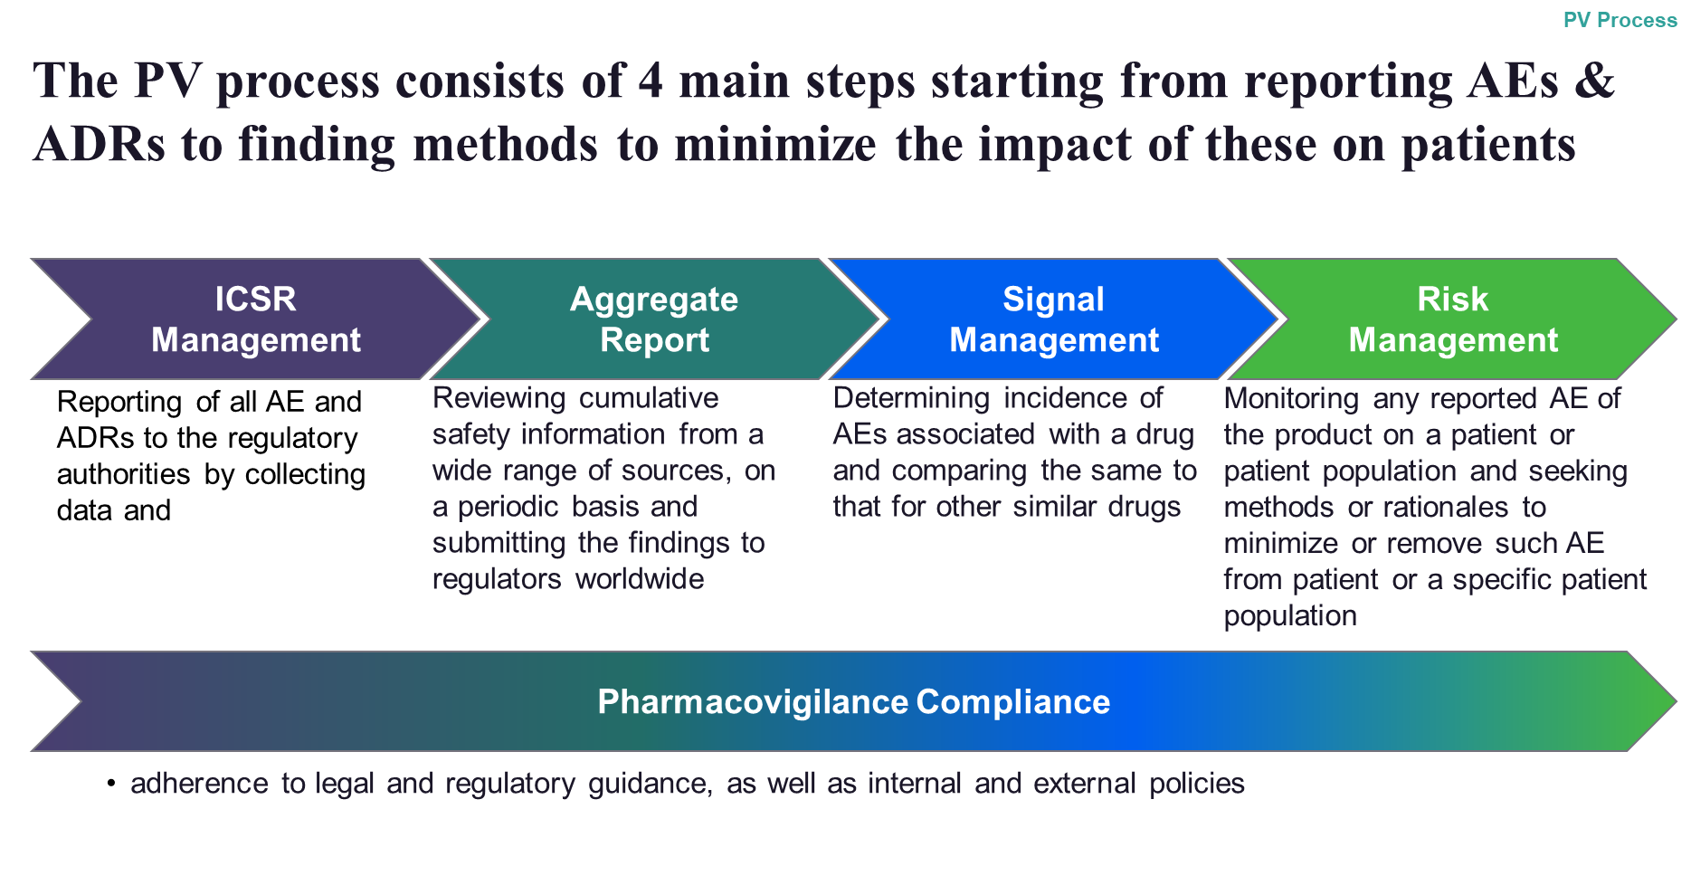
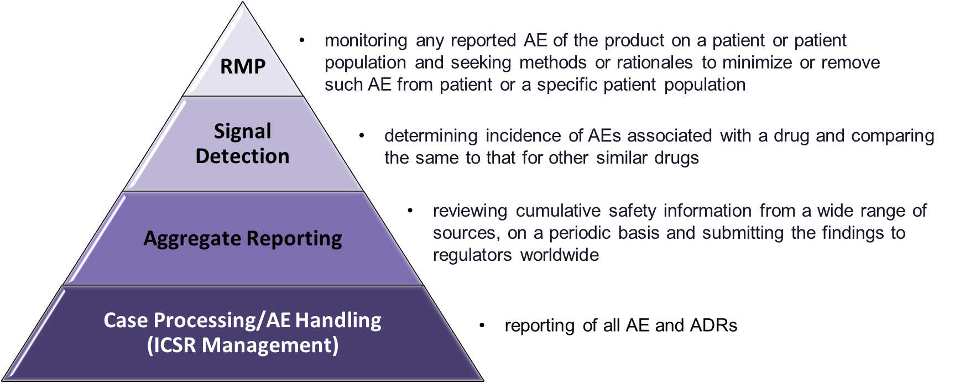
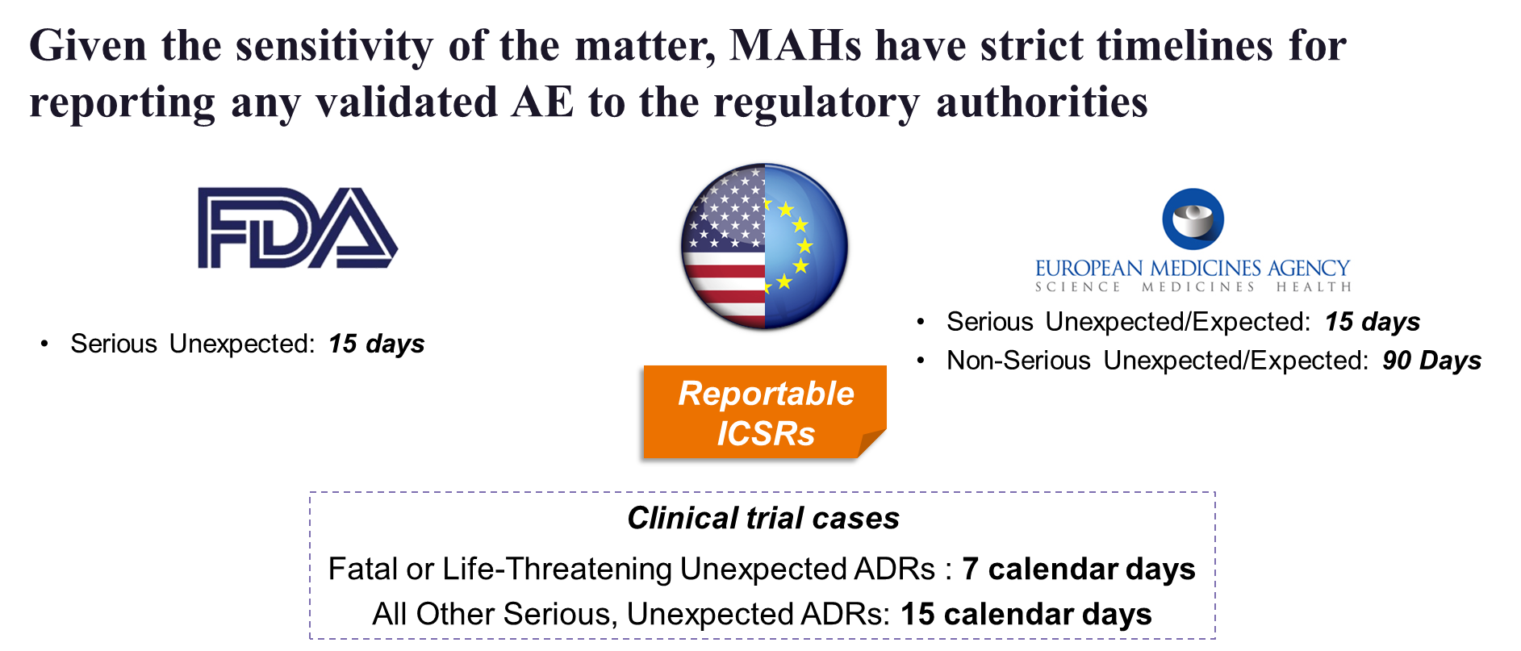
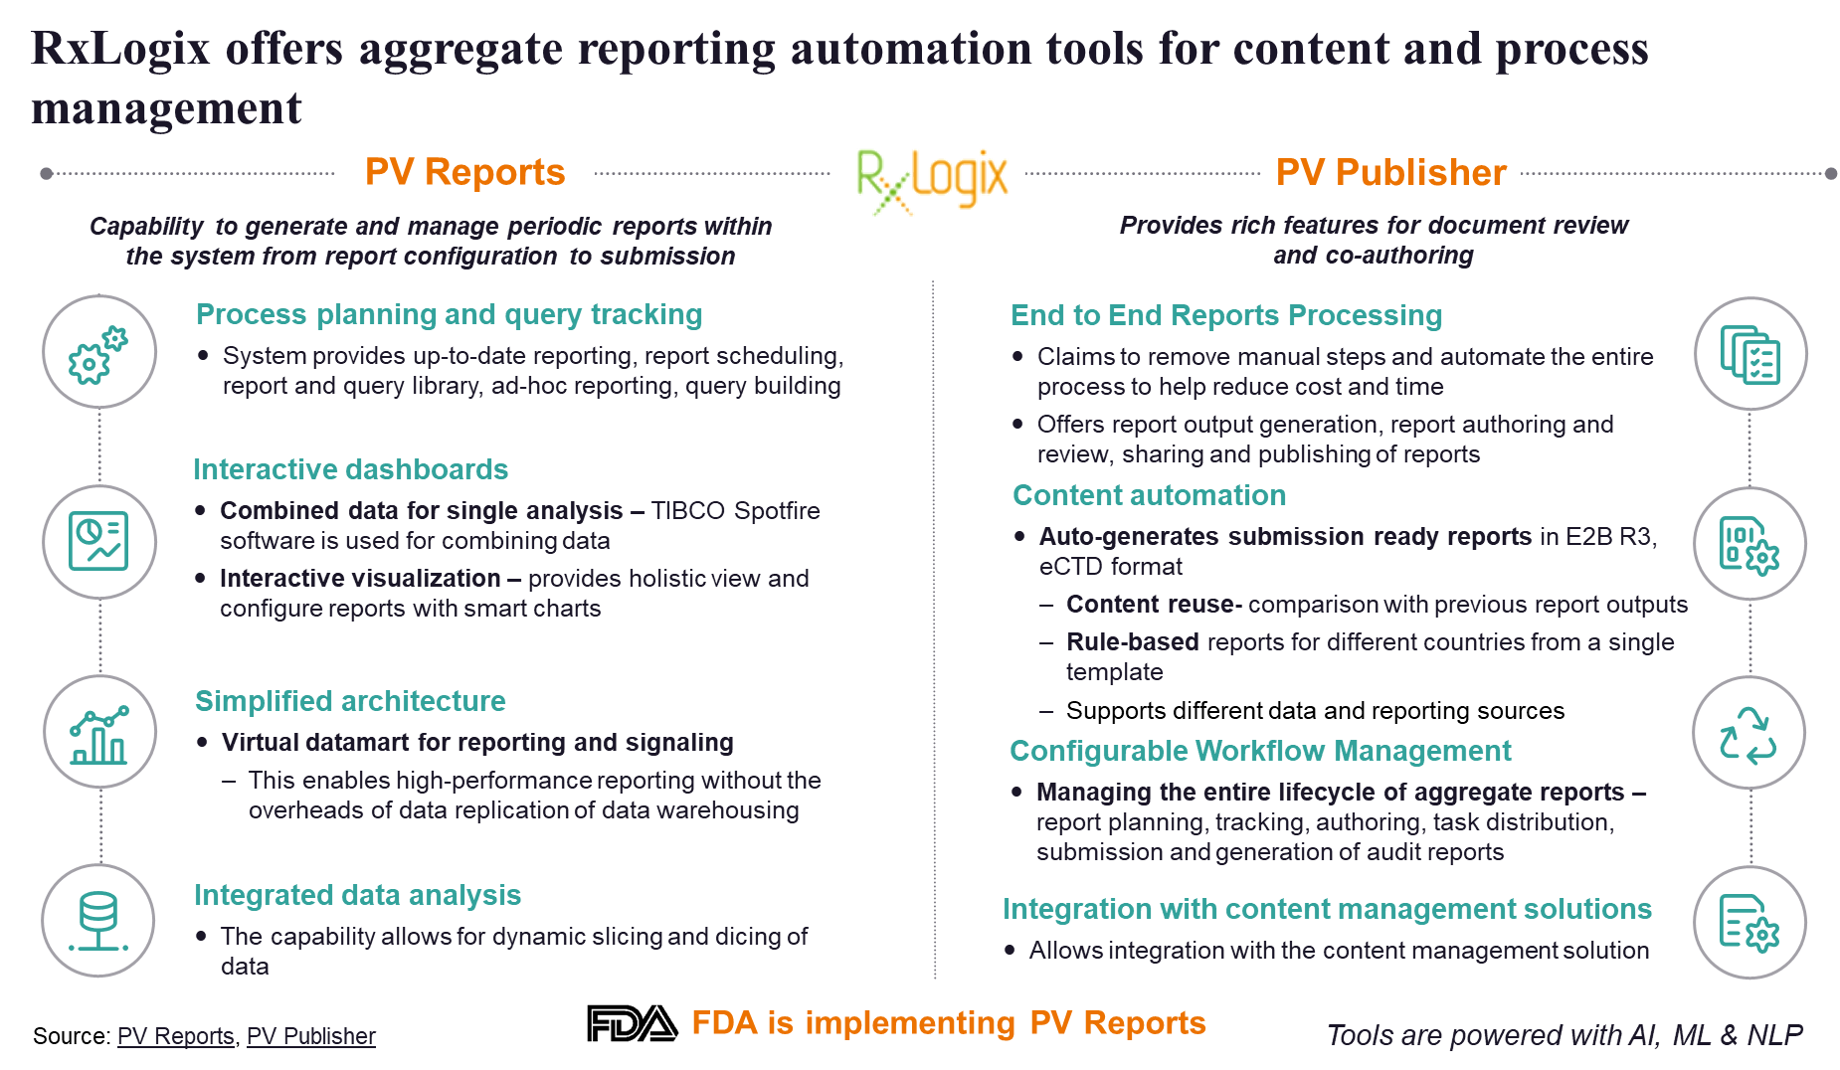
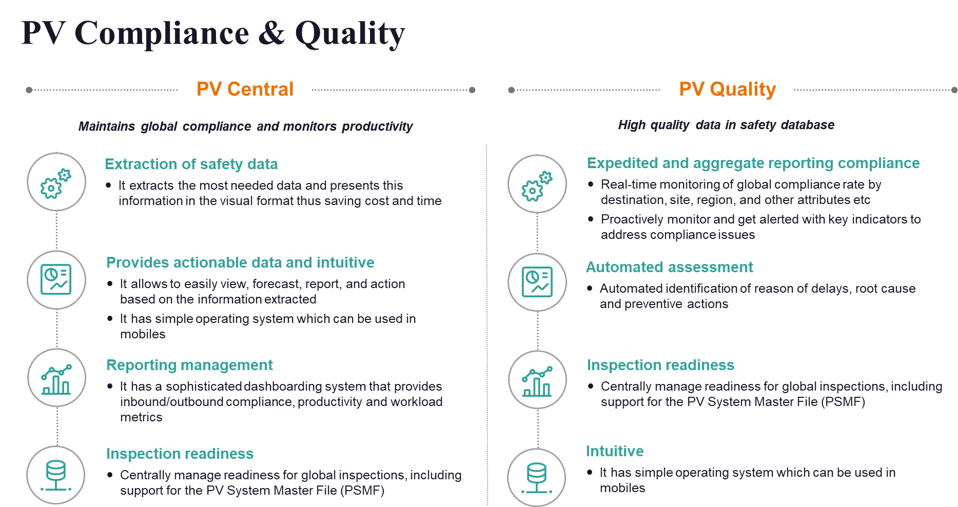
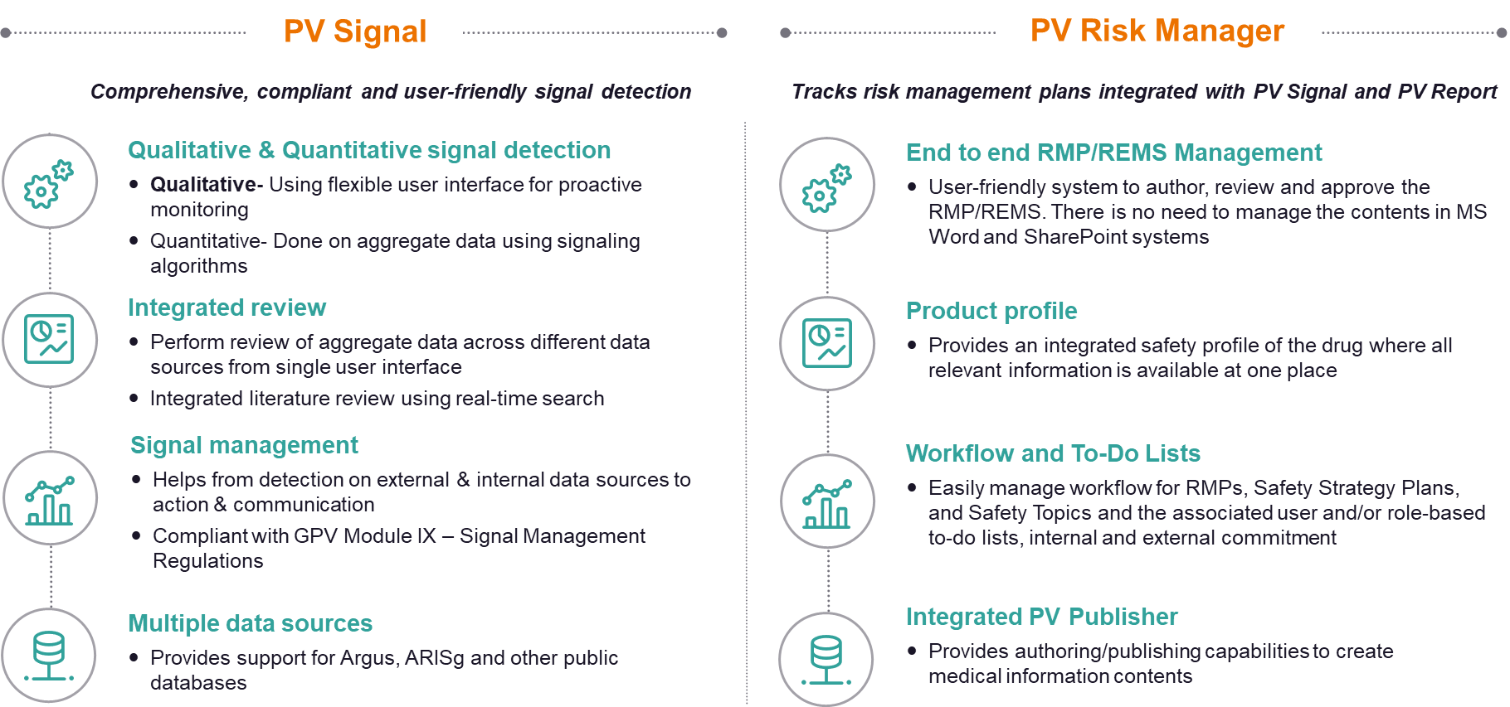
“Pharmacovigilance: Information Systems And Services”
Name- Animesh Roy / Roll No.- 0288
Stream- MBA PM 13
Faculty Mentor- Dr. Saurabh Kumar
Industry Mentor- Ms. Vartika Pandya
ZS Associates
ZS Associates is a management consulting and professional services firm focusing on consulting, software, and technology, headquartered in Evanston, Illinois that provides services for clients in healthcare, private equity, and technology.
ZS Associates was founded by Andris Zoltners, Frederic Esser Nemmers Distinguished Professor Emeritus of Marketing at the Kellogg School of Management, and Prabhakant (Prabha) Sinha, a former associate professor of marketing at the Kellogg School of Management. At Kellogg, Sinha and Zoltners developed a side business advising companies on sales and marketing, which evolved into ZS Associates.
Organizational Structure
Technology
Operation
Consulting
Learnings
Pharmacovigilance
Pharmacovigilance is aimed at determining if the benefits from a drug outweigh the risks to the patients
Definition
As per WHO, Pharmacovigilance is the science and activities relating to the detection, assessment, understanding and prevention of adverse effects or any other medicine/vaccine related problem
Aim
Early detection of unknown safety problems
Detection of increases in frequency
Identification of risk factors
Quantifying risks
Preventing patients from being affected unnecessarily
Why is PV Required?
It involves ongoing monitoring of drugs to ensure they remain safe for use as previously undetected AEs can occur at any time
Drugs appear to be safe and well-tolerated, but safety in real-world is unclear
Safety in vulnerable groups is unknown
Significant harm to a few patients, rumors, and myths can destroy the credibility and adherence to treatment.
RxLogix
To deliver the IT systems needed to support business activities of the revised pharmacovigilance legislation and to change the relevant business functions to maximize the benefits for stakeholders. New EU Pharmacovigilance legislation has been operational since July 2012. The legislation foresees various information systems to enhance pharmacovigilance, particularly to support the collection, management, and analysis of data, information, and knowledge. These systems will contribute to public health through the optimization of the safe and effective use of medicines.
This will improve the safety monitoring of medicines through better quality safety information.

