Slide 1


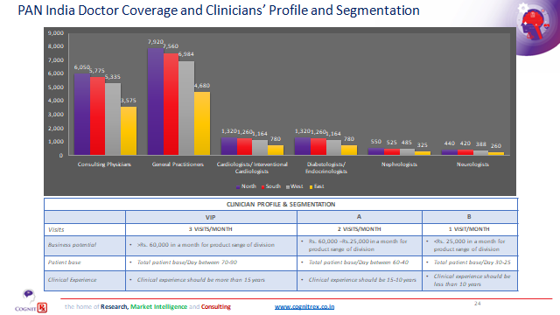
SUMMER INTERNSHIP – POSTER PRESENTATION
Made By:- Ayush Tiwari (MBA-PM 13)
Roll No- IIHMR-U/2021-23/0295
Industry Mentor:- University Mentor:- Abinash Sahoo Dr. Saurabh Kumar Banerjee
GLIMPSES ON COMPETETIVE ASSESMENT OF STAMLO BRAND
THANK YOU

