Slide 1


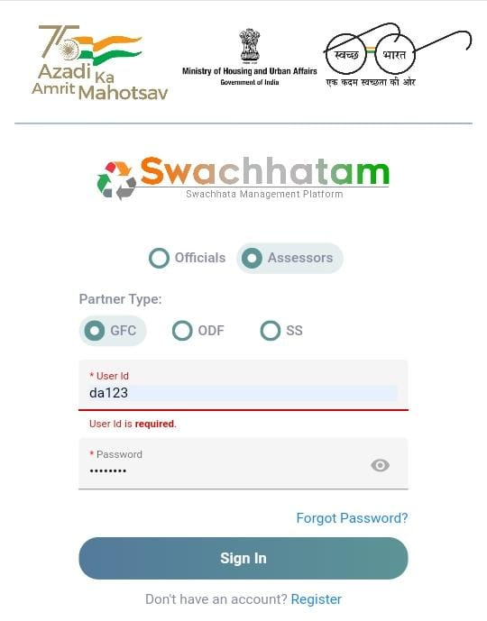
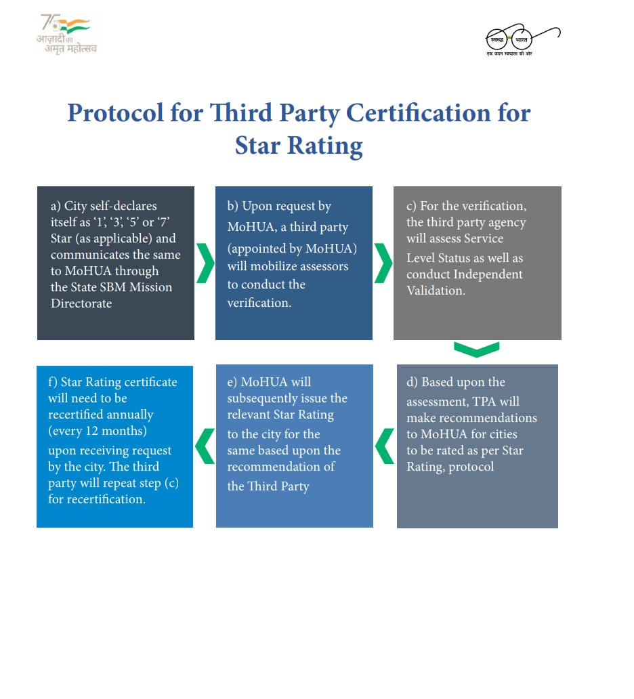
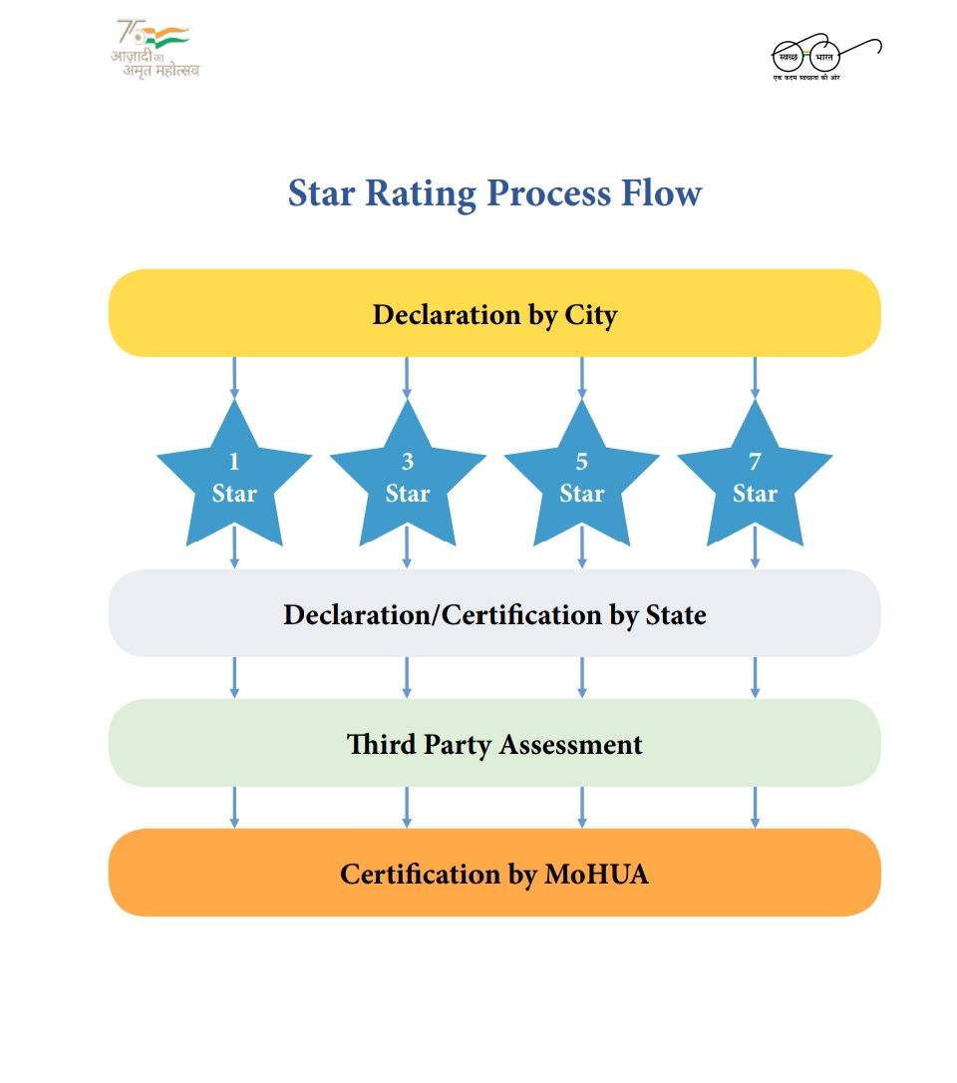
GARBAGE FREE CITY 2022 DESKTOP ASSESSMENT & QUALITY CHECK FOR FIELD ASSESSMENT
PRESENTED BY: BINITA LAHIRI
R.NO- 0297 STREAM- PM 13
FACULTY MENTOR- Dr. SAURABH KUMAR BANERJEE
INDUSTRY MENTOR- RASHI KHARE
ORGANIZATION- IQVIA
INTRODUCTION
ABOUT PROJECT
Swachh Bharat Mission (SBM), also known as Swachh Bharat Abhiyan or Clean India Mission, is a national programme launched by the Government of India in 2014 to eradicate open defecation and boost solid waste management. The Swachh Bharat Mission's Phase 1 lasted through October 2019 as well as its goals included eliminating manual scavenging, raising awareness and influencing behaviour on sanitation practises, and adding capacity at the local level . Phase 2 is being executed between 2020–21 and 2024–25 to help reinforce the work of Phase 1. Its goal is to maintain open defecation-free status and strengthen solid and liquid waste management, while also seeking to improve sanitation personnel' lifestyles
IQVIA, originally Quintiles and IMS Health, Inc., is an American multinational corporation that operates in the health information technology and clinical research industries. IQVIA is a biopharmaceutical development and commercial outsourcing company that primarily focuses on Phase I-IV clinical trials and associated laboratory and analytical services, as well as consultancy services.
VISION & MISSION- Imagine a world where advances in data science and human ingenuity come together to provide creative solutions to improve human health. Where every challenge is seen as an opportunity to make a meaningful impact for customers, for patients, for people. Discover a career with purpose and help create a healthier world.
Swachh Bharat Mission-Urban was started in October 2021 to develop "Garbage Free Cities" (GFC), putting India on a new growth curve toward an ecosystem of comprehensive sanitation and waste management. It is one of the approaches aimed at making the Swachh Bharat Mission-Urban (SBM-U) a successful undertaking. The Star Rating Protocol was launched by the MoHUA in 2018 to institutionalise a mechanism for cities to achieve Garbage Free status, and to motivate cities to achieve higher degrees of sustainable cleanliness. It aims to make every urban local body at least 3-star garbage free as per the star rating protocol
In the recently concluded certification exercise for Garbage Free Cities nearly 3597cities participated in the certification exercise
ORGANOGRAM
SENIOR PRINCIPLE
WASH HEAD(WATER & SANITIZATION)
SENIOR CONSULTANT
ASSOCIATE CONSULTANT
RESEARCH ASSOCIATE
EXTERNAL CONSULTANT
INTERNS
FIELD ASSESSORS
SWOT ANALYSIS
STRENGTH:
Elimination of open defecation
To effect behavioural change regarding healthy sanitation practices
Generate awareness about sanitation and its linkage with public health
Regular waste collection
WEAKNESS:
Poor dumping management
Less focus on other aspects of sanitation i.e., the campaign mainly focuses on achieving ODF (Open Defecation Free) status wherein every individual in the village uses sanitary latrines leading to abolition of open field defecation, but at the same village there is huge amount of animal excreta and other waste polluting and spreading infection in the environment despite achieving goal of open defecation free
OPPORTUNITIES:
Waste management through biogas/gobar gas plant/Domestic biogas plants
Providing scientific and visual proof i.e., a review of previous health reforms can assist to illuminate the problems of improving public health, as well as evaluate various techniques used to alleviate health crises in the short and long term
THREATS:
Insufficient attention to promote environmental research
Increase in urban population
Change the mindsets of the people
CHALLENGES
USEFULNESS OF INTERNSHIP
LEARNING & VALUE ADDITION
Time management
Competitive co-interns
Afraid to ask questions
Exposure to grey area of corporate world
Gain valuable work experience
Experienced the edge in the job market
Explore a career path
Develop & refine skills
Gain confidence
Receive financial compensation
Networking
Acquire the genuine work insight
Networking opportunities
Boost self confidence
Productivity
Real corporate world experience

