Slide 1


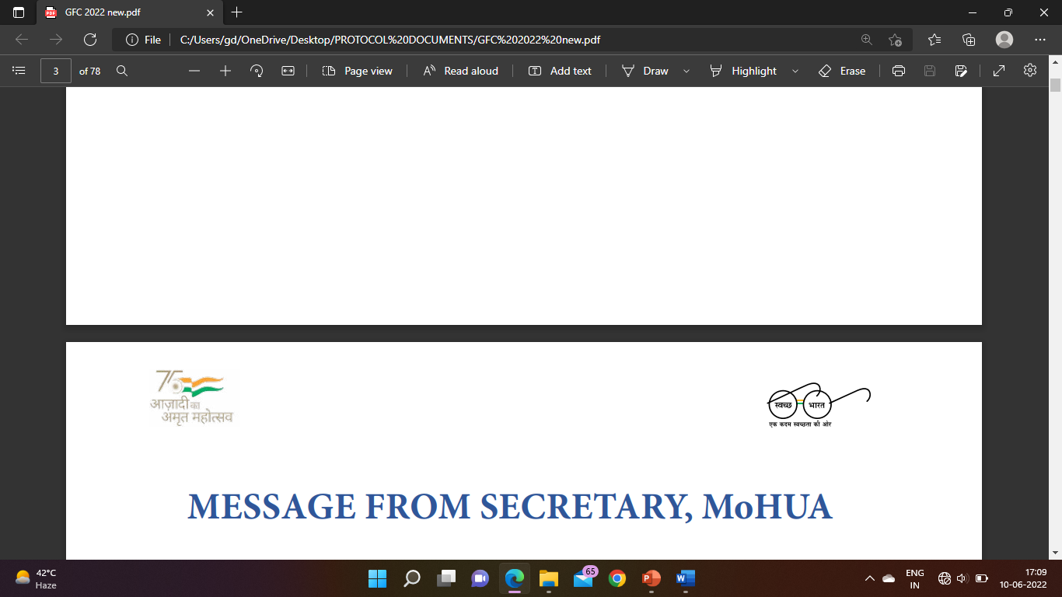
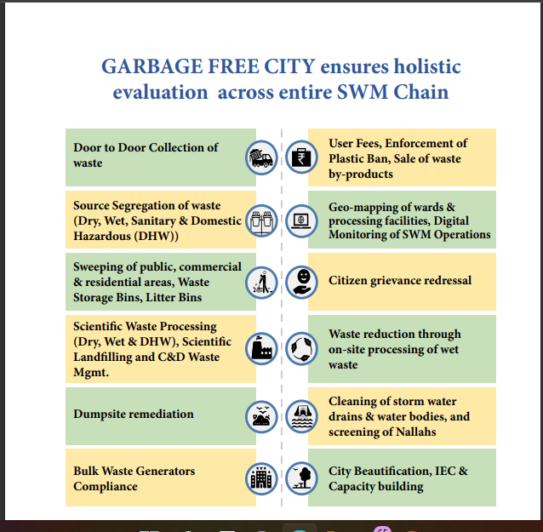

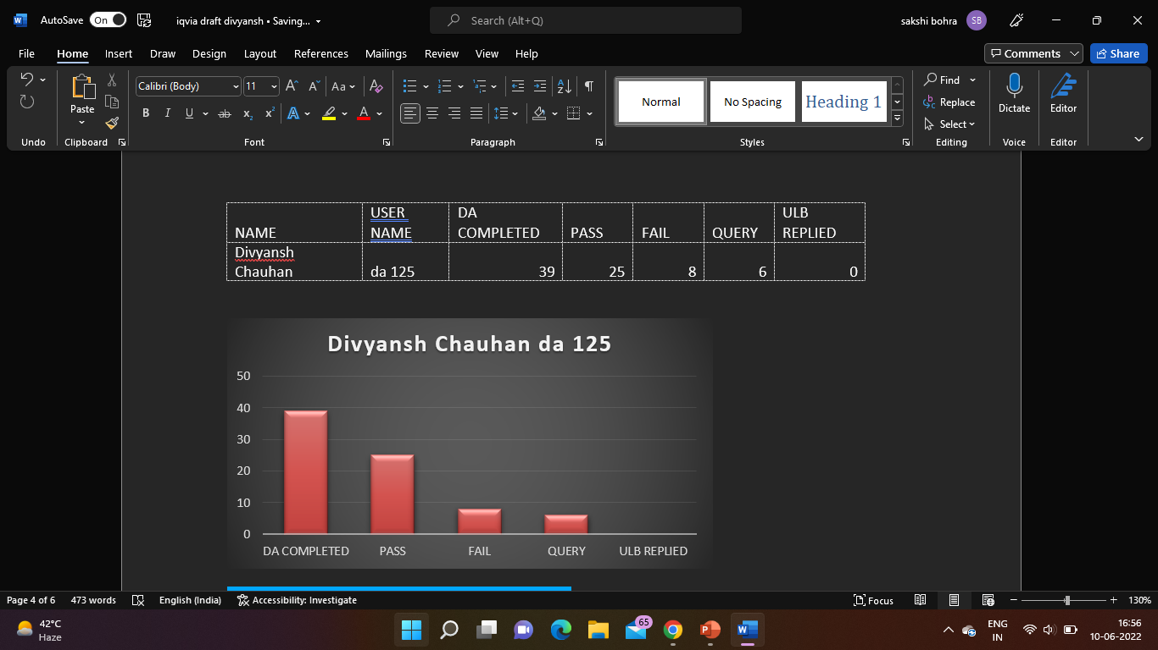
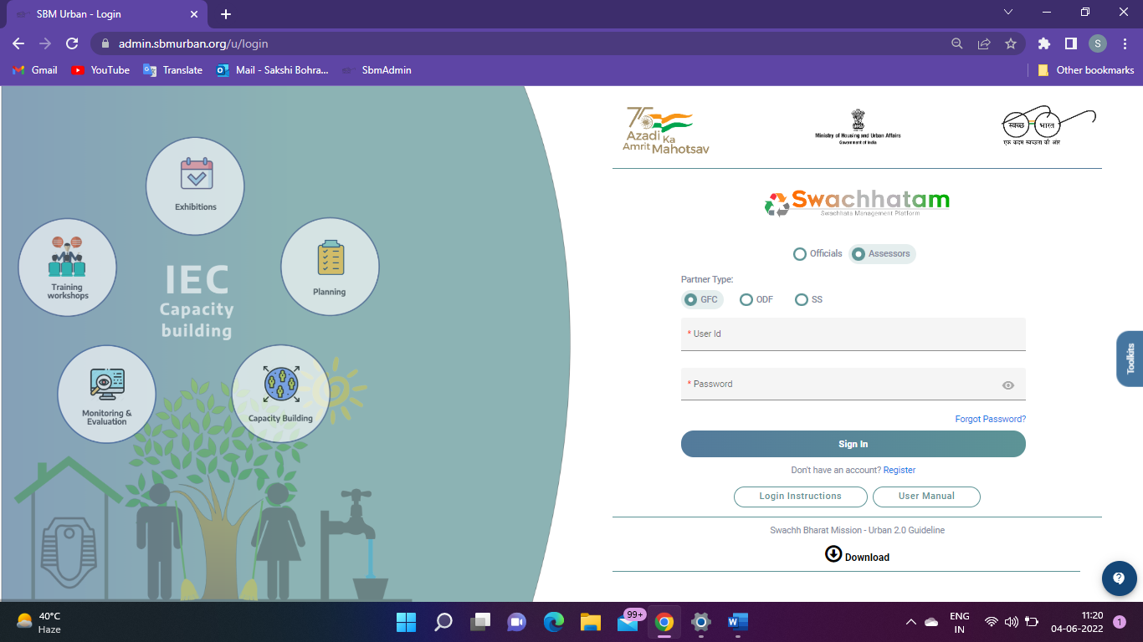
DESKTOP ASSESSMENT OF GARBAGE FREE CITIES
NAME: Divyansh Chauhan ROLL NO. 0299 STREAM: Pharmaceutical Management
NAME OF FACULTY MENTOR: DR. Sudhinder Singh Chowhan
NAME OF INDUSTRY MENTOR: Rashi Khare
VISION AND MISSION:
BREIF HISTORY OF IQVIA
IQVIA ORGANOGRAM:
DIFFERENCES BETWEEN PRACTICAL AND THEORITICAL EXPOSURE:
IQVIA brings together advances in data science, technology, and healthcare expertise to help customers make better decisions and ultimately improve patient outcomes.
Our mission is to help create a healthier world. We believe by accelerating innovations and making intelligent connections across the healthcare ecosystem, we can make exponential progress.
In 2016, Quintiles and IMS Health converged to create an entirely new organization capable of serving the healthcare industry like never before.
Senior principal
Wash Head (Water and Sanitation)
Senior Consultant
Associate Consultant
Research associate
External Consultant
Interns
Field Assessor
Gained more knowledge on analyzing and understanding the documents properly in the SBM Portal and filling the excel sheets accordingly and at last was able to understand the nature of my data and transform it into insights, which bought me to the usage of machine learning techniques, social analytics.
CHALLENGES FACED DURING INTERNSHIPS:
Lack of confidence
Lack of guidance
Sitting ability
Afraid of asking doubts
Work pressure
Peer pressure
In a dilemma that am I doing my work correctly or not.
STAR RATING PROCESS:
ABOUT PROJECT:
LEARNING AND VALUE ADDITIONS:
Since its inception in 2014, the Swatch Bharat Mission-Urban adventure has aided India in creating and accomplishing new Swatchhata targets. The protocol for garbage free city star rating was launched in January 2018 (and has been conducted every year thereafter) in order to institutionalize a mechanism for cities to achieve Garbage Free status and to motivate cities to achieve higher degrees of cleanliness. The star rating system reflects cities' ambitions to improve their "Swatchhata" standards. Since its inception in 2014, the Swatch Bharat Mission-Urban adventure has aided India in creating and accomplishing new Swatchhata targets. In order to make a system permanent, it must be institutionalized.
Giving up is not an option
Swachhagraphis performance was also monitored as part of learning process
Creating a network, the chance to meet people from all throughout the company.
Professional behavior.
Confidence build-up.
SWOT ANALYSIS:
STRENGHTS:
GROWING BRAND AWARNESS
Loyal runners
Attracting new participants
Strong and race knowledge and experience
WEAKNESS:
Updating running information is time consuming
Unable to effectively manage volunteers
Current system cannot be customised to support our complex team/relay program
OPPORTUNITIES:
Enhance sponsor involvement
Build on social sharing
THREATS:
Saturated race market
Limited staff to use the portal resources
PROGRESS REPORT:
SUGGESTIONS:
Portal glitches
Make better intelligent connections between its needs and capabilities
Never be fully satisfied with the success.
Notes:
For assistance with this research poster template visit: https://www.posterpresentations.com/helpdesk.html

