Slide 1


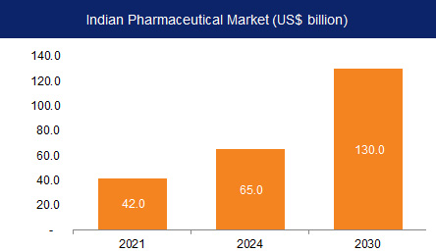
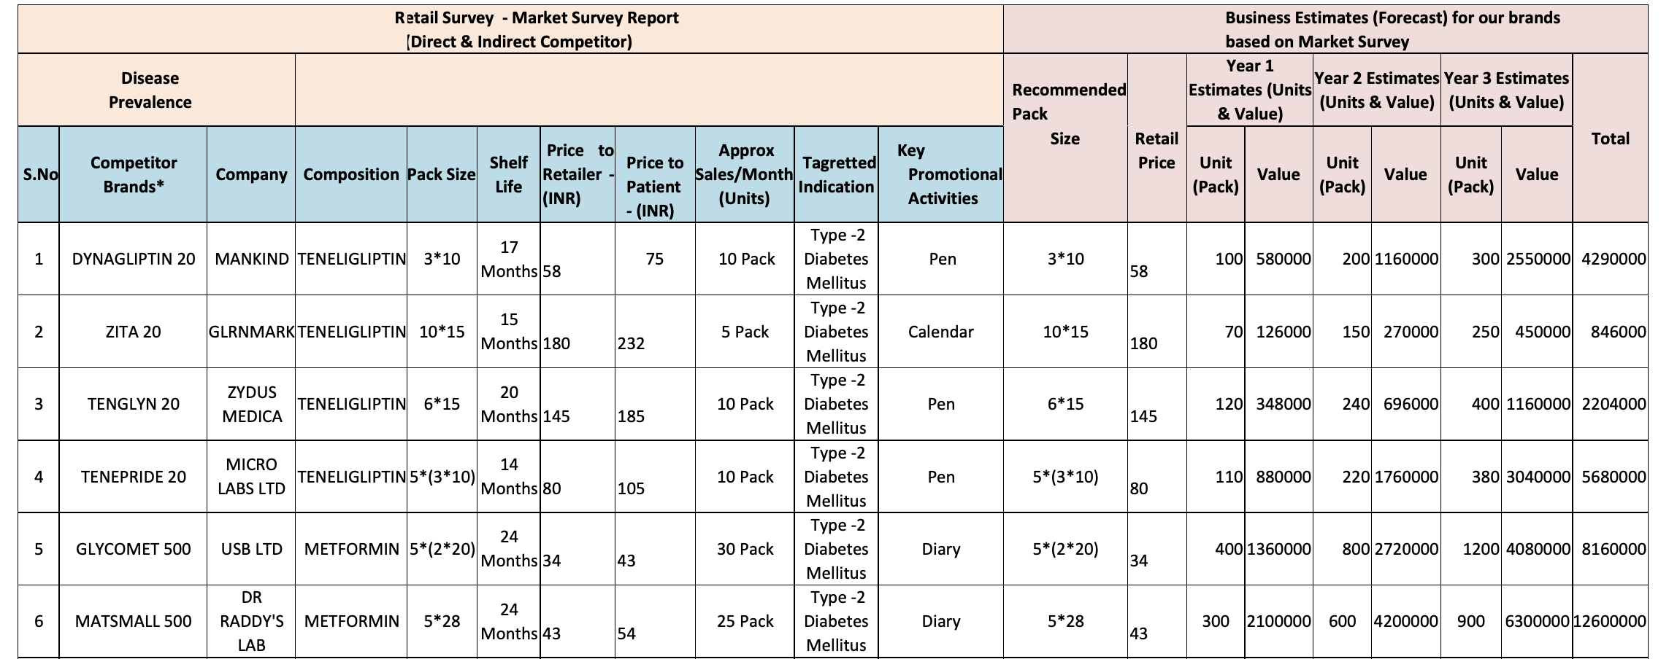
BRAND PLAN FOR “ Teneligliptin”
Presented By- Injamul Haque Guided By- Dr. Sudhinder Singh Chowhan
Roll No- 0304, Industry Mentor- Tavinder Jit Singh Vasudeva
Stream- MBA PM-13
About Micro Labs Ltd.
Micro labs was incorporated on 7th September 1973. Micro Labs Limited's operating revenues range is Over INR 500 cr. It is a multifaceted healthcare organization with a proficient marketing team. Have manufacturing facilities and R&D centres that are with international standards. It is ranked 14th among prescriptions by SMSRC and 19th in sales as per AWACS Mat. The company is well known for its brand “DOLO” while the portfolio includes some of the topmost brands in various specialities like Cardiology, Diabetology, Anti-infective , Ophthalmology, Pain, etc,. The company’s domestic market share is around 2% while it is among top 5 players in liver-therapy and in Oral Anti-diabetic segment. The company is placed 11th in the Cardiovascular product division. Around 60% of the company’s domestic revenue is from Chronic segment. This financial year company’s export sales grew by about 35% while the domestic sales were moderate at 5% because of lower prescription-based sales due to COVID.
About Industry
The pharmaceutical industry in India was valued at an estimated US$42 billion in 2021.
India is the world's largest provider of generic medicines by volume, with a 20% share of total global pharmaceutical exports.
It is also the largest vaccine supplier in the world by volume, accounting for more than 50% of all vaccines manufactured in the world.
India is a major exporter of pharmaceuticals with over 200+ countries served by Indian Pharma export.
India supplies over 50 % of Africa’s requirement for generics, ~40% of generics demand in the US, and ~25% of all Medicine in the UK.
Organization Structure
Micro Labs has a hierarchical organization structure i.e., top-bottom. Employees are grouped with every employee having one clear supervisor.
PRODUCT PROFILE
Teneligliptin is used in the treatment of type 2 diabetes mellitus in combination with diet and exercise.
It inhibits the action of DPP-4 enzymes and slows the rate of incretin breakdown.
It is eliminated with a half-life of 24.2 hours via excretion in human plasma.
VISION
Micro labs desires to not just be the best, but a leader in the development, manufacturing and sales of premium pharmaceutical products.
Micro labs wish to manufacture medicine of the highest standards and market it at affordable price across the globe.
SWOT Analysis
Strength
Weakness
Opportunities
Threats
It works by increasing the release of insulin and decreasing the hormones that raise blood sugar.
It mainly used in type-2 diabetes.
It may cause hypoglycemia ( low blood sugar level) when used with other antidiabetic medicines.
Less product availability.
Target the alternative channels and promote it through medical representatives.
Combination market is also growing very fast.
Lot of competition in the market.
Market competitors are coming with advanced technology and combinations.
ASPIRATION
Micro labs aspires to deliver value through high-quality pharmaceutical products and to build brands across the therapeutic segments.
LEARNINGS
I learned that how to manage time efficiently and how to tackle pressure situation.
Challenges Faced
Short deadline period.
Travel too much for market survey.
Time management.
Practical exposure and Theoretical work
We will learn our own perceptions during practical exposure but on the other hand in theoretical we will learn others perception.
In theoretical I read about how to work in market is not same in practical field.
Suggestions:
More involvement of interns can be there.
If the internship was in offline mode; it could be more beneficial.

