Slide 1





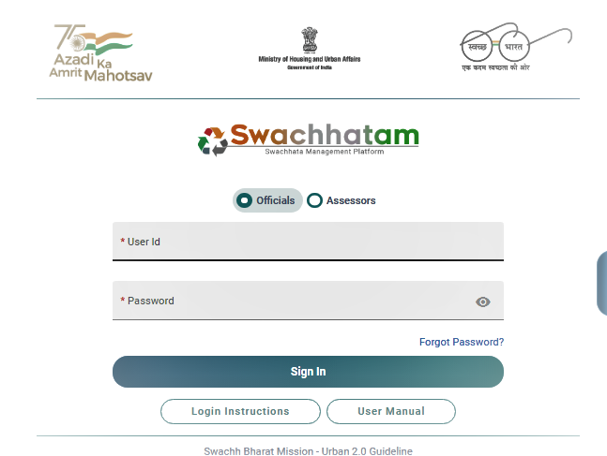
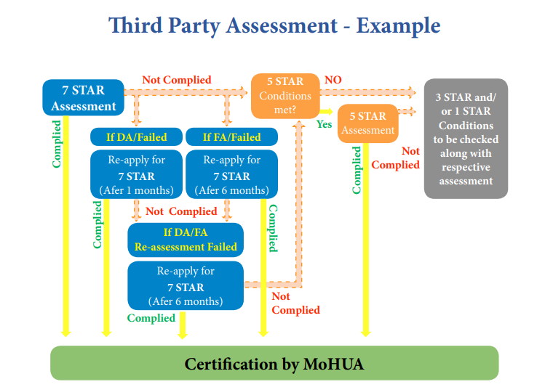
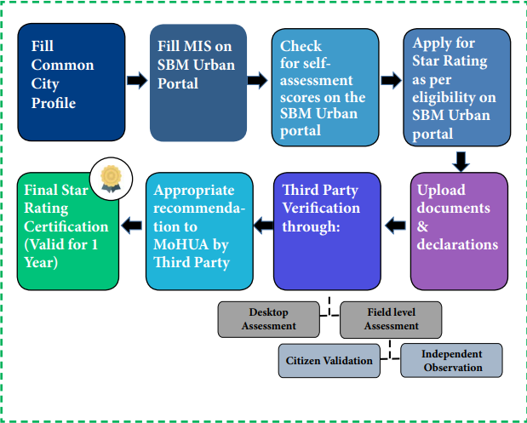
Garbage free city 2022 Desktop Assessment
Swachh Bharat Mission Project in Association with MoHUA
PRESENTED BY: JAIBHAGWAN R.NO- 0305 STREAM- PM 13
FACULTY MENTOR: DR. SAURABH KUMAR
INDUSTRIAL MENTOR: RASHI KHARE
Introduction:
IQVIA: IQVIA is a leading global provider of advanced analytics, technology solutions, and clinical research services to the life sciences industry dedicated to creating intelligent connections that deliver unique innovations and actionable insights.
Task assigned:
45 cities of different states were assigned to analyze
Organogram
Data Analysis:
Vision and Mission:
Our mission is to create a healthier world. Believe by accelerating innovation and making intelligent connections across the healthcare ecosystem, we can make exponential progress.
Senior Principal
Swachh Bharat mission:
On 2nd October 2014, Swachh Bharat Mission was launched as a national movement. The campaign aims to achieve the vision of a 'Clean India' The Government of India launched the Swachh Bharat Mission, with the vision of ensuring hygiene, waste management, and sanitation across the nation.
Wash head
Senior Consultant
Associate Consultant
Research associate
About the project:
Swachh Bharat Mission’s sub-projects are being undertaken by IQVIA in partnership with the Ministry of Housing and Urban Affairs.
IQVIA is the technical consultant for the Swachh Bharat Mission (Urban) under the Ministry of Housing and Urban Affairs for conducting an on-ground assessment of Star Rating for Garbage Free Cities and Open Defecation Free Protocols.
External Consultant
Interns
Field assessors
About GFC:
Garbage-free city certification is a part of the Swachh Bharat Mission which is given to the cities after both desktop and field assessment and according to the documents provided and field assessment scores are given to the cities and then certification is provided by the MoHUA.
Respective roles in DA :
I was working as a Desktop Assessor in the GFC team of the project, which was directly connected to the Nodal Officer or commissioner. There were 16 components for 1-star and 3-star certifications and 24 components for 5-star certifications different no. of question are there in each component in which cities must pass for the applied star.
Learnings and value addition:
New and improved technical skills for live project
Time and traveling management
Organizational behavior
Keeping personal and professional life separate
Professional communications with colleagues
Professional communication with the HR,
heads of the project, core team members, and seniors.
STRENGTH
Complete eradication of open defecation and manual scavenging.
Generate awareness about sanitation and regular waste collection
WEAKNESS
Lack of effective planning leads to poor dumping.
Municipalities focus more on documental work rather than ground-level fieldwork in Urban Local Bodies.
Difference between practical and theoretical exposure:
Practical exposure needs more time management.
More formal communications in que than the theoretical.
Emotional control is needed during the practical exposure rather than theoretical.
Learnings are different compared to theoretical like soft skills, technical skills, and organizational etiquette
SWOT
ANALYSIS
THREATS
Inadequate financial support and lack of interest in environmental research.
Increase in urban population due to steady and constant migration of people from rural areas.
OPPORTUNITIES
Proper management of biodegradable waste leads to clean energy production
Basic sanitation can help improve public health and decline infectious disease
Challenges faced:
Difficulty in traveling due to remoteness of workplace
Working late at nights
Different tasks simultaneously
In the initial days due to multiple works and communication with govt. officials, it seems scary but later everything got handled.
The usefulness of the internship:
Got a feel for the work environment.
Boosted in confidence
Increased motivation
Improved CV
Suggestions:
Portal handling can be improved with some innovations for easy analysis in the future.
Strong server can be there for smooth and efficient work.

