Slide 1


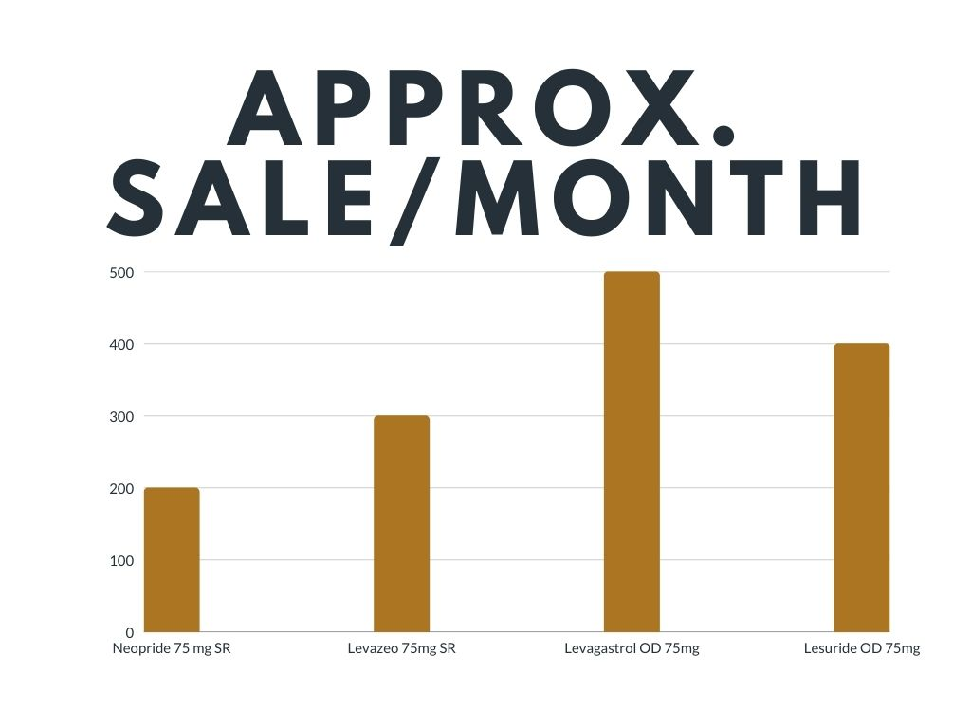
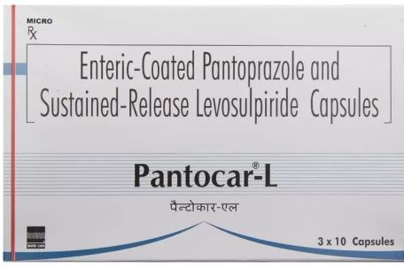
BRAND PLAN AND MARKETING STRATEGIES OF LATANOPROST SOLUTION IN MICRO LABS LTD.
By - Koushik hosh
Roll no-0311 MBA Pharmaceutical Management
Under the Guidance of – Dr Sudhinder Singh Chowhan
Name of Organization Mentor- Mr. Tavinder Singh
Organization Name- Micro Labs Ltd.
INDUSTRY SECTOR PROFILE
HISTORY
VISION & ASPIRATION
ORGANIZATION & STRUCTURE
DESCRIPTION ABOUT THE INDUSTRY
In 1993, Micro labs was founded by the late Shri. G.C Shurana to manufacture ethical pharmaceutical products with a manufacturing facility in Chennai
In 2011 Micro-Labs incorporated with USA
Our vision is built around a desire to not just be the best.
But a leader in the development, manufacture.
Sales of premium pharmaceutical products.
We wish to raise the flag of Micro Labs in India as well as abroad.
Hierarchical Organization structure i.e., Top to bottom. Employees are grouped with every employee having one clear supervisor.
Micro Labs Limited operates as a pharmaceutical company.
The Company manufactures and produces generic medicines and drugs for cardiology, diabetology, anti-invective, and ophthalmology.
LEARNING & VALUE ADDITION
BRAND PLAN FOR LEVOSULPRIDE 75 MG SR IN MICRO-LABS LTD.
Product Profile
It is a typical anti psychotic drug,
It treats psychiatric condition, vertigo, dipression,hallucination,schizoprenia
It can also treat digestive issues like GERD, IBS, indigestion, and incessant heartburn
Market Trends
Total population of INDIA 139cr.(Estimated 2021).
Current adult population is 86cr
Health Insurance covered 70cr
Business implication
Increment in the Health budget will increase health awareness
Due to health insurance patient spending on diagnosis and treatment will increase.
SWAT ANALYSIS
DISEASE PREVALENCE
STRENGTH Dosage is OD Dosages Forms are Tablet , Capsule | WEAKNESS Available in market As a combination Drug High Price
THREATS History of Neuroendocrine tumour Weight Gain The increased prolactin level in blood | OPPORTUNITY Less competitors
A total of 66.4% patients were treated with 75 mg levosulpiride and 33.6% with 50 mg/day. At the 15-day visit, a decrease greater than 50% in the global symptom score was observed.
CAMPAIGN
Communication with a doctor-
Literature
Webinars
Customized inputs
Brand Campaigns
Proposed input
Customized diary
Customized pens
Customized
Positioning
MARKET COMPETITORS
ELEMENTS | Details
BRAND NAME | Levosulpiride 75mg Sr
MARKET DEFINITION | Anti Psychotic Drug
CUSTOMER TARGETS | Depressed , Anxiety Disorder , Indigestion patient
INSIGHTS | Treat the Psychiatric problem as well as digestion related problem
METABOLISM | Hepatic metabolism by the CYP2D6 enzyme
DURATION OF ACTION | > 1day
EXCRETION | Kidney
SL NO | BRAND NAME | COMPANY NAME | PRICE
1 | Neopride 75 mg SR | Intas Pharmaceuticals | RS-178
2 | Levazeo 75mg SR | Intas Pharmaceuticals | RS-208
3 | Levagastrol OD 75mg | Alembic Pharma | RS-215
4 | Lesuride OD 75mg | Sun pharma | RS-185.30
PRACTICAL & THEORITICAL EXPOSER
CHALLENGES
USEFULNESS OF INTERNSHIP
Subjects like request exploration, pharmaceutical marketing were enforced on practical grounds which are a part of syllabus.
Gained practical knowledge of how a product revolves around a request.
Check up on the brand equity and its sourcing
The drug Levosulpride 75 mg SR comes in two combinations out of which the single salt which is not being purchased by most of the pharmacist as it was a speciality drug and the combination drug was facing heavy competition from alternative composition.
As for me, I felt after working with micro labs that it made me realize how important theoretical exposure and learning are.
Additionally, this training made me more aware of the dynamics of the real corporate world and how flexibility, planning, and consistency are crucial to success
OUTCOME
During the internship that how alternative compositions can effect the other salts treating the same indication.

