Slide 1




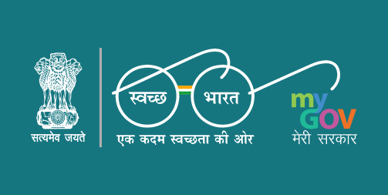

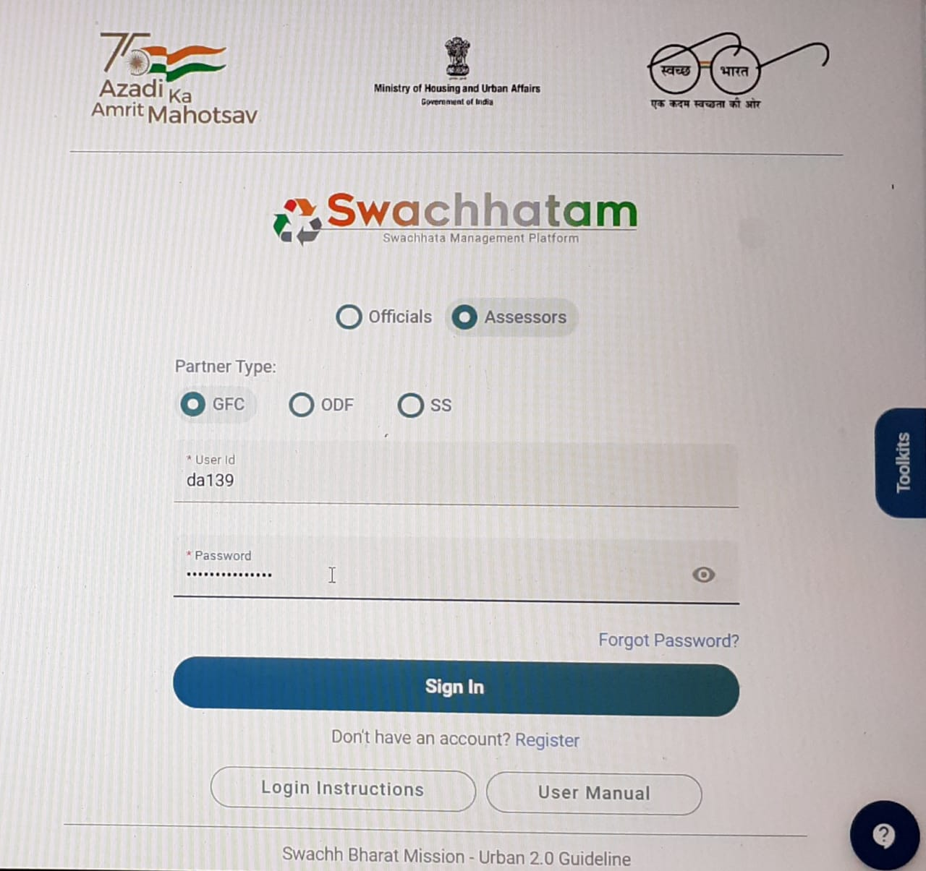
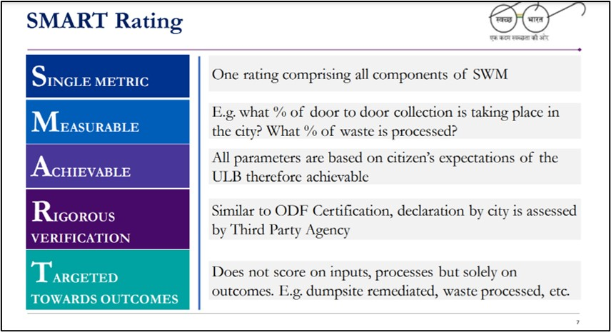
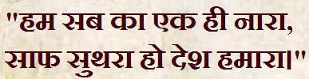
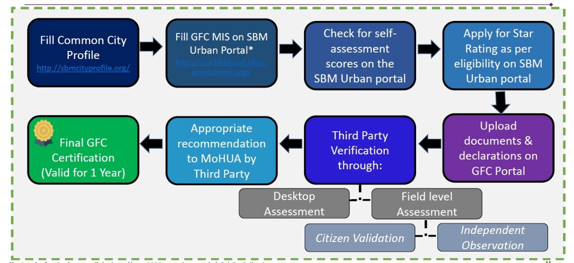





GARBAGE FREE CITY 2022 DESKTOP ASSESSMENT AND QUALITY CHECK FOR FIELD ASSESSMENT
Presented by: Laxmikanta Lenka
Enrolment Number: IIHMR-u/02/2021-23/0313
Subject Stream: MBA Pharmaceutical Management
Faculty Mentor: Dr. Sudhinder Singh Chowhan
Industrial Mentor : Rashi Khare
Organization for Summer Internship : IQVIA INDIA
ABOUT SBM
ABOUT IQVIA
VISION AND MISSION
ABOUT PROJECT
Swachh Bharat Abhiyan or Clean India Mission also known as Swachh Bharat Mission (SBM), is a national programme initiated by the Government of India under Our Honourable Prime Minister Shri Narendra Modi in 2014 to eliminate open defecation and to promote solid waste management. The SBM is divided into 2 phases.
IQVIA is an American multinational company serving the combined industries of health and pharmaceutical information technology and clinical research.
IQVIA is a provider of biopharmaceutical development and commercial outsourcing services, focused primarily on Phase I-IV clinical trials and associated laboratory and analytical services, including consulting services.
MISSION Statement: Our mission is to help create a healthier world. We believe by accelerating innovations and making intelligent connections across the healthcare ecosystem, we can make exponential progress. We bring together advances in data science, technology, and healthcare expertise to help customers make better decisions and ultimately improve patient outcomes
VISION Statement: Imagine a world where advances in data science and human ingenuity come together to provide creative solutions to improve human health. This is our vision. Where every challenge is seen as an opportunity to make a meaningful impact for customers, for patients, for people. Discover a career with purpose and help create a healthier world.
Swachh Bharat Mission-Urban (SBM-U) was launched in October 2021 to promote “Garbage Free Cities” (GFC) that highlights India on a new growth curve towards positive ecosystem of comprehensive sanitation and waste management.
It is one of the approaches aimed at making the SBM-U a successful undertaking of Government of India.
Its main objective is to make every Urban Local Bodies (ULBs) with at least 3-star Garbage Free Status as per the Star Rating Protocol.
According to recent concluded certification exercise for Garbage Free Cities, nearly 3597 cities participated in this certification exercise.
SBM is handled by respective parties at Central and State Level. In Central Level, MoHUA handles protocol design and fund raising, then Project Management Unit (PMU) and lastly the 3rd Party Agency (IQVIA).
In State Level, MoHUA under State Government and Nagar Nigam or Palika, then State coordinated PMU and lastly, Sanitary Inspector or Project Implementation Unit (PIU).
DIFFERENCE BETWEEN PRACTICAL AND THEORETICAL EXOPSURE
SWOT ANALYSIS
Practical experience needs more time management in comparison to theoretical knowledge.
More proper presentation and formal communication is needed here than theoretical information.
In practical state more emotional control is important as compared theoretical databases.
In practical exposure there is a constant learnings from our surrounding work environment rather than theoretical knowledge like technical skills, business communication skills and organizational etiquette.
STRENGTH
WEAKNESS
Complete elimination of open defaecation and manual scavenging.
Effectively change the mindset regarding healthy sanitation practices.
Generate awareness about sanitation and regular waste collection.
Organise training programmes to promote waste management in that area.
Lack of effective planning leads to poor dumping management.
Less focus on every aspect of sanitation that focuses on only paperwork on municipalities to get open defecation free status and garbage free status but on ground level the picture is far from expectation.
OPPORTUNITY
THREATS
Proper waste management can lead to production of biogas which is good resource for conservation of energy and step towards clean energy production.
Basic sanitation is a necessity for every human which can lead to improve public health and control of infectious diseases.
Recycling of plastic waste can lead to reduce the production of new plastic products and less plastic wastage leads to less plastic pollution.
Insufficient funding and lack of interest for environmental research and eco-friendly reforms.
Increase in urban population due to constant migration of people from rural areas.
Rise in global warming due to greenhouse gases generated from incineration of waste materials due to lack of proper management.
RESPECTIVE ROLE IN DA
SUGGESTIONS: Swachhtam Portal which is maintained by servers of MoHUA was lagging due to heavy data traffic. So strong servers must be there for smooth and efficient work.
During internship, I was assigned to work as desktop assessor in the GFC team of the project, which serve as a link between Ministry and nodal officer or commissioner of municipalities.
There were 16 set of important components for 1-star and 3-star certifications and 24 set of aspirational components for 5-star and 7-star certifications where each component ask specific questions in which cities must pass as per applied star.
TASK ASSIGNED: Total of 48 Urban Local Bodies were assigned for assessment. Out of which 28 ULBs have passed and 20 ULBs have failed.
 | CHART TABLES
States Assigned | Total ULBs | 5-Star | 3-Star | 1-Star
Odisha | 18 | 10 | 5 | 3
Telangana | 10 | 6 | 3 | 1
Haryana | 8 | 1 | 2 | 5
Maharashtra | 9 | 2 | 5 | 2
Madhya Pradesh | 3 | 1 | 2 | 0
ORGANOGRAM
SENIOR PRINCIPAL
WASH HEAD (WATER & SANITIZATION)
SENIOR CONSULTANT
ASSOCIATE CONSULTANT
RESEARCH ASSOCIATE
EXTERNAL CONSULTANT
INTERNS
FIELD ACCESSORS
CHALLENGES FACED
LEARNING & VALUE ADDITION
USEFULNESS OF INTERNSHIP
Effective Time Management and complete the task in desired time.
Competitive Co-interns and fast progressive work culture.
Hesitancy to ask questions and lack of confidence in answering the questions.
Complete exposure to grey area of corporate world.
Attaining the genuine work insight and efficiency.
Networking opportunities and building good professional connections.
Boosting self confidence and providing experience in corporate work culture.
Promoting productivity and positive learning experience.
Access to a variety of tasks and departments which help guide career goals.
Helped in gaining a valuable work experience and developing new skills.
Provided some insights on employment market and competitiveness behind it.
Exploring correct career path and refining our practical knowledge.
Receiving financial compensation and various perks.
Building good connections with corporate employees.
Providing better information about corporate work culture and hierarchy.

