Slide 1


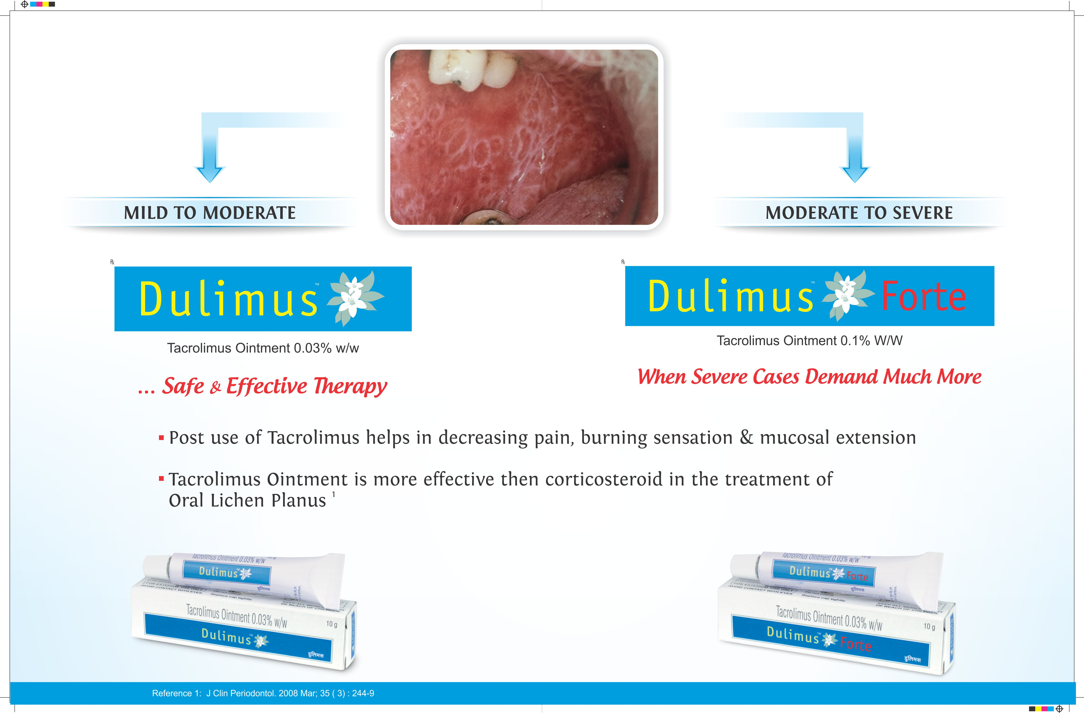


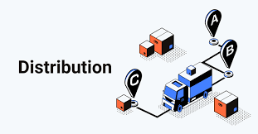
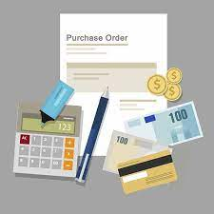


8 MODULES IN PHARMA MANAGEMENT
PRESENTED BY MANISH SARDANA ROLL NO. 0314
UNDER THE GUIDANCE OF DR. SUDHINDER SINGH CHOWHAN (UNIVERSITY MENTOR)
AND MR. KAPIL MUDLIAR {SALES AND MARKETING SPECIALIST (INDUSTRY MENTOR)}
History of NECS Pharma LLP
NECS Pharma LLP Started in 2019 under the leadership of Mr. Dave Rachit Bharat and Mr. Narayana Shankar Moorthy as API traders Pan India.
NECS Pharma LLP Initiated another Segment in 2020 as Stockist for Dupen Laboratories.
In April 2022 NECS Pharma LLP Overtakes Marketing rights of Dupen Laboratories and purchased 22 Brands and initiated own Marketing and Sales with 10 people staff in head office and 150 Sales Officers and Managers in Field (Uttar Pradesh, Bihar, Maharashtra, Chhattisgarh, Uttarakhand, West Bengal, Jharkhand)
This is one of the most exciting modules out of all the modules. In this module we give training to the field force (Includes Newly Joined Business Executive, existing Business Executive Area Business Manager (ABM), Regional Business Manager (RBM) in Lucknow (U.P). For 7 days (from 10 May 2022 to 16 May 2022) I trained around 70 people on 14 products, namely MOXUNATE-625, CEFTANECS, AMINECS, PIPTANECS, SOLECOOL DSR, SOLECOOL DSR, AZUNECS-250, AZZUNECS 500, DUFLOX-OZ, THERABACT-B3, PIGLOW-NXT, PAINTOL, PAINTOL-AP, PAINTOL GEL. There I trained them on the mode of action, indications, targeted doctors, and USP of the products.
After that part, I also took the products to each salesperson and prepared them for the field. We also took some quiz activities for their learning.
Training Field Force To Ensure Productivity Related To Profitability.
NECS Pharma LLP working with The Mission of “High-Quality Products at Affordable Price”.
MISSION
Visual Aid and Other Promotional Input with the help of Data
VISION
In this module with the help of the context provided, we have to make the PPT of the products and, with the help of the that ppt, we have to make the visual aid for the same. I was assigned the following products:
CALENE GEL
DULIMUS & DULIMUS FORTE
EVEDAY MOUTHWASH
PIPTANECS INJECTION
FBO GEL
THERABACT
GUMPEN
This PPT’s of the product covers about the Mechanism of Action, Basic drug knowledge, Targeted doctors, Indications, USP of the products.
With the Vision of “Good Health for Brighter Tomorrow”.
Organization Structure
1) Head Office Department
2) Field
PURCHASE
STORE
ACCOUNTS
MARKETING AND SALES
HR AND ADMIN
DISTRIBUTION
Leadership and Team Management.
150-Business Executive (Medical Representative)
25-Area Business Managers (ABM)
1-Zonal Business Manager (ZSM)
2-Regional Business Managers (RSM)
This module helps me to builds the Leadership and Team Management Quality. During the training part module, I lead the entire process from the front from there Training to detailing of the salesperson. And under the guidance of Mr. Tirthraj Zala (Group Product Manager in NECS Pharma) and My Mentor Mr. Kapil Mudliar (Sales and Marketing specialist in NECS Pharma) Me and My Colleague Mr. Amol Patil work as a team.
Brief Description About Pharmaceutical Industry
The pharmaceutical industry discovers, develops, produces, and markets drugs or pharmaceutical drugs for use as medications to be administered to patients (or self-administered), with the aim to cure them, vaccinate them, or alleviate symptoms. Pharmaceutical companies may deal in generic or brand medications and medical devices. They are subject to a variety of laws and regulations that govern the patenting, testing, safety, efficacy using drug testing and marketing of drugs. The global pharmaceuticals market produced treatments worth $1,228.45 billion in 2020 and showed a compound annual growth rate (CAGR) of 1.8%.
And In August 2021, the Indian pharmaceutical market increased at 17.7% annually, up from 13.7% in July 2020. According to India Ratings & Research, the Indian pharmaceutical market revenue is expected to be over 12% Y-o-Y in FY22.
Talent Retention And Acquisition and Process of Interview
In this module we learnt about how we take the talent retention and acquisition and how to conduct the interview, also we trained to the Sales officers how to pitch doctors how to detailed the products in front of doctors in Lucknow and from home through video calling.
Difference between Practical exposure and Theoretical Work
8 MODULES IN PHARMA MANAGEMENT
Enhancing Knowledge and Practical Exposure
At the initial stage of the internship, competitive analysis of 12 brands were done as a part of Market research where we visited stockist and chemists to learn about the PTS of each product, wherein in theoretical aspect we only had a gest about the market research, not the actual application to the field.
Helped the PMT team in the making of the visual aid, also learnt how to read it in front of a doctor, also Conducted Detailing of 34 products of the company for 70 Medical representatives with the help of visual aid, whereas in theoretical practice, we only had glance of the visual aid.
Created Product manual for the brands which in turn helped in the minute knowledge of the product containing the product’s USP, lifecycle, it’s betterment or it’s superiority as compared to other similar compositions or analogue of the product.
Communication with the marketing field was the major learning in the internship which was lacking in the theoretical manner.
1.
Competitive Analysis of Brands as per HO Instruction.
2.
Scientific data Crunching.
3.
Training field force to ensure productivity related to profitability.
4.
Visual aid and other promotional input with the help of data.
5.
Budgeting and planning on expenditure related to productivity.
6.
Talent retention and acquisition and process of interview.
7.
Leadership and team management.
8.
Brand plan and brand management skills to enhance brand value in market.
SWOT Analysis of Dulimus and Dulimus Forte
Strengths
First company to find the new indication of tacrolimus ointment to use in the treatment of Oral Lichen Planus
More economical as compared to other brands in the market.
Weakness
Less Field force to sale the product all over India.
Very less people are known to the product due to less advertising.
Competitive Analysis of Brands as per HO Instruction.
Competitive analysis in marketing and strategic management is an assessment of the strengths and weaknesses of current and potential competitors. This analysis provides both an offensive and defensive strategic context to identify opportunities and threats. In this module was we also find direct and indirect competitors of Each and Every product of NECS Pharma LLP.
So, I was assigned 12 products for which I had to find out potential competitors and list them in a tabular form separated in two groups of direct and indirect competitors.
FB-O
THERABACT
GUMPEN
EVEDAY
PIGLOW CREAM
DULIMUS
DULIMUS FORTE
CALENE GEL
PIGLOW NXT CREAM
AMINECS
PIPTANECS
CEFTANECS
Opportunity
As everywhere the no. of patients of Oral Lichens Planus increases every year a lot of opportunity will be there
Threats
Now, so many companies are selling this molecule for the same indication, and they have good field force and advertisement
Challenges Faced During Internship
Takes time to adapt the office environment, but eventually everything went aligned.
New lifestyle of being in corporate journey.
Sometimes, work goes overloaded, but somehow, I managed to complete on deadline given by Mentor
Usefulness of Internship
Understanding of:
Competitive analysis.
Pareto analysis.
Trained field force (Presentations of 34 products with help of Visual Aid).
Crunching of data.
How to Pitch to the Doctors for prescribing our Products.
How to Conduct Interview of Sales officers.
PowerPoint presentation and Visual aid making
Leadership and team management
Scientific Data Crunching And Working On Highlighting On Brand Lifecycle.
Suggestions
Focused on to Increase Field Force in the Organization
More Focused on Promotional Strategy
Focus more on to Catering with Doctors
In this Scientific data Crunching we learnt about how we can crunch the data from the big data excel sheets and what are the importance of the pareto analysis in sales how it works.

