Slide 1


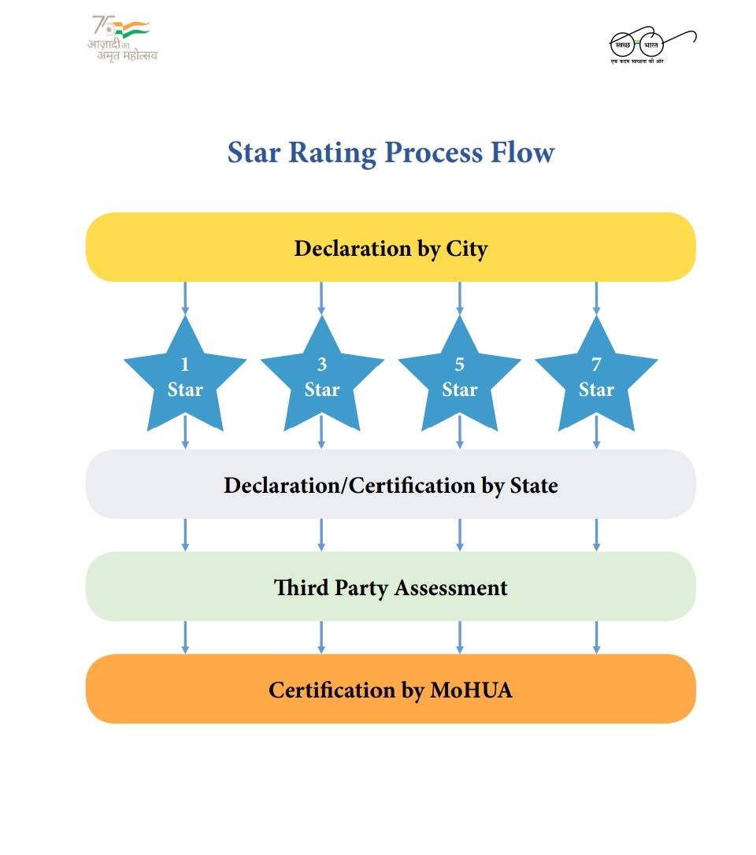
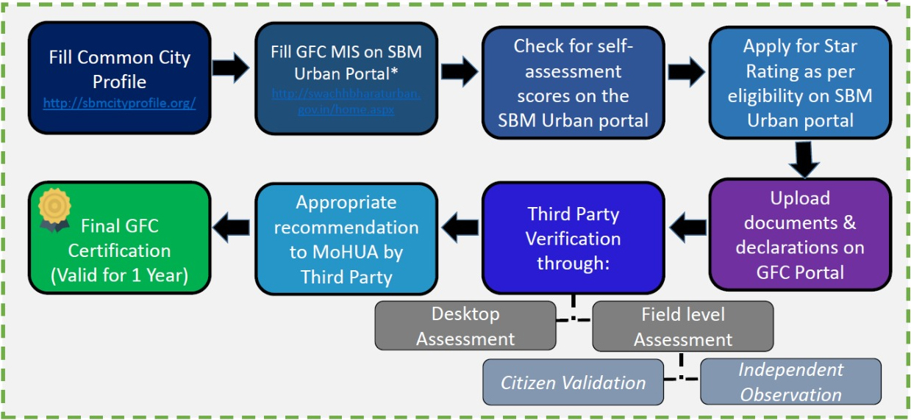
GARBAGE FREE CITY 2022 DESKTOP ASSESSMENT
Presented by : Mustafa
R. No : 0317 SPM - 13
Faculty mentor : Dr. Sudhinder Singh Chowhan
Industry mentor : Mr. Rashi Khare
Organization : IQVIA
INTRODUCTION
ORGANOGRAM
Swachh Bharat Mission (SBM), commonly referred to as Swachh Bharat Abhiyan or Clean India Mission, is a countrywide initiative started by the Indian government in 2014 to eliminate open defecation and improve solid waste management. This program was formally inaugurated on 2 October 2014 at Rajghat in New Delhi. India's largest-ever cleaning initiative, with 3 million government personnel and school and college students participating. The mission's goal is to have India free of open defecation in five years.
IQVIA is a massive worldwide leader of advanced analytics, technological solutions, and clinical research services to the life sciences sector, devoted to delivering unique ideas and real-time insights through intelligent connections.
VISION & MISSION- Imagine a world where advances in data science and human ingenuity come together to provide creative solutions to improve human health. Every challenge is seen as an opportunity to make a meaningful impact for customers, patients and people. Discover a career with purpose and help create a healthier world.
SENIOR PRINCIPLE
WASH HEAD(WATER & SANITIZATION)
SENIOR CONSULTANT
Acc. to this graph, there are 3 components in DA assessment Pass, Fail, and Query.
The graph shows that 67% pass city and 32% query & 1% fail city acc. to this graph.
Madhya Pradesh has a maximum number of the passed city during DA assessment.
ASSOCIATE CONSULTANT
RESEARCH ASSOCIATE
EXTERNAL CONSULTANT
INTERNS
FIELD ASSESSORS
ABOUT PROJECT
As a commemoration of Mahatma Gandhi's 150th birth anniversary, the Government of India (GOI) announced the Swachh Bharat Mission (Urban) [SBM (U)] to guarantee cleanliness, waste management, and sanitation across the country. The Ministry of Housing and Urban Affairs is implementing SBM (Urban) (MOHUA)
Nearly 3597 localities participated in the recently completed Garbage Free Cities accreditation exercise.
SWOT ANALYSIS
STRENGTH:
Raise awareness about cleanliness and its relationship to public health.
Strong information and training programs to improve waste management in the division.
WEAKNESS:
Poor dumping management.
Insufficient waste infrastructure(waste bins, collection & transfer vehicles).
OPPORTUNITIES:
Waste disposal using biogas/gobar gas plants/domestic biogas plants.
People’s concern about waste problems.
THREATS:
Insufficient attention to promoting environmental research.
LEARNING & VALUE ADDITION
CERTIFICATION BY (MOHUA. )
Networking Opportunities
Boost Self-Confidence
Gain the Real Work
Experience.
D. Enthusiasm is invaluable
CHALLENGES
USEFULNESS OF INTERNSHIP
There is far too much labor.
Time management.
Competition with other interns.
Understanding the office culture.
Cultivate adaptability and creativity in a dynamic world.
Ease the transition from being a student to entering the workforce.
Have hands-on opportunities to work with equipment and technology that may not be available on campus.
Gain exposure to real-world problems and issues that perhaps are not found in textbooks.
Interns

