Slide 1



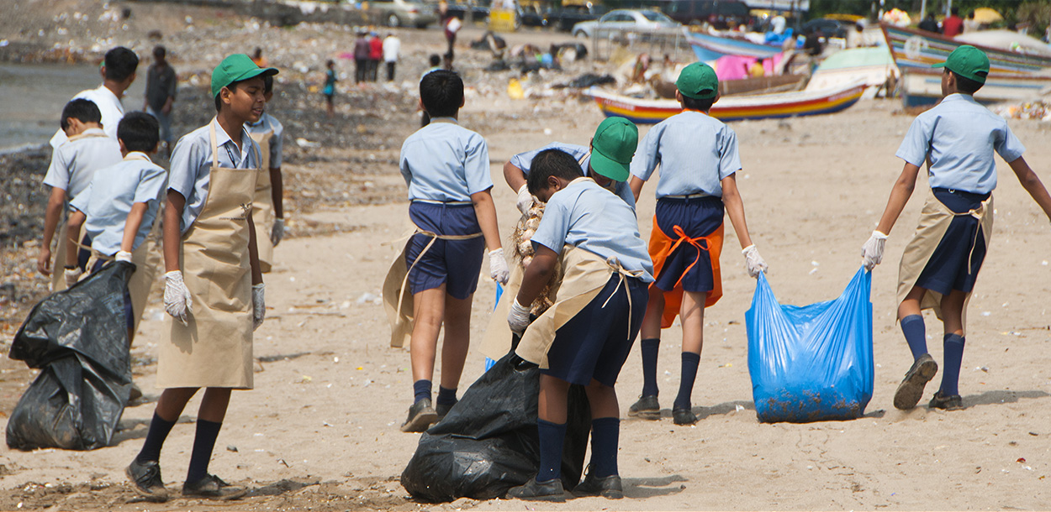
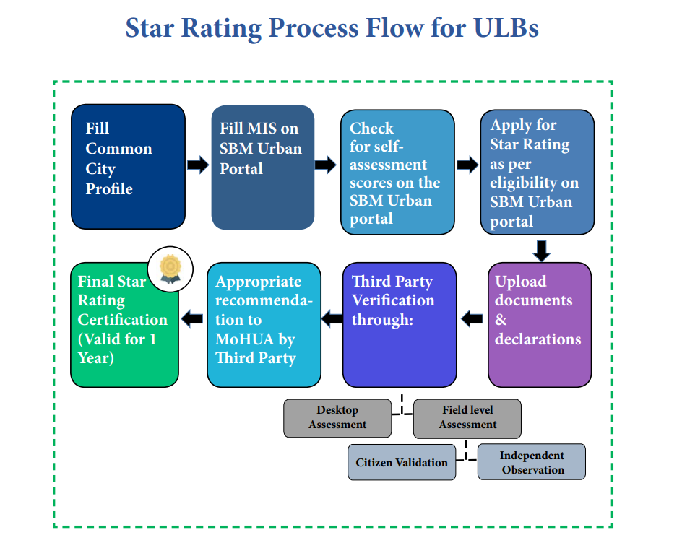
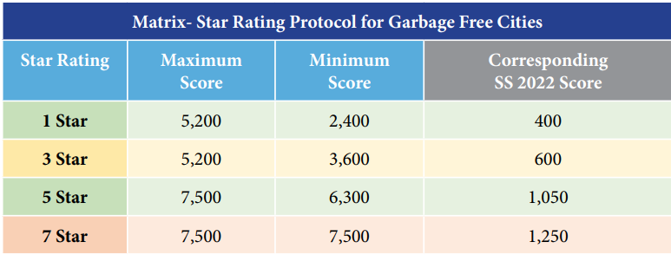
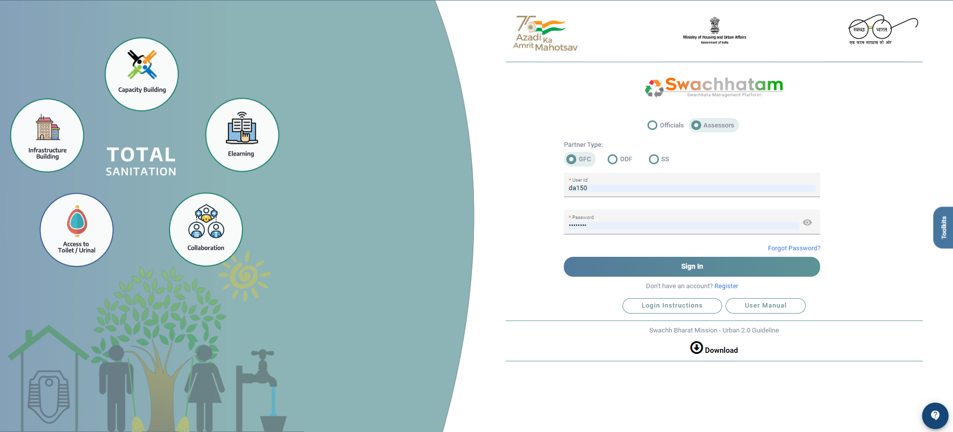
GARBAGE FREE CITY 2022 DESKTOP ASSESSMENT
Swachh Bharat Mission Project in Association with MoHUA
Presented By : Muzammel Ali Ahmed Roll No: 0318 Stream: PM 13
Faculty Mentor : Dr. Sudhinder Singh Chowhan
INTRODUCTION
IQVIA, formerly Quintiles and IMS Health, Inc., is an American multinational company serving the combined industries of health information technology and clinical research. IQVIA is a provider of biopharmaceutical development and commercial outsourcing services, focused primarily on Phase I-IV clinical trials and associated laboratory and analytical services, including consulting services. It has a network of more than 88,000 employees in more than 100 countries and a market capitalization of $49 Billion as of August 2021. As of 2017, IQVIA was reported to be one of the world's largest contract research organization.
Our Mission
Our Mission is to help create a healthier world . We believe by accelerating innovations and making intelligent connections across the healthcare ecosystem, we can make exponential progress.
Our Vision
We deliver integrated information and technology solutions to drive healthcare forward. Our industry is working to improve real-world patient outcomes through treatment innovations, care provision, and access to healthcare. For the information, technology, and service solutions they need to drive new insights and approaches, they rely on us. Our team harnesses insights, commercial and scientific depth, and executional expertise to empower clients to achieve some of their most important goals: Improving clinical, scientific, and commercial results. Realizing the full potential of innovations. And, ultimately, driving healthcare forward.
GFC STATUS
LEARNING AND VALUE ADDITIONS DONE DURING INTERNSHIP:
Professional communication with the HR, heads of the project, and other core team members and seniors.
New and improved technical skills for live project
Organizational behaviour
Time and traveling management
ORGANOGRAM
SENIOR PRINCIPLE
USEFULNESS OF INTERNSHIP
WASH HEAD(WATER AND SANITIZATION
Familiarize with working environment
Swachh Bharat Mission:
The Swachh Bharat Mission (SBM) was launched in 2014 to fulfil the vision of a cleaner India by 2 October 2019, as a tribute to Mahatma Gandhi on his 150th birth anniversary.
The campaign is one of the biggest-ever drives to accelerate efforts towards achieving universal sanitation coverage, improving cleanliness and eliminating open defecation in India. The Mission comprises components such as the construction of individual household toilets, community and public toilets, and solid and liquid waste management, etc.
SENIOR CONSULTANT
Help to build and expand professional network.
ASSOCIATE CONSULTANT
An internship experience creates a positive impact on resume
RESEARCH ASSOCIATE
Boosts confidence level
EXTERNAL CONSULTANT
Receive financial compensation
GFC:
The Swachh Bharat Mission includes garbage-free city certification, which is offered to cities after both a desktop and field assessment, based on the documentation presented and field assessment scores, certification is then issued by the MoHUA.
INTERNS
FIELD ASSESSOR
SWOT ANALYSIS
STRENGTHS
Good waste management system.
Availability of basic , supporting and environmental protection facilities for community and visitors.
Future vision of the country
WEAKNESSES
Some poor quality of operational human resources.
Poor dumping management.
OPPORTUNITIES
Local government supporting for landfill improvements.
Waste management through biogas/ gobar gas plant/ domestic biogas plants.
THREATS:
Low budget or financial support for operational facilities.
Uncertain political effect to management assembly.
Change the mindsets of the people.
MY ROLES IN DA:
IQVIA is the technical consultant for the Swachh Bharat Mission (Urban) under the Ministry of Housing and Urban Affairs for conducting an on-ground assessment of Star Rating for Garbage Free Cities and Open Defecation Free Protocols.
I was working as a desktop assessor in the GFC team of the project. Individual Id was provided by the core team members and then cities of different states were allotted on my user Id which I needed to check and query them if there were any irrelevant or no documents that were provided. We need to check 16 components for 1-star and 3-star certifications and 24 components for 5- star and 7- star certifications.
CHALLENGES FACED DURING INTERNSHIP:
Difficulty in traveling due to relocation of the office.
Sometimes multiple tasks were given to complete within the allotted time.
Afraid to ask questions.

