Slide 1


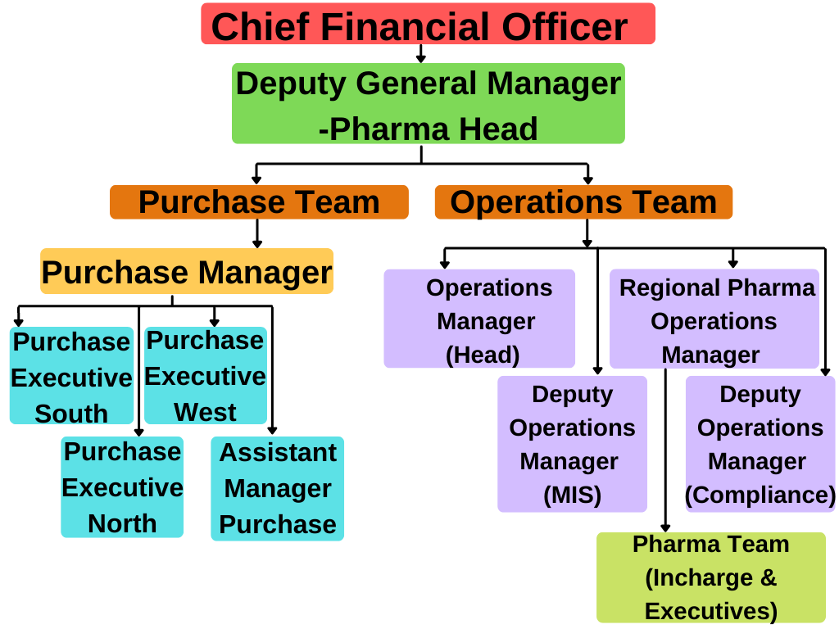
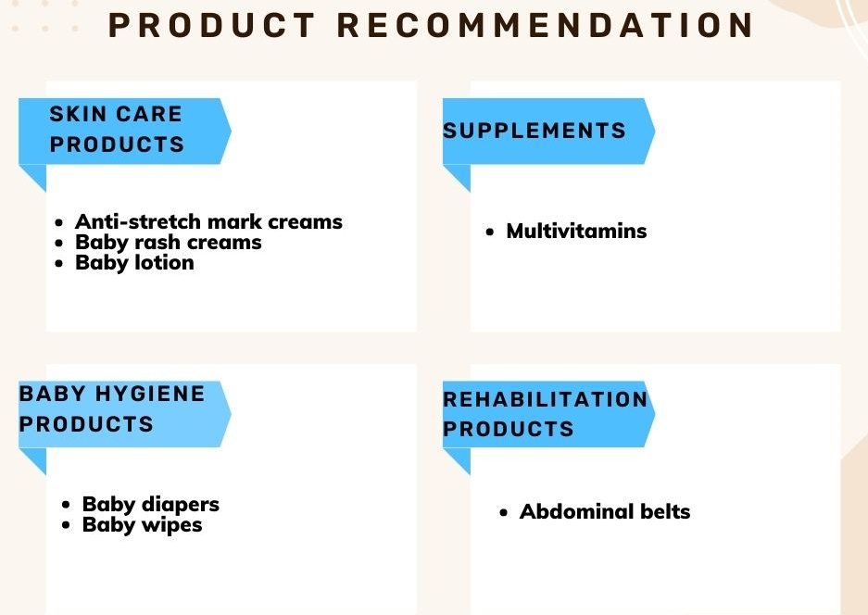
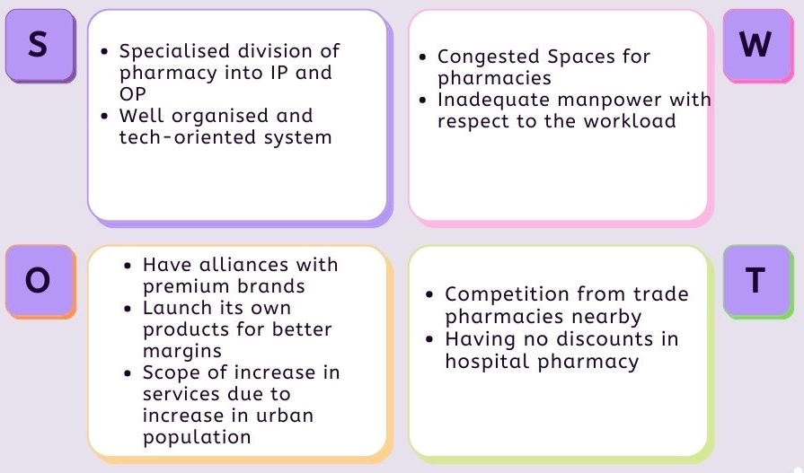
PERCEPTION MAPPING OF TARGET AUDIENCE AND
EVALUATION OF PRODUCTS FOR LAUNCHING
AS PRIVATE LABEL BRANDS FOR CLOUDNINE
Presented By : Niyati Talwar MBA PM 13
Mentor : Mr. Tridip Chatterjee,DGM-Pharma, C9 Hospital
Dr. Sudhinder Singh Chowhan, IIHMR University , Jaipur
Due to different ideation and upbringing, the international market cannot be compared to the Indian market. As a result, the approach to pregnancy is likewise unique. Customers demand high-quality products at reasonable pricing.
The Indian people consider their expenditures and are price sensitive.
Customers in India have product requirements, many of which are unmet by most companies. This creates a market gap between what customers want and what businesses are willing to provide.
Focusing on addressing these gaps in the market gives an opportunity to grow in this industry.
Understanding the concept of private label brands.
Research Type – Descriptive research including exploratory survey
Data Collection – Primary & Secondary data
Measurement Technique –Extremely structured questionnaire
Sample selection – Cloudnine Group of hospitals , Trade pharmacies
Sample Size ( North ) – 349
Sampling Technique- Purposive Sampling
Competitors were taken into consideration and STP of products , pricing , packaging ,Sourcing of products Inventory management system was done
Bengaluru,Karnataka based Cloudnine Group of Hospitals is a chain of maternity, childcare, and fertility hospitals .
Founded by neonatologist Dr. R Kishore Kumar.
Seeing crowded, unhygienic government hospitals and poorly run private nursing centres in the country, Dr. Kumar and his team of three co-founders decided to focus on providing quality newborn care.
LEARNING & VALUE ADDITIONS
CLOUDNINE
To be the kind of leader in the space of women and health that India has not witnessed yet, by providing premier quality healthcare to women and children.
MISSION
Our aim is the pursuit of excellence in providing the best maternal and neonatal care by setting higher standards for ourselves and striving constantly to achieve them..
VISION
ORGANIZATION STRUCTURE
.
The subjects which are a part of curriculum were applied based on the knowledge which gave a wide explanation on subjects like research methodology , epidemiology , financial management, pharmaceutical marketing and organization behaviour & their applications.
DATA ANALYSIS - DOCTORS
OUTCOMES
To travel all across the centers in north region .
To influence trade pharmacist to fill out the survey.
CHALLENGES
On the basis of analysis of the data from the target audience , a list of product recommendation was made for the organization to launch as private label brands..
Parameters like pricing , packaging , low cost , easy procurement , high margin & value were considered during analysis.
SUGGESTION
India is the second most populous country with a population of 1.3 billion people. It also contributes to largest youth population in the world.
The current birth rate for India in 2022 is 17.163 births per 1000 people, and in 2021 it was 17.377 births per 1000 people.
Driven by the Government’s push and unmet need of Indian parents, the Healthcare sector has witnessed the rise of specialty care delivery models focused on mother and childcare. The market is estimated to be more than INR 15,000 crore and is expected to grow at a CAGR of 15% over the next few years.
According to the National Foundation for Health Statistics, 47.4 percent of newborns delivered in the private sector are born through C-section, compared to 14.3 percent in government institutions. According to the National Family Health Survey, the national C-section rate is 21.5 percent, which is higher than the World Health Organization's "ideal" rate of 10-15 percent.
BRIEF DESCRIPTION ABOUT MATERNITY & CHILDCARE
SWOT ANALYSIS

