Slide 1


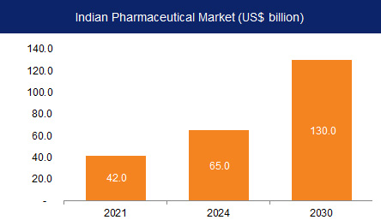
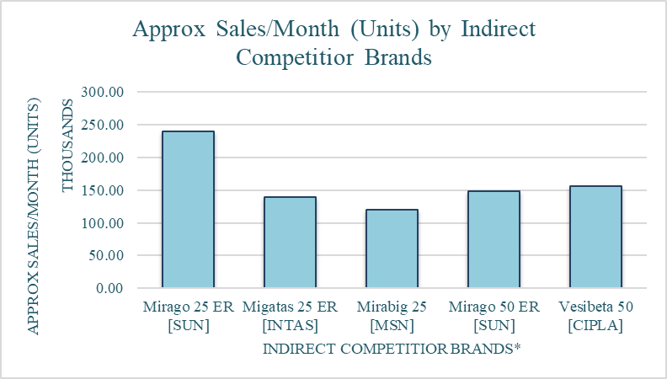
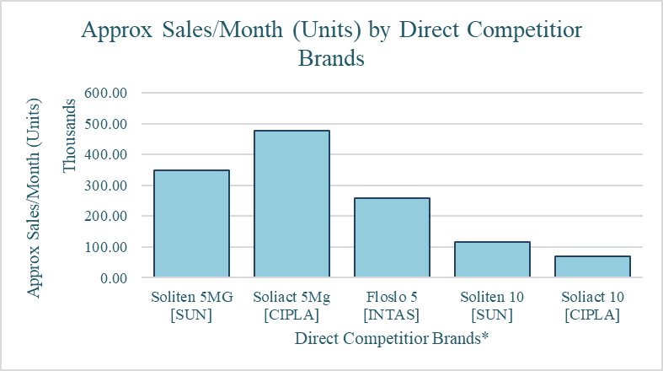

BRAND PLAN OF “Solifenacin”
Name- Piyush Shukla / Roll No.- 0323
Stream- MBA PM 13
Faculty Mentor- Dr. Ashok Peepliwal
Industry Mentor- Mr.Tavinder Jit Singh Vasudeva
Micro labs was incorporated on 7th September 1973. Micro Labs Limited's operating revenues range is Over INR 500 cr. It is a multifaceted healthcare organization with a proficient marketing team. Have manufacturing facilities and R&D centres that are with international standards. It is ranked 14th among prescriptions by SMSRC and 19th in sales as per AWACS Mat. The company is well known for its brand “DOLO” while the portfolio includes some of the topmost brands in various specialities like Cardiology, Diabetology, Anti-infective , Ophthalmology, Pain, etc,. The company’s domestic market share is around 2% while it is among top 5 players in liver-therapy and in Oral Anti-diabetic segment. The company is placed 11th in the Cardiovascular product division. Around 60% of the company’s domestic revenue is from Chronic segment. This financial year company’s export sales grew by about 35% while the domestic sales were moderate at 5% because of lower prescription-based sales due to COVID.
Micro labs desires to not just be the best, but a leader in the development, manufacturing and sales of premium pharmaceutical products. Micro labs wish to manufacture medicine of the highest standards and market it at affordable price across the globe.
Micro labs aspires to deliver value through high-quality pharmaceutical products and to build brands across the therapeutic segments.
Micro Labs has Hierarchical Organization structure i.e., Top to bottom. Employees are grouped with every employee having one clear supervisor.
The pharmaceutical industry in India was valued at an estimated US$42 billion in 2021.
India is the world's largest provider of generic medicines by volume, with a 20% share of total global pharmaceutical exports.
It is also the largest vaccine supplier in the world by volume, accounting for more than 50% of all vaccines manufactured in the world.
\
Cost efficiency
High economic growth along with increasing penetration of health insurance to push expenditure on healthcare and medicine in India.
Policy Support
Increasing investment
MICRO LABS LTD.
PHARMACEUTICAL INDUSTRY
VISION
VISION
Advantages in India
Advantages in India
ASPIRATION
ASPIRATION
ORGANIZATION STRUCTURE
Used in the treatment of overactive bladder [OAB].
Is an anticholinergic.
Works by relaxing muscles of the urinary bladder to prevent. frequent, urgent or uncontrolled urination.
The elimination half-life is 45 to 68 hours.
Dose- 1 od
Formulation- tablets.
Target specialty – urologists.
1 in 6 Over age of 40 is suffering from OAB says urologists.
30% Men's lives with symptoms of OAB.
40% Women's lives with symptoms of OAB.
ORGANIZATION STRUCTURE
PRODUCT PROFILE
DISEASE PREVALENCE
MARKET SURVEY
Government in India is stable, unlike in Afghanistan.
Growing focus of the government toward pharma in India is a positive sign.
Capital expenditure in pharma is increasing.
Healthcare spending by citizens in India is increasing.
The population is getting older and specifically, this drug is more related to the old age people.
Digitalization has made it easier for marketing campaigning.
Increase in E-pharmacy and this sector is supposed to grow more.
The industry is highly regulated which makes it more important to be extra careful in every aspect of the drug.
Low wages in India allowed for manufacturing the drug at cheaper rates.
There are ideal climatic conditions in India for pharma manufacturing plants.
PESTLE ANALYSIS
POLITICAL
SWOT ANALYSIS
POLITICAL
Current population of India 138cr.
Current adult population 18-64 is 87cr.
Health expenditure of India is 1.3% of GDP & growing by 2.5% by 2025.
Health insurance covers 70crs.
Increase in healthcare expenditure will increase awareness.
Due to health insurance patient spending toward diagnosis and treatment will increase.
STRENGTH | WEAKNESS
Dosage is OD Cheap Price Present in both 10mg and 5mg combination Sales force | Less market share.
OPPORTUNITY | THREAT
Can be given in combination with mirabegron to achieve more effectiveness. Market is increasing Health expenditure is increasing by 2.5%. | Presence of large options. Market players.
ECONOMICAL
MARKET TRENDS
ECONOMICAL
SOCIAL
SOCIAL
BUSINESS IMPLICATIONS
BUSINESS IMPLICATIONS
TECHNOLOGY
TECHNOLOGY
POSITIONING
Literature
Webinars
Customized inputs
Brand Campaigns
Customized diary
Customized pens
Customized Millville rose
CAMPAIGN
SALT NAME- “Solifencine”
INDICATION- “Overactive Bladder”, related to frequent Urination.
Almost every brand present in the market is related to the salt. So, I would suggest the name to be related to the indication and the effect it will create.
BRAND NAME – “UROLAX”.
Prefix- “URO” – Urination.
Suffix- “LAX”- Relax.
ELEMENTS | DETAILS
Brand Name | Urolex
Market Definition | Anticholinergic
Customer Target | Urologist, Diabetologist & Consultant physicians.
Insights | Provides Relieves from frequent urination
Brand Essence | Inhibits smooth muscle and detrusor muscle contraction around the bladder.
Competitive advantage | Cheaper Price
Supporting Evidences | Solifenacin: treatment of overactive bladder by Kim Chilman-Blair 1, J L H R Bosch. The emerging role of solifenacin in the treatment of overactive bladder by Robinson D, Cardozo L.
Brand positioning summary statement | Solifenacin is a competitive muscarinic receptor antagonist, has highest affinity for M3, M1, M2 muscarinic receptors. Its antagonism prevents contraction of detrusor muscle, while antagonism of the M2 receptor prevents contraction of smooth muscles.
Key Message | Inhibits smooth muscle contraction around the bladder and relieves from frequent urination.
COMMUNICATION TO DOCTOR’S
BRAND NAME
COMMUNICATION TO DOCTOR’S
LEGAL
LEGAL
PROPOSED INPUTS
ENVIRONMENTAL
SAMPLE FLYER
While my time with micro labs the most important thing which I noticed was while the theory gives you a deeper understanding of a concept through seeing it in the context of understanding the “why” behind it, it gives you the insights from the experience of other’s.
While, Practical makes you capable enough to know how things happen in the real world, this practical experience made my understandings of concepts deeper and clearer as because I was able to understand things through my personal experience
My most challenging task was completing market research since respondents didn’t want to share their data, their prices and didn’t have the time to get the data out. This, was for me my most important learning; how one needs to approach.
As I worked at Micro Labs, time management was another challenge. I had to complete all my work within limited timeframes, which was another learning experience for me.
As for me, I felt after working with micro labs that it made me realize how important theoretical exposure and learning are.
Additionally, this training made me more aware of the dynamics of the real corporate world and how flexibility, planning, and consistency are crucial to success.
Difference between practical and theoretical exposure
CHALLENGES FACED
USEFULNESS OF INTERNSHIP
During my market research, I learned that most doctors are moving toward "Merabegron" over "Solifenacin" due to its better response and fewer side effects, While I found certain prescriptions having both the molecules prescribed, When I talked to the doctors prescribed them, I found out that both the molecules when taken combined [25 or 50 mg Merabegron and 5 or 10 mg Solifenacin] showed better results than the individual drugs. Also, when I delved deep into this practice, I found out certain research papers claiming this to be right. Prescribing both molecules made prescription expensive, Also, Two tablets at a time for similar indication. So, my suggestion to micro labs would be, What if we invest into the R&D and try to make a single drug having both molecules in right quantity. As because both the molecules showed better efficiency while taken together. Also, This drug can be positioned as highly effective as well as cost effective and easy to use for the patient.
LEARNING OUTCOME AND RECOMMENDATIONS

