Slide 1


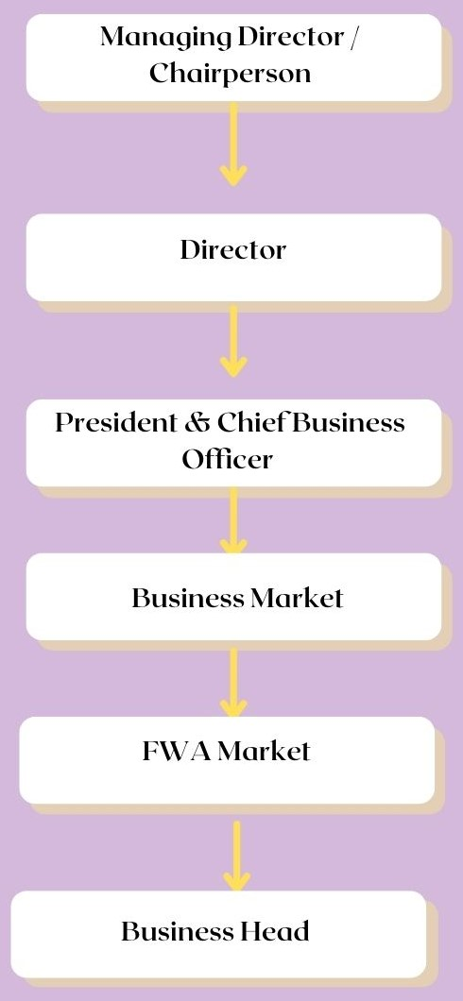
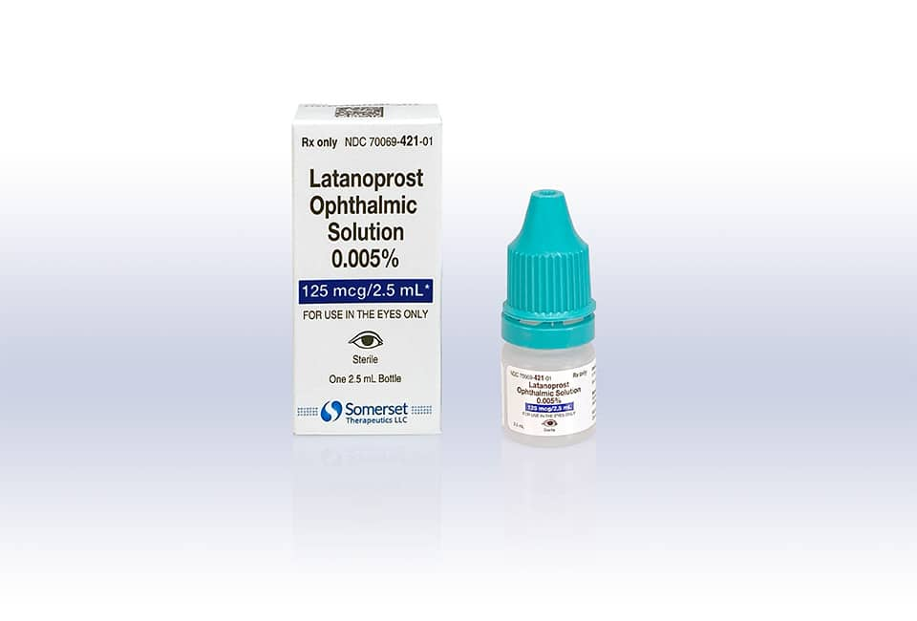
BRAND PLAN AND MARKETING STRATEGIES OF LATANOPROST SOLUTION IN MICRO LABS LTD.
BY-PRINCE RANA-MBA PHARMACEUTICAL MANAGEMENT ROLL NO-0328
UNDER THE GUIDANCE OF –DR.ASHOK PEEPLIWAL
NAME OF ORGANIZATION MENTOR- MR. TAVINDER SINGH
ORGANIZATION NAME- MICRO LABS LTD.
INDUSTRY SECTOR PROFILE
HISTORY
VISION AND ASPIRATION
ORGANIZATION STRUCTURE
DESCRIPTION ABOUT THE INDUSTRY
In 1993, Micro labs was founded by late shri G.C. Surana to manufacture ethical pharmaceutical products with a manufacturing facility in Chennai.
In 1982 , Company established a second manufacturing unit at Hosur, Tamil Nādu
In 1999, Micro labs established a new manufacturing unit-Micro nova pharmaceuticals ltd, at Pena industrial area, Bangalore.
In 2011, Micro labs US was incorporated in the year 2011.
The company later become the majority stakeholder in RA chem pharma.
Our vision is to built around a desire not to be the best, but a leader in development, management, sales of premium pharmaceuticals products.
We wish to raise the flag of micro labs in India as well as in Abroad.
Micro labs is dedicated to manufacturing medicine of the higher standard and the marketing if it affordable prices across the globe.
It is a multi-faceted healthcare organization with a proficient-marketing team, state of the art manufacturing facilities, R&D center that are at par with international standards.
Major products- Dolo-650, Amlong, Duprex, Diapride ,Avas , Tripride, Bactoclav, Tenepride-m, Arbitel.
Company is ranked 19th amongst all pharmaceutical companies in INDIA as per AWACS 2021 retail audit and is ranked 14th as per prescription audit by SMRC 2021
“BECAUSE HEALTH IS IN SMALL DETAILS”
LEARNING AND VALUE ADDITION
BRAND PLAN FOR LATANOPROST OPTHALMIC SOLUTION IN MICRO LABS LTD. AND MARKET RESEARCH OR STARTEGIES
PRODUCT FACT PROFILE
MARKET STRATEGIES
POSITIONING
PESTEL ANALYSIS ON LATANOPROST
It include ocular hypertension and open angle glaucoma
Latanoprost is in a class of medication called prostaglandin analogy.
It is an ophthalmic solution and used to treat glaucoma ( a condition in which pressure increase in eye and lead to gradual loss of vision)
Half-life of latanoprost is 17 minutes ( plasma)
Latanoprost , sold under the brand name, XALATAN.
It was approved for medical use in united states in 1996. It is also available in generic medication.
It was 77th most prescribed medication in united states with more than 9 million prescriptions.
Dosage- In still 1 drop(1.5mg) ( once daily in evening).
Speciality- ophthalmologists
We can create market strategies like conduct the campaigns and provide incentive to employee for completing the target.
We can provide the promotional inputs to small business creator like, retailers as well as stockists and provide some gifts to our customers like doctors and nurse’s staff.
Latanoprost market size and analysis maintain enhanced dynamics and is overshadowed by a to player across the globe.
Consumption market share by each product type is provided in the repo
We can also look up the competitor of the brand and hit on the target.
We can train our business executive to make a plan and should implement on it.
ELEMENTS. | DETAILS
BRAND NAME | LATANOPROST OPTHALMIC SOLUTION
MARKET DEFINITIONS | OCCULAR HYPERTENSION
CUSTOMER TARGETS | OPTHALMOLOGI-STS
INSIGHTS | MEDICINE THAT TREAT HIGH PRESSURE UNDER THE EYE
METABLOSIM | ACTIVATION BY ESTER HYDROLOSIS
DURATION OF ACTION | >24 HRS
Economic condition is quite descent.
Government can make available of the product at cheap rate, so it can be benefit in rural areas.
It also hit the economy factor of the product and may be a plus point for increasing the sales.
When people know the product and make them desire for own, then they can also share or tell products benefits to the neighbor as well.
Uses of new technology in the product also increase the segment like the product available in drops we can also launch the products in ointments.
SWOT ANALYSIS
STRENGHT -DOSAGE IS OD -IT IS STERILE ,ISOTONIC, BUFFERED | WEAKNESS -HIGH COST
OPPORTUNITIES -MARKET INCREASING -LESS COMPETITOR | THREAT -IRIS PIGMENTATION -EYELASH DARKENING -INTRAOCULAR INFLAMATION
PRACTICAL AND THEORITICAL EXPOSURE
DISEASE PREVALENCE
Subjects like market research, pharmaceutical marketing were implemented on practical grounds which are a part of syllabus.
Gained practical knowledge of how a product revolves around a market.
Check up on the brand equity and its sourcing
Prevalence of OSD in glaucoma patient is high, with estimate ranging from 39% to 59%.
Mean age is 62.1,62.3, and 63 years respectively and 50%,40.5%, and 38.9% were made.
CHALLENGES FACED
SUGGESTION
In my learning phase of the internship, I learned how to manage the time.
And, I also learned that never wait for the opportunity you have to grab it.
Always take the initiatives.
I also learned that don’t wait for the time to come to done the work, because it will be overloaded keep going on daily basis and then it will be easy for you to complete the work on time
On the basis of analysis of the data from the target audience, a list of product recommendation was made for the organization to launch as private label brands.
Parameters like pricing, packaging ,low cost ,easy , procurement ,high margin & value were considered during analysis.

