Slide 1



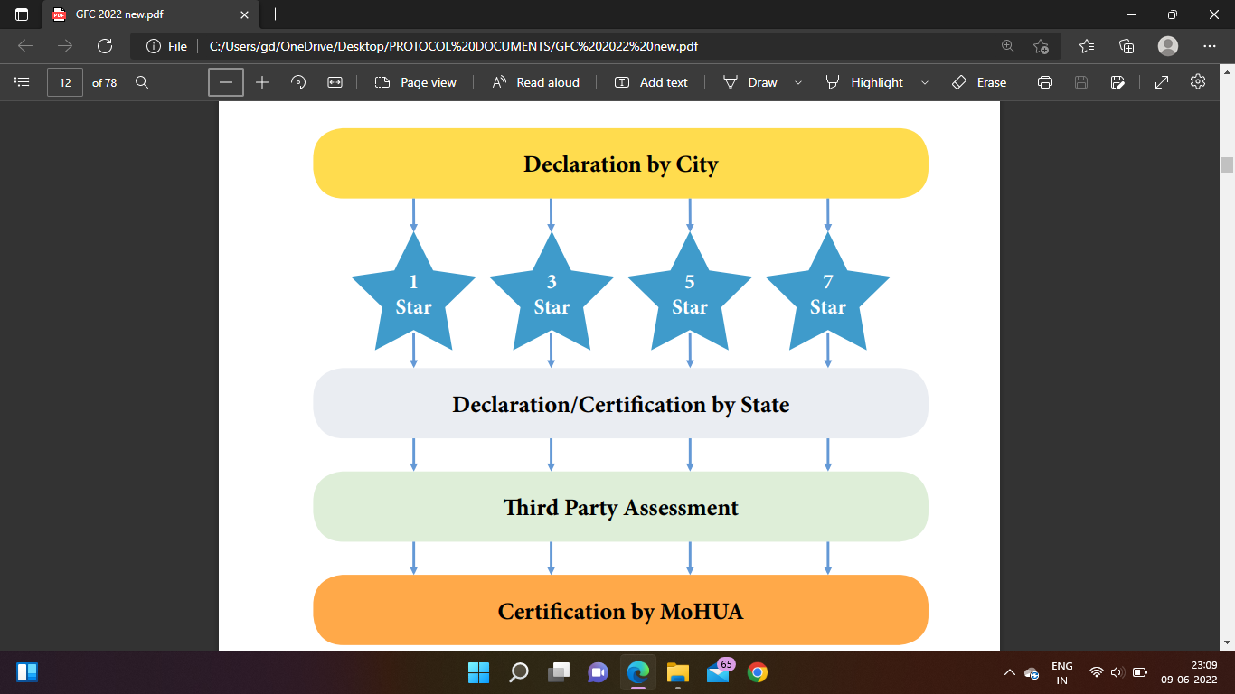
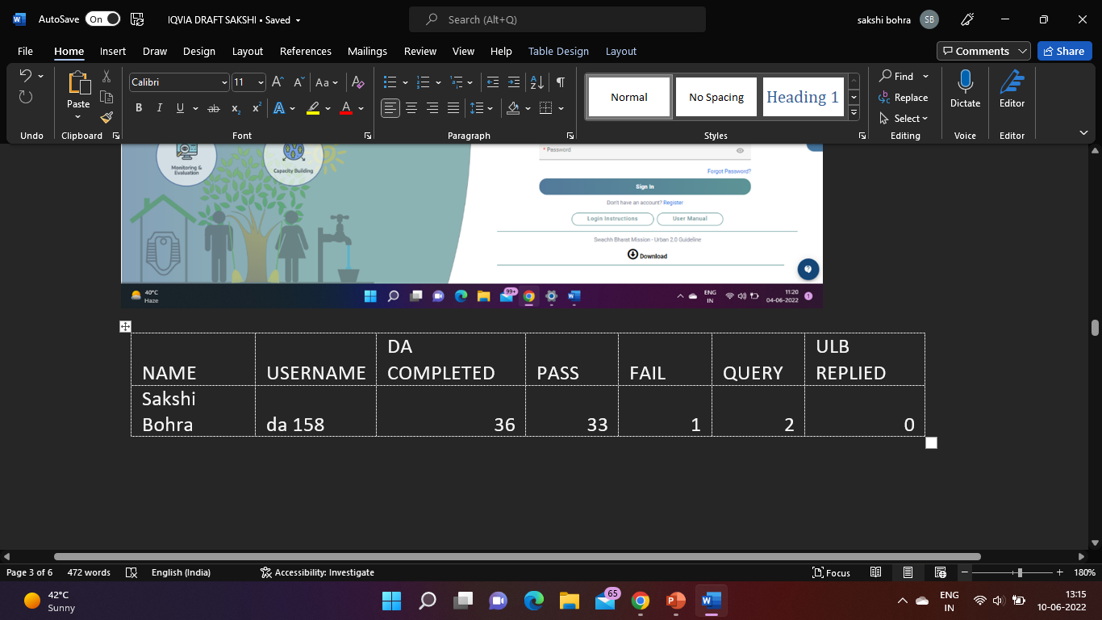
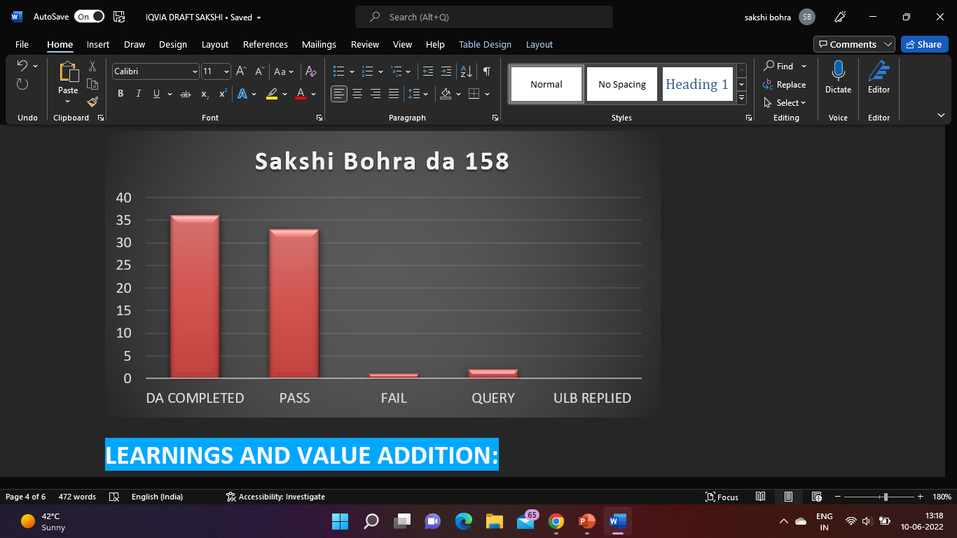
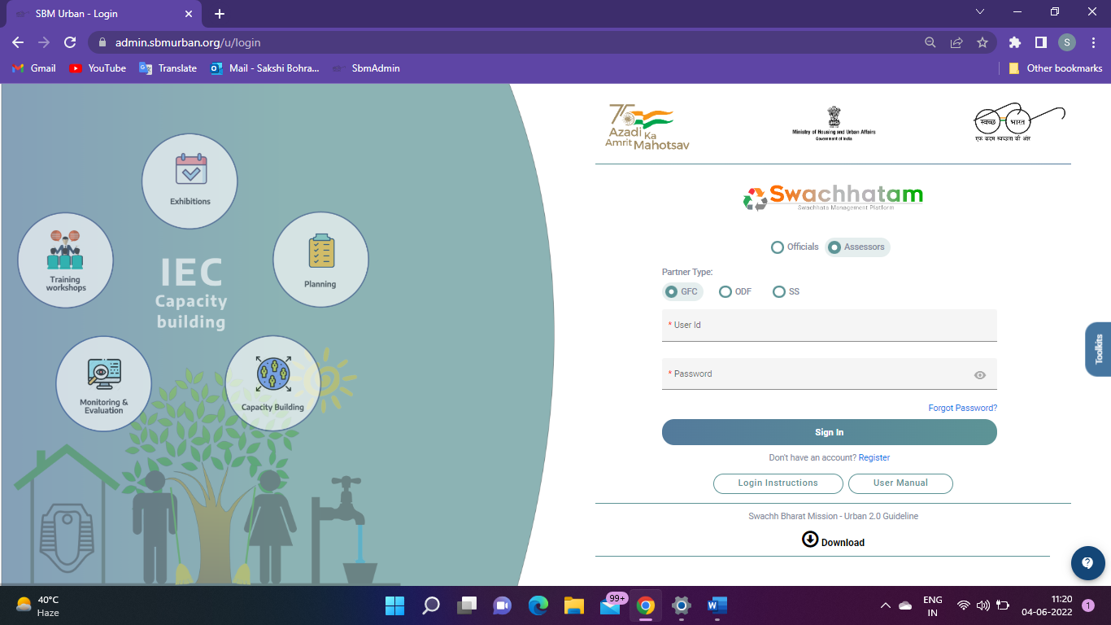
DESKTOP ASSESSMENT OF GARBAGE FREE CITIES
Name: Sakshi Bohra Roll No.: 0334 Stream: Pharmaceutical Management
Name of Faculty Mentor: Dr. Sudhinder Singh Chouhan
Name of Industry Mentor: Rashi Khare
VISION AND MISSON:
BREIF HISTORY OF IQVIA:
IQVIA ORGANOGRAM
DIFFERENCES BETWEEN PRACTICAL AND THEORTICAL EXPOSURE:
IQVIA brings together advances in data science, technology, and healthcare expertise to help customers make better decisions and ultimately improve patient outcomes.
Our mission is to help create a healthier world. We believe by accelerating innovations and making intelligent connections across the healthcare ecosystem, we can make exponential progress.
In 2016, Quintiles and IMS Health converged to create an entirely new organization capable of serving the healthcare industry like never before.
Senior Principal
Wash head( Water and Sanitation)
Senior Consultant
Associate Consultant
Research Associate
External Consultant
Interns
Field assessor
Listening to full-time employees/ seniors/ mentors and learning from them.
Providing assistance without overburdening full-time personnel.
Making sound decisions. Don't tell your non-working friends about the company's secrets. Don't break the rules, and so forth.
Creating a network, the chance to meet people from all throughout the company.
Got a Taste of the Field I've Selected.
Professional behaviour.
Confidence build-up.
Theoretical learning is what the knowledge is about, and the practical application is how the knowledge learnt needs to be implemented in certain real-life situations. The mode of practical application along with theory gives everyone a clear explanation about the facts.
STAR RATING PROCESS:
ABOUT PROJECT:
LEARNING AND VALUE ADDITION:
SWOT ANALYSIS:
STRENGTHS:
Relevant & unique content
User-friendly design
Quick sign-up and check-out process
Good hosting service
WEAKNESS:
Poor content and images
Long subscription process
Poor mobile optimization
Poor hosting service
OPPORTUNITIES:
New technology
Innovative marketing strategies
New design trends to better communicate messages
THREATS:
New entrants
Poor government policies
Software privacy
Fraudulent activities
The Swatch Bharat Mission-Urban adventure, which began in 2014, has assisted India in setting and achieving new Swatchhata goals. In order to institutionalise a mechanism for cities to achieve Garbage Free status and to motivate cities to achieve higher degrees of cleanliness, the protocol for star rating of garbage free cities was launched in January 2018 (and has been conducted every year since) in order to establish a mechanism for cities to achieve Garbage Free status and to motivate cities to achieve higher degrees of cleanliness. Cities' desires to improve their "swachhta" standards are reflected in the star rating process.
WORK REPORT:
CHALLENGES FACED DURING INTERNSHIPS:
You're afraid to ask questions
Supervisors forget that you're new to the field
There's competition with other interns
Not used to corporate life (10am to 6pm)
It's a new lifestyle
Workload was more as it was all new to us.
SUGGESTIONS:
Never be fully satisfied with the success.
Resolving SBM portal glitches
Make better intelligent connections between its needs, and our capabilities.

