Slide 1
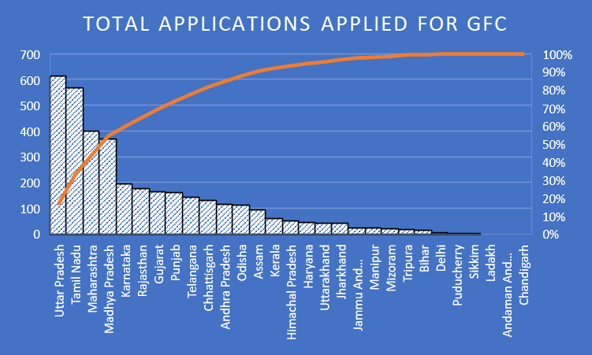


Garbage Free City ( GFC) 2022 Desktop Assessment ( DA) and Quality Check ( QC)
INTRODUCTION
Strength
SWOT ANALYSIS
Weakness
Swachh Bharat Mission (SBM), Swachh Bharat Abhiyan, is a country-wide campaign initiated by the Government of India in 2014 to eliminate open defecation and improve solid waste management. It is a restructured version of the Nirmal Bharat Abhiyan launched in 2009 that failed to achieve its intended targets
Funding provisions , technological innovations and flexibility to states in implementation of program
Toilet construction without demand generation , caste system , the political system , voluntary nature of campaign instead of compulsory and less focus on other aspects of sanitation
IQVIA is a world leader in the healthcare sector offering advisory, data, technology and advanced analytics services. IQVIA through its various engagements across the world is enabling a more modern and effective healthcare system and creating breakthrough solutions that transform business and patient outcomes
Vision And Mission
Opportunities
Threats
Vision - Ensuring hygiene, waste management and sanitation across the nation, as a tribute to Mahatma Gandhi on his 150th birth anniversary, to be celebrated in the year 2019. SBM (Urban) is being implemented by the Ministry of Housing and Urban Affairs (MoHUA).
Waste management through biogas providing scientific and visual proof of transmission of diseases
Change in administration , recycling solid waste to change the mindset of the people
The mission focuses on improving the levels of cleanliness through Solid Waste Management activities.
Uttar Pradesh 2022 status in SBM 2.0
SBM ORGANOGRAM
Learning And Value From Internship
Challenges faced by Internship
Theoretical Knowledge
Practical knowledge
Senior Principle
Wash and sanitization head
Senior consultant
Associate consultant
When I was doing QC work , there is a language barrier between me and field assessor
Evaluation of cities on the approach and methodologies adopted for managing municipal solid waste and aspects of sanitation such as wastewater management and associated technology feasibility
How to manage with the senior government officials to facilitate the process GFC QC
Communication and interpersonal skill
Teamwork
Time management and multitasking
Usefulness Of Internship
Star Rating Flow Process
Roles and responsibilities people play in the work environment – it is very helpful to get real corporate world experience.
Field Assessor
Intern
External consultant
Research associate
Declaration By City
1
star
3
Star
5
Star
7
Star
Declaration/ Certification By State
Third Party Assessment
Certification By MoHUA
Name – Sakshi Verma
Roll no – 0335
Stream – Pharmaceutical management
Name of faculty mentor – Dr. SURYA PRAKASH
Name of Industry mentor – VAIBHAV RAO
Organization name

