Slide 1
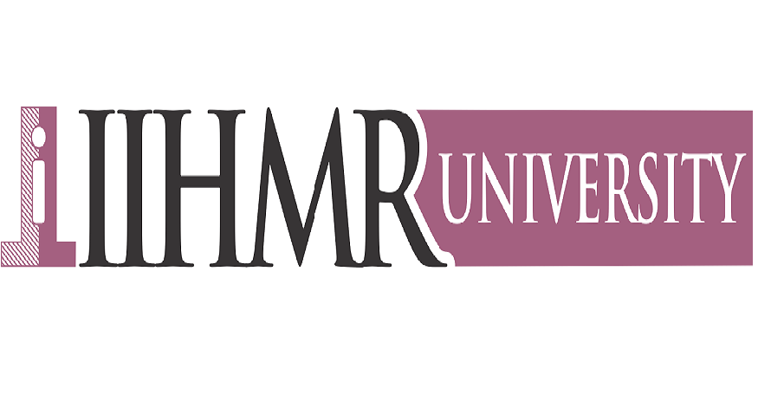
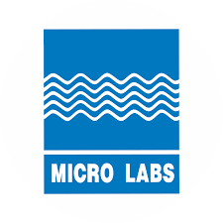
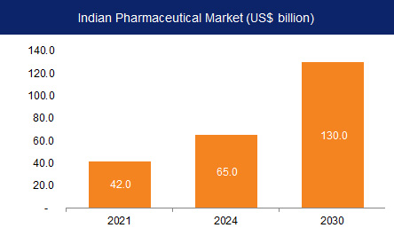
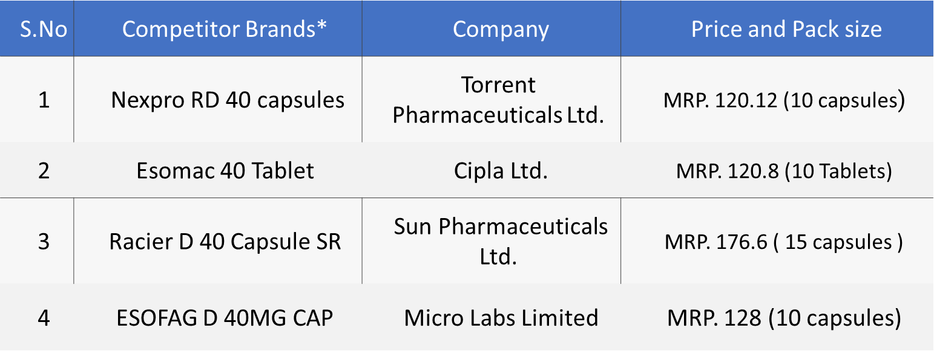
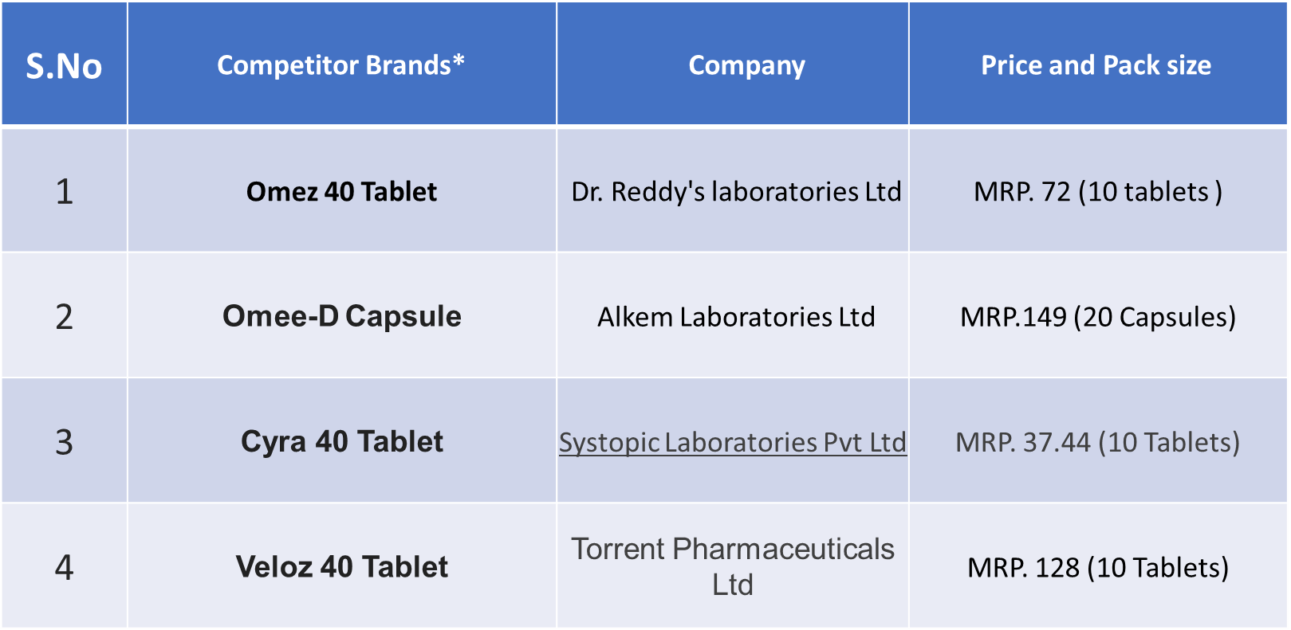
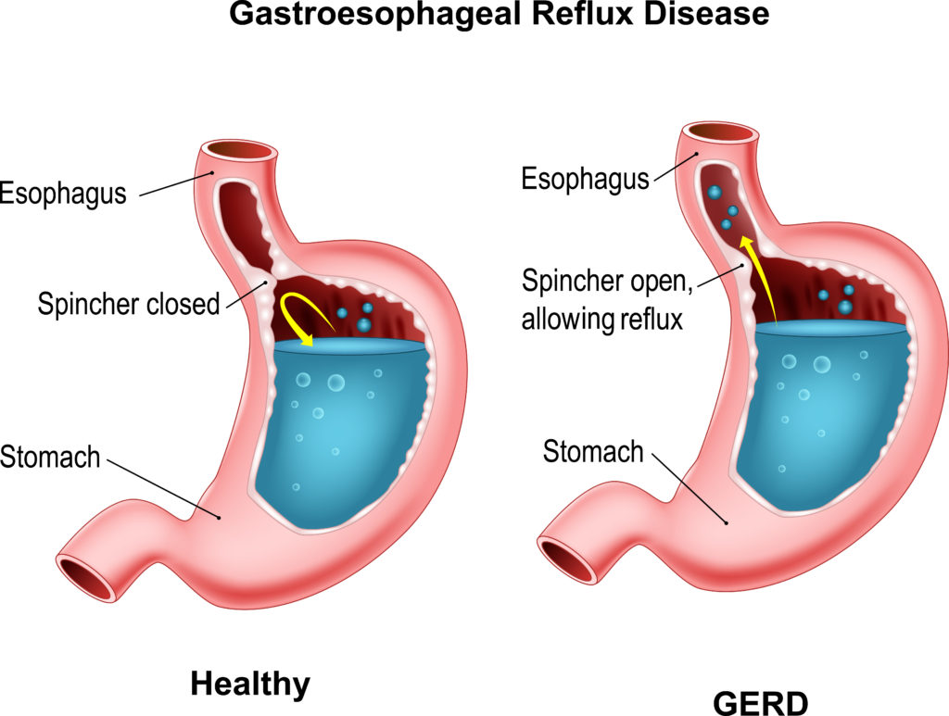
BRAND PLAN OF “Esomeprazole”
Name :- Satyam Kumar
Roll No. :- 0339
Stream :- MBA PM 13
Faculty Mentor :- Dr Ashok Peepliwal
Industry Mentor :- Mr. Tavindra Jit Singh Vasudeva
Micro labs was incorporated on 7th September 1973. Micro Labs Limited's operating revenues range is Over INR 500 cr. It is a multifaceted healthcare organization with a proficient marketing team. Have manufacturing facilities and R&D centres that are with international standards. It is ranked 14th among prescriptions by SMSRC and 19th in sales as per AWACS Mat. The company is well known for its brand “DOLO” while the portfolio includes some of the topmost brands in various specialities like Cardiology, Diabetology, Anti-infective , Ophthalmology, Pain, etc,. The company’s domestic market share is around 2% while it is among top 5 players in liver-therapy and in Oral Anti-diabetic segment. The company is placed 11th in the Cardiovascular product division. Around 60% of the company’s domestic revenue is from Chronic segment. This financial year company’s export sales grew by about 35% while the domestic sales were moderate at 5% because of lower prescription-based sales due to COVID.
Micro labs desires to not just be the best, but a leader in the development, manufacturing and sales of premium pharmaceutical products.
Micro labs aspires to deliver value through high-quality pharmaceutical products and to build brands across the therapeutic segment.
Micro Labs has Hierarchical Organization structure i.e., Top to bottom. Employees are grouped with every employee having one clear supervisor
The pharmaceutical industry in India was valued at an estimated US$42 billion in 2021.
India is the world's largest provider of generic medicines by volume, with a 20% share of total global pharmaceutical exports.
It is also the largest vaccine supplier in the world by volume, accounting for more than 50% of all vaccines manufactured in the world.
India is a major exporter of pharmaceutical with over 200+ countries served by Indian Pharma export.
India supplies over 50 % of Africa's requirement for generics, ~40% of generics demand in the US and ~25% of all Medicine in the UK.
MICRO LABS LTD.
PHARMACEUTICAL INDUSTRY
VISION
ASPIRATION
ORGANIZATION STRUCTURE
In India have a certain framework regarding the pharmaceutical industry. This includes safety standards, certifications and drug related laws.
As the economic condition of the India are developing with time and the household income of people is also increasing.
Increasing attention in healthcare
Access to essential services.
The online opportunity can see the growth in: - Social media for healthcare, customized treatment , direct to patient communication.
Import – Exports custom duties on pharmaceutical drugs.
Regulations on pharmaceutical drugs.
Adverse weather condition causes the temporary suspension some factories.
Growing attention to environment protection.
Esomeprazole is used in the treatment of gastroesophageal reflux disease (acid reflux) and peptic ulcer disease .
The plasma elimination half life of esomeprazole is approximately 1-1.5 hours . Less than 1% of parent drug is excreted in the urine.
Approximately 80% of an oral dose of esomeprazole is excreted as inactive metabolites in the urine, and the remainder is found as inactive metabolites in the feces.
s
In general, esomeprazole more effectively inhibits gastric acid secretion than omeprazole .
PESTLE ANALYSIS
PRODUCT PROFILE
POLTICAL
MARKET SURVEY
ECONOMIC
POLTICAL
ECONOMIC
SOCIAL
SOCIAL
ECONOMIC
The GERD and NERD treatment market is expected to grow at a CAGR of 4% during the forecast period 2022 to 2023.
Current population of India 138 crores.
Current adult population comes underage of 12 to 64.
Increase in healthcare expenditure will increase awareness.
Due to health increase patient spending towards diagnosis & treatment will increase.
TECHNOLOGICAL
TECHNOLOGICAL
MARKET TRENDS
SOCIAL
LEGAL
LEGAL
TECHNOLOGICAL
BUSINESS IMPLICATIONS
ENVIRONMENT
ENVIRONMENT
DIRECT COMPETITOR
INDIRECT COMPETITOR
LEGAL
Many different types of therapy options are available to treat GERD and IBD depending on the risk profile.
Cheap price and Sales force
Less market share
Issue in pediatric patients ( Use in above 12 years)
Growing therapeutic segment
Combination market is growing very fast
Markets players are coming with advanced technology & combinations.
POSTIONONG
SWOAT ANALYSIS
STRENGTHS
Sales and promotional activities are carried out face to face with clients.
We are direct to consumer advertising .
Increase your customer coverage
Free goods
Bulk purchase offer
In India, the prevalence range for GERD is 8% to 20% of the population.
During stress conditioning , cortisol is released from the adrenal gland .
WEAKNESS
CAMPAIGN
DISEASE PREVALENCE
Opportunity
BRAND PLAN
Brand Name | Nexium
Molecule Name | Esomeprazole
Tablets | 40 mg tablets
Prefix | ‘’Oprazole”
Suffix | “Praxole”
Drug Category | Proton Pump Inhibitor
Indication | Risk reduction of NSAID, GERD and Peptic Ulcer
PRESCRIPTION DOCTOR CAMPAIGN
Threats
During my market research, I learned that most doctors are moving toward “NEXPRO RD 40” over “Omez” and “Omee-D” capsule due to its better response and fewer side effects, But when I talked with doctors and pharmacist about this drug, they were saying most medical shop are selling this drug because, its price very less than “Nexpro RD 40”. While, when I did complete market research at the different medical shop and hospitals. Then, I got a different statement from different prescriber and pharmacist . These are saying “Nexpro RD 40” more active than “ESOFAG-D” 40 mg because , very few cases of side effect of “Nexpro RD 40” on the liver have been reported. I analyzed most of the chemist shop sell “Omez” and Omee-D than I recognized at clinical or when , I asked doctor , then they gave me advised “Nexpro RD better responses than other drugs because it works by inhibiting the neurotransmitter dopamine (a chemical messenger present in our body) this drug from acting on the vomiting center . So, my suggestion to micro labs would be, what if we invest into the R.D and we should try to make cheap and good medicine so, that this medicine has less side effect and less bioavailability. Also, This drug can be positioned as highly effective as well as cost effective and easy to use for the patient.
The most challenging part of the task was completing market research since respondents did not want to share their data, prices, and didn't have time to get the results out. This was my most significant learning; how to approach things
As I worked at Micro Labs, time management was another challenge. I had to complete all my work within limited timeframes, which was another learning experience for me.
LEARNING OUTCOME AND RECOMMENDATIONS
CHALLENGES FACED
While my time with micro labs the most important thing which I noticed was while the theory gives you a deeper understanding of a concept through seeing it in the context of understanding the “why” behind it, it gives you the insights from the experience of other’s.
While Practical experience gives you an understanding of how things happen in the real world, but my practical experience gave me a deeper understanding of concepts as I was able to gain an understanding of things through my personal experiences.
Difference between practical and theoretical exposure
My experience with micro labs made me realize how important theoretical exposure and learning are.
Further, this training has made me more aware of the dynamics of the real corporate world and how flexibility, planning, and consistency are essential to success.
USEFULNESS OF INTERNSHIP

