Slide 1




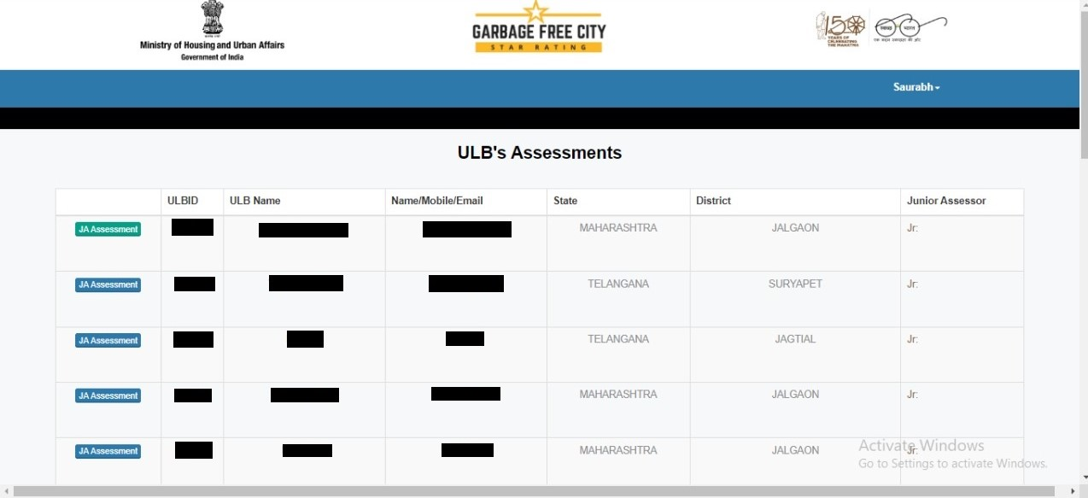
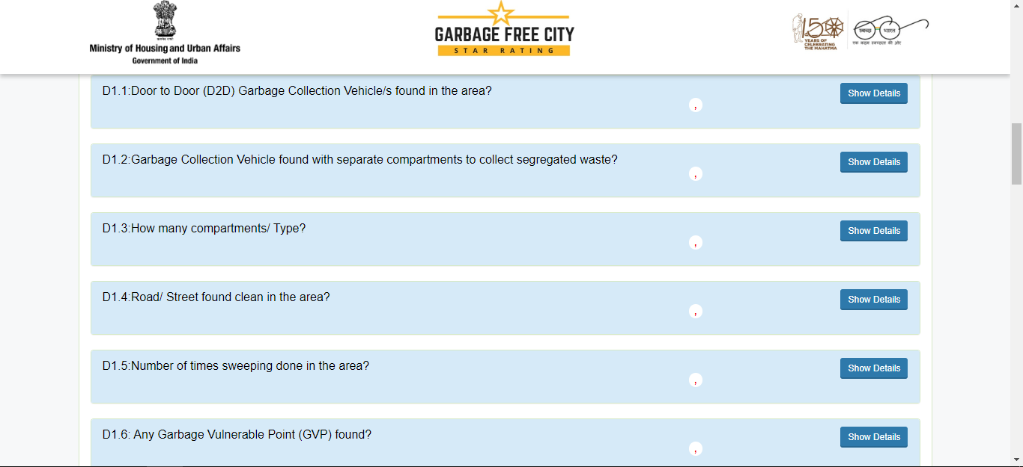
NAME: Saurabh
ROLL NO.: 0340
STREAM: MBA PM-13
GARBAGE FREE CITY 2022 QUALITY CHECK
INTRODUCTION TO SBM
INTRODUCTION TO IQVIA
MISSION
Swachh Bharat Mission (SBM) is a campaign introduced by the Government of India. Meant to combat the problem of defecating in the open and improve solid and liquid waste management, the campaigned resulted in the construction of nearly 90 million toilets in the first phase, which lasted till October 2019.
Phase II introduced the concept of Garbage Free Cities (GFC). This star rating system encourages States to clean and beautify their ULBs with at least a 1-star rating to avail funds from the Central Government.
This massive undertaking is handled by the Ministry of Home and Urban Affairs (MoHUA) for urban areas (SBM-U) and the Department of Drinking Water and Sanitation, Ministry of Jal Shakti in rural areas (SBM-G).
Formed as the result of a merger between IMS Health and Quintiles in 2016, IQVIA is an American multinational company dealing in biopharmaceutical development and commercial outsourcing services. With operations in over 100 countries and a market capitalization of $41 billion, IQVIA is regarded as one of the world's largest contract research organizations.
To create a healthier world by accelerating innovations and making intelligent connections across the healthcare ecosystem.
QC Portal
Assessment Mechanism
Self Assessment
All ULBs will mandatorily carry out self assessment as per the protocol.
The self assessment tool will be available on the SBM portal
Declaration of Star Rating
Depending on the results of the self assessment, the ULB will apply for a Star Rating (1-star, 3-star, 5-star or 7-star)
Citizens of the ULB will be involved through citizen declarations for any star rating.
Third Party Assessment
The MoHUA independently verifies the self assessment of each ULB by hiring a third party agency (IQVIA).
Each certification lasts for a year, after which the ULB must reapply.
To apply for each level of GFC Star rating, ULBs must ensure a corresponding ODF rating:
ODF – 1 star
ODF+ - 3 star
ODF++ - 5 star
Water+ - 7 star
Assessment Process
ULB data processed by DA team
DA team passes or fails the ULB
ULBs which pass begin FA
Assessors collect data from the field
Data is collected in the form of pictorial evidences to answer a set of questions as well as surveys of citizens
Data is synced in real time to be assessed by QC team
QC team verifies data
Data is sent to Scoring and Certification
Fill common city profile
Fill MIS on SBM-U portal
Check self-assessment scores
Apply for Star Rating
Upload Documents and Declarations
Third Party Verification
Recommendation to MoHUA
Final Certification (1 Year Validity)
Desktop Assessment (DA)
Field Assessment (FA)
Citizen Validation
Independent Observation
Quality Check (QC)
SKILLS LEARNED
CHALLENGES FACED
SWOT Analysis
Strength
Improved sanitation standards, better quality of life, city beautification
Threats
Clashes with citizens, manipulation and errors in data
Opportunity
Networks formed for future endeavors, communicating and coordinating with multiple stakeholders of various States
Weakness
Language barriers between QC team and on field Assessor, incorrect data submitted, Assessors threatened on field
Time management.
Multitasking and handling multiple ULBs.
Communication and interpersonal relationship development.
Rectifying incorrect data submitted by assessors was challenging and time consuming.
QC Portal would face issues and decrease productivity.
Convincing assessors to work in the field when they refuse.
GFC 2021
Voluntary participation
25 Components with Mandatory, Essential & Desirable categories.
GFC 2022
Mandatory Participation
24 components with two groups into ‘Important’ (16 components) and ‘Aspirational’ indicators (24 components)
Three-step calculation
One-step calculation
Paper-based declarations
Digital declaration
No centralized monitoring of assessors
Assessors to be centrally monitored by Ministry.
SUGGESTIONS
Improving IT team capabilities and streamlining QC portal.
Hiring assessors with a basic understanding of English.
Sample questions used in questionnaire.

