Slide 1



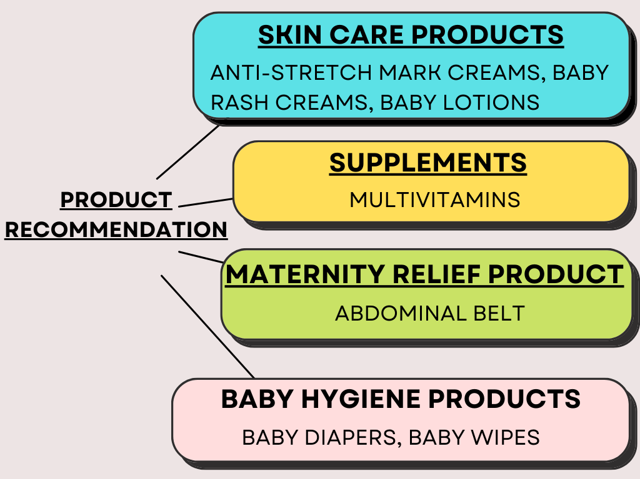
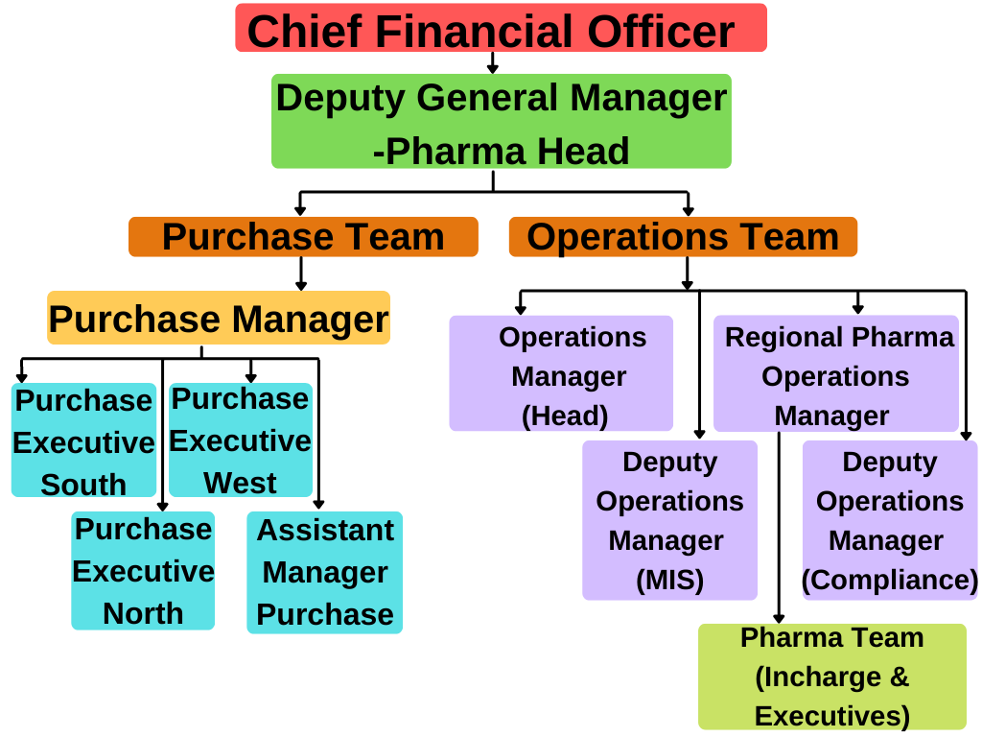
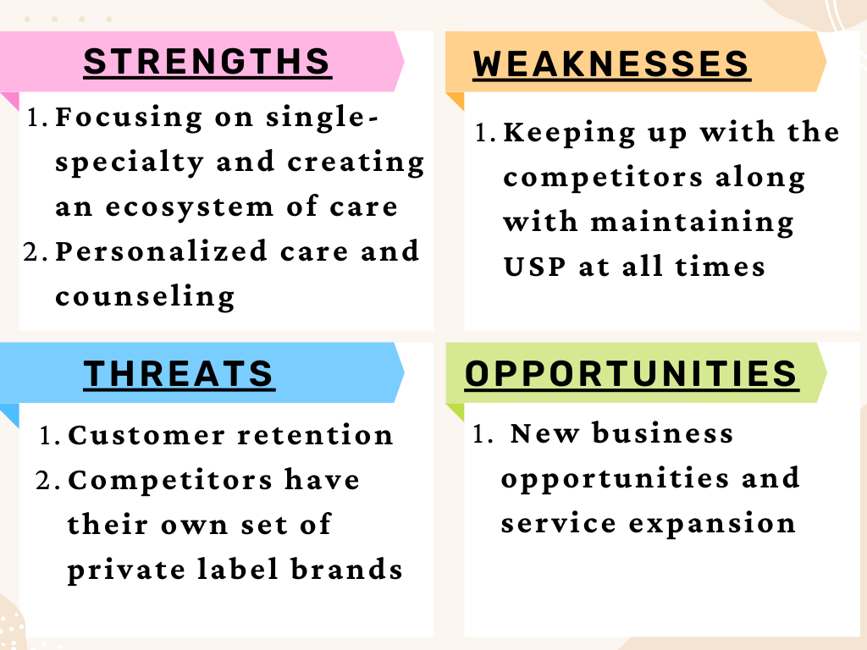
PERCEPTION MAPPING OF TARGET AUDIENCE AND EVALUATION OF PRODUCTS TO LAUNCH AS CLOUDNINE PRIVATE LABEL BRANDS
NAME: SHIVAKSHI SHAH NAME OF THE FACULTY MENTOR: DR. ASHOK PEEPLIWAL
ROLL NUMBER: 0341 ORGANISATION NAME: CLOUDNINE GROUP OF HOSPITALS
STREAM: MBA- PHARMACEUTICAL MANAGEMENT 13 NAME OF THE INDUSTRY MENTOR: TRIDIP CHATTERJEE
INDUSTRY SECTOR PROFILE
PROJECT INSIGHTS
BRIEF HISTORY
BRIEF DESCRIPTION ABOUT INDUSTRY
A survey was conducted at 23 branches of Cloudnine hospitals across the three regions in India with a questionnaire designed with respect to the various stakeholders. It was done to evaluate the launch of Cloudnine products.
Based on the analysis and taking in consideration of parameters such as Low risk, High volume and High margin, the low cost and high margin products were considered for launching as private label brands.
Cloudnine Group of Hospitals is a premium chain of maternity, childcare, and fertility hospitals headquartered in Bengaluru, India.
The hospital was co-founded by neonatologist Dr. R Kishore Kumar in 2007.
Seeing crowded, unhygienic government hospitals and poorly run private nursing centres in the country, Dr. Kumar, and his team of three co-founders decided to focus on providing quality new-born care.
Cloudnine Group of Hospitals is a joint venture of the Kids Clinic India Private Limited and Scrips N Scrolls India.
Today, Cloudnine hospitals provide every aspect of care across maternity, gynaecology, fertility, neonatology, and paediatrics services.
It has 23 units running across India in the North, South and West region.
India is the second most populous country with a population of 1.3 billion people. It also contributes to largest youth population in the world.
The current birth rate for India in 2022 is 17.163 births per 1000 people.
In 2020, India's urban population was estimated to be 34.93 percent. As the level of urbanization grows, so does their economic output, resulting in a greater demand for individualized healthcare.
The Indian Healthcare sector has witnessed the rise of specialty care delivery models focused on mother and childcare. The market is estimated to be more than INR 15,000 crore and is expected to grow at a CAGR of 15% over the next few years.
Government of India has launched initiatives like Janani Shishu Suraksha Karyakram which has facilitated the shift of births from homes to health facilities and seen an overall 75% rural births under supervision and 89% urban deliveries.
According to the National Foundation for Health Statistics, 47.4 percent of new-borns delivered in the private sector are born through C-section, compared to 14.3 percent in government institutions.
According to the National Family Health Survey, the national C-section rate is 21.5 percent, which is higher than the World Health Organization's "ideal" rate of 10-15 percent.
ORGANISATION VISION AND MISSION
Vision: Our aim is the pursuit of excellence in providing the best maternal and neonatal care by setting higher standards for ourselves and striving constantly to achieve them.
Mission: To be the kind of leader in the space of women and health that India has not witnessed yet, by providing premier quality healthcare to women and children.
ORGANISATION STRUCTURE
LEARNING AND VALUE ADDITION
LEARNING OUTCOME
DIFFERENCE BETWEEN PRACTICAL EXPOSURE AND THEORETICAL WORK
SWOT ANALYSIS
Effective listening and communication skills.
Teamwork
Work ethics and Discipline
Value of time
Networking
Internships are a great medium to implement the theoretical work on field.
SWOT analysis, 4 P’s of Marketing that is Product, Price, Place and Promotion techniques, Market research, Preparing the questionnaires, were implemented practically in the internship.
Having learnt theoretically and applying these technique on field helped a lot and made work easier.
CHALLENGES
USEFULNESS
Travelling time: A large amount was spent on travelling to reach the workplace.
Doctor’s availability: In certain cases, Doctors were either busy or not present to answer the questionnaire.
Gaining Industry perspective: Understanding Maternity and Child healthcare market, how hospital pharmacies work, factors to be considered before launching private label products, etc.
Interaction with Experienced professionals: Understanding the dynamics of the profession
Boost in confidence along with enhancement of skillsets.
RECOMMENDATIONS
Discount: Hospital Pharmacy should provide occasional discount offers in certain OTC categories in order to boost the sales.
Branching out Office: The corporate office should branch out to all the regions in order to have an easy, time saving and effective communication between the corporate office and the particular region’s hospital.

