Slide 1

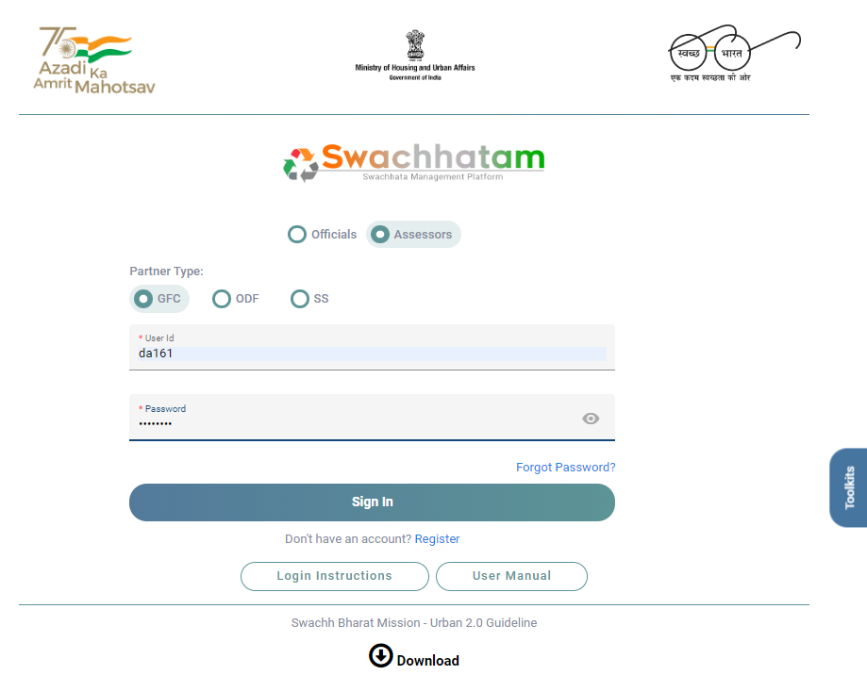
GARBAGE DESKTOP ASSESSMENT 2022
Presented By: Shivam Sharma Roll. No. 0342 STREAM PM 13
Faculty Mentor : DR. SURYA PRAKASH and Industry Mentor : MS. RASHI KAHRE
INTRODUCTION
CHALLENGES FACED
USEFULNESS OF INTERNSHIP
Swachh Bharat Mission (SBM) launched by Government of India in 2014. This mission started in two phases, phase 1 lasted till October 2019 with the aim of open defecation free India and phase 2 is being implemented between 2020-21 and 2024-25 to sustain the open defecation free status and improve the management of solid and liquid waste.
IQVIA formerly Quintiles and IMS Health, Inc., is an American multinational company serving in industries of health information technology and clinical research.
IQVIA’S MISSION AND VISSION Brings together advances in data science, technology, and healthcare expertise to help customers make better decisions and ultimately improve patient outcomes.
Garbage free city desktop assessment steps:
Verify city and wards
Assess and verify the documents submitted by the cities for all components as per Level 1 requirements
Door to door collection, Source segregation ,Litter bins, Waste processing & capacity, User charges, Dumpsite remediation, Screening of Nallahs, C&D waste, on site wet waste processing by BWG
Heavy work with minimal training
Scared of asking any question
Understanding the office culture
Co interns competition
Time limitation
Actual Work Experience
Networking Opportunities
Give resume a boost
Gain confidence
Career discovery
SWOT ANALYSIS OF SBM
Strengths :
State level workshops
Technological evaluations
Flexibility to states in implementation of program
Weaknesses :
Maintenance
Campaign is voluntary not compulsory
No focus on excreta disposal in railway department
Opportunities :
Waste management through biogas/gobar gas plant
Threats :
Sustainability of interest and priority
Changes in administration and leadership
Recycling solid waste is a big problem
ABOUT PROJECT
SBM splits into two : rural and urban, SBM Urban 2.O launched in October 2021, to create Garbage Free Cities (GFC) with most important governance tool of waste management- the star rating protocol launched by MoHUA in 2018 to motivate cities to achieve higher degrees of sustainable cleanliness as well as garbage fee status.
In 2021, 4470 cities were there in India and 2238 participated in this mission, out of which 1383 passed and 855 failed.
Difference between theoretical work and practical exposure
No. of Urban Local Bodies (ULBs) completed
Practical knowledge is gained through doing things, it is very much based on real-life endeavors and tasks. On the other hand, theoretical knowledge teaches the reasoning, techniques and theory of knowledge.
LEARNING AND VALUE ADDITION
SUGGESTIONS
SBM portal can be improved
Instructions must be given to officials of ULBs prior document submission
Time management
Analytical work
Communication skills
Excel preparation
Practical Knowledge
No. of ULBs which passed, failed and in the process of query
Portal sign in interface

