Slide 1


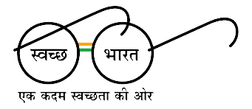



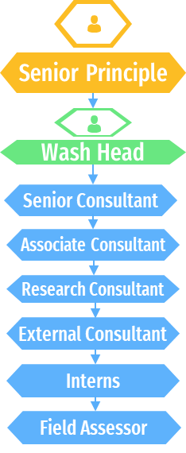




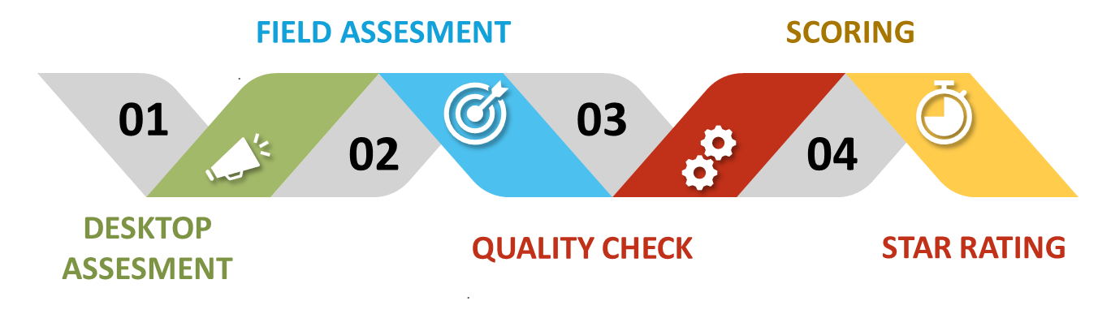
GARBAGE FREE CITIES 2022 – QUALITY CHECK
ORGANIZATION STRUCTURE
S
SWOT ANALYSIS
CHALLENGES FACED DURING INTERNSHIP
Vision Statement
We believe by accelerating innovations and making intelligent connections across the healthcare ecosystem, we can make exponential progress to sustainable environmental.
Mission statement
As part of our mission to create a healthier world, we are committed social, and governance practices around the world.
W
O
T
Time management
Communication challenges
Management of excessive workload
Balance between social and work life
STRENGTHS
WEAKNESSES
OPPORTUNITIES
THREATS
• Efficient team with lot of young employees working on a national project.
• Well funded projects.
• Strong management that embraces the team.
• Physical resources like office space, location were excellent.
•Technical aspects of the organization like portal for assessment had a lot of irregularities in functioning.
•The protocol of the project was changed regularly which affected the consistency of the data.
•IQVIA is working for Swachh Bharat Abhiyan for last 2 years, IQVIA should take this as an opportunity to get more government projects by performing efficiently with the ongoing project.
• IQVIA needs to hire more people in core team for business development.
• As last to last year this project
was with KPMG, they could again, try to steal this project
from them if they find any mistakes that were done by IQVIA
• As this project is under Gov, IQVIA needs to be
Carefully related to privacy of project
DIFFERENCE BETWEEN PRACTICAL EXPOSURE AND THEOROTICAL WORK
BRIEF HISTORY
IQVIA is a leading global provider of advanced analytics, technology solutions and clinical research services to the life sciences industry, including services and solutions to global health sector. IQVIA creates intelligent connections to deliver powerful insights with speed and agility — enabling customers to accelerate medical innovations that improve healthcare outcomes for patients. With approximately 79,000 employees, IQVIA conducts operations in more than 100 countries across Africa, Asia, Europe, Middle East, Latin America and North America. The company has more than 10,000 clients worldwide and works closely with many global health institutions, donors, and local ministries and others healthcare stakeholders to improve public health
Experienced Corporate functionality
Applying various theoretically learned skills on day-to-day basis.
Application of Communication skills and ethics.
Practical experience provides never ending learning process.
Hands on experience on the technical aspects of corporate.
LEARNING AND VALUE ADDITION
Suggestion to organization
Analysis of cities assigned to me
Real time exposure of multinational corporate company
Learned Various analytical skills required to interpret data.
Ability to communicate and network with colleagues and seniors.
Enhanced knowledge
Privileged to work on a nation building project.
Corporate ethics
To develop a well efficient portal for Quality check of data, Errors related to portal functionality were time consuming as well as expensive.
Develop a clear idea related to the protocol of the project during the beginning, changes in the process of functionality regularly could affect the consistency of data.
To provide a clear channel for communication related to work.
CITIES ASSIGNED
BRIEF DESCRIPTION ABOUT INDUSTRY LIKE HEALTHCARE/PHARAMA/DEVELOPMENT ORGANIZATIONS
GFC PROCESS
IQVIA Is a leading healthcare industry whose primary role is to provide data driven research in healthcare field. The project with which I was involved was of Swatch Bharat Abhiyan. 2 Years ago, this project was with KPMG, but IQVIA has got its tender for the past 2 years continuously. What I found most peculiar about this transfer of project was that IQVIA hired some of the lead employees who were working on that project in KPMG in IQVIA so that they could provide better training and insights in the projects. Which led me to understanding that working in a corporate consultant company is all about your worth to the company, which the employee's can leverage for a better opportunity.
INTERPRETATION
The job description assigned to me for summer internship at IQVIA was to develop a quality check mechanism and conduct quality check of field data collected by the assessors
ULB (Urban Local Bodies) were assigned to the quality check team to conduct a proper quality check on the data provided by the field assessors. A total of 27 ULB’s were allotted to me for quality check during my 2 months of internship. Out of which 44 percent of ULBs were from Madhya Pradesh, 30 percent from Maharashtra, 11 percent from Andhra Pradesh, 7 percent from Telangana and 4 percent each from Odisha and Uttar Pradesh.
GAP ANALYSIS
IQVIA conducts Third Party Verification through desktop assessment of the documents provided by the ULB’s. After passing through the desktop assessment the Field assessment of ULB’s takes place. During the field assessment, direct observation of wet, dry, sanitary, and domestic plants to check the functionality and operationality of the plants is carried out by the field assessor. Some of the ULB’s in Madhya Pradesh would collect the sanitary and domestic but did not have the resources to process the waste. These ULB’s had a third-party agreement with private company situated outside the ULB’s location. The ULB’s would send their sanitary and domestic waste in cluster to private agency to process the waste. So, the functionality and operationality of the cluster plants were checked through direct observation at the private agency. The plants were certified by checking just the agreement documents. But the inability of the ULB’s to process their own sanitary and domestic waste is ignored in this observation. Processing plants in respective ULB’s should be certified based on their ability to process the waste at the respective ULB location.
Name- SHUBHAM SUDHAKAR RUKME Roll no - IIHMR-U/02/2021-2023/0345 CLASS - MBA PM -13 Mentor - DR SURYA PRAKASH Industry Mentor- PANKAJ BAJAJ

