Slide 1



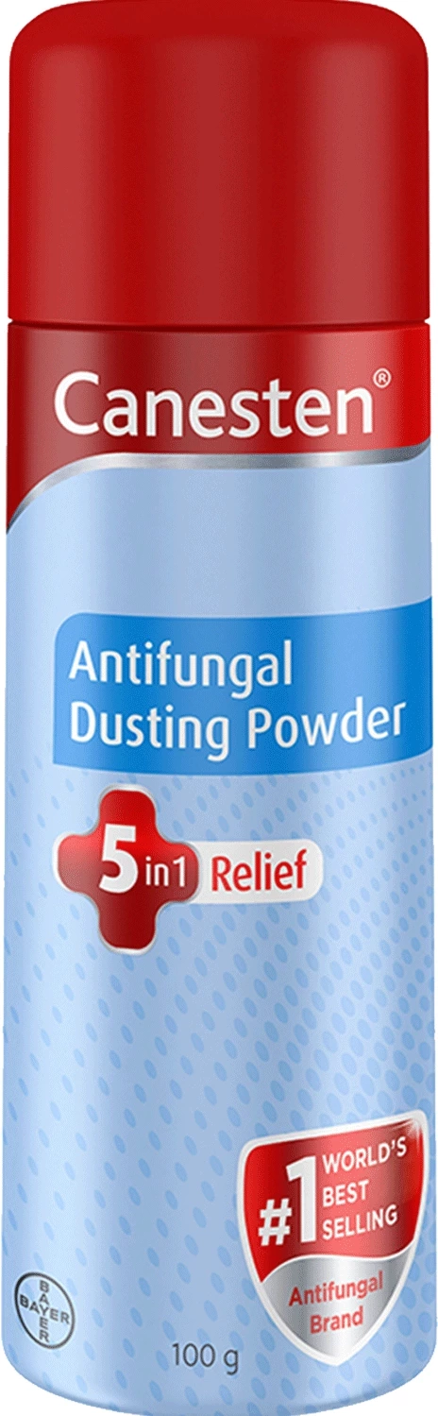
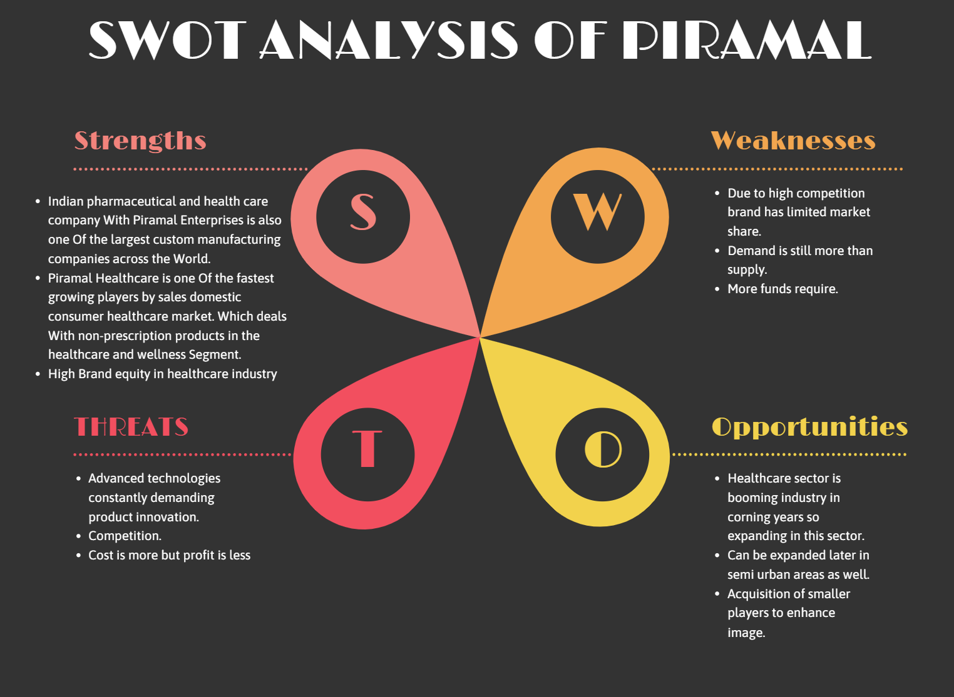
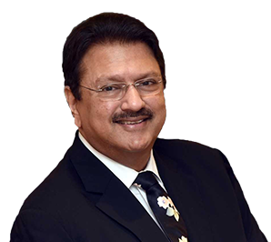




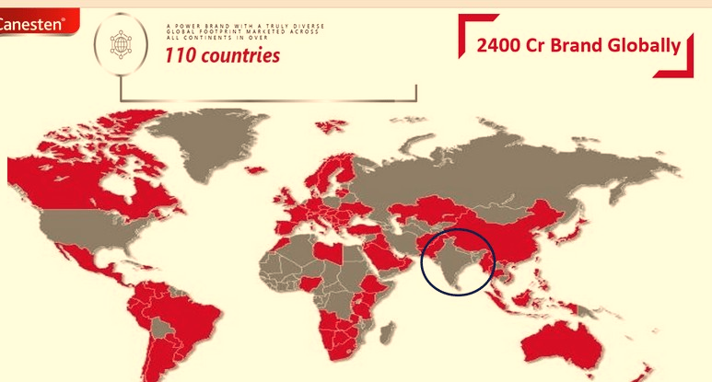
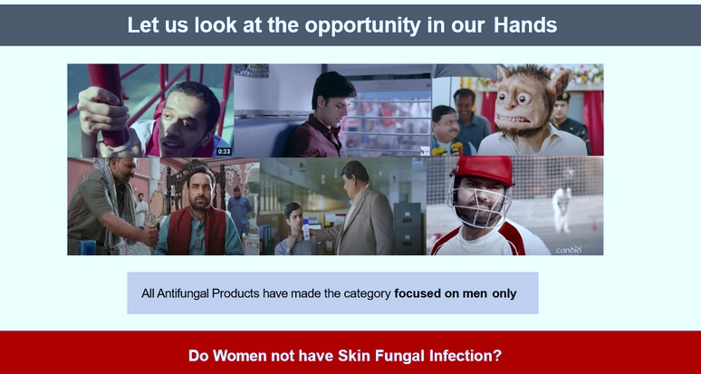

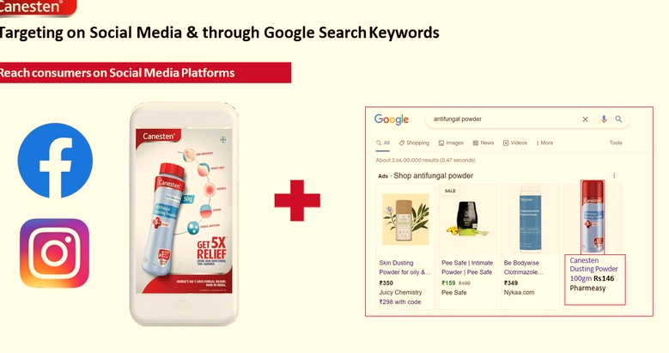
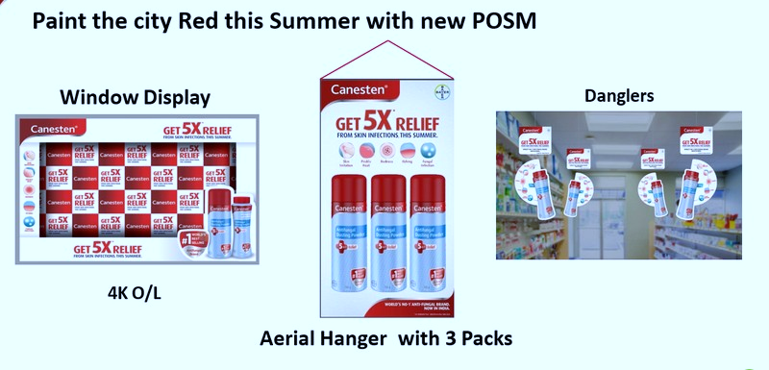

Manage GTM (Go-To-Market) rollout of Canesten Powder in Delhi City
By- Sparsh Jain
Roll no- 0349
MBA PM-13
Faculty mentor- Dr. Surya Prakash
Industry Mentor- Mr. Rohit Verma
ABOUT THE COMPANY
COMPANY MISSION AND VISION
Brief History-
Piramal Group is a global multi-industry company with diverse interests in Pharma, Financial Services and Real Estate.
The Group has offices in over 30 countries and a global brand presence in more than 100 markets.
It was founded in 1984 and Led by Mr. Ajay Piramal, the Chairman.
Piramal Pharma Solutions has a globally integrated operational model with a network of assets across North America, Europe ansd Asia.
Awards and Accolades:
Awarded ‘Industry Partner of the Year 2018’ at the Global Generics & Biosimilars Awards at the recently held CPhI Conference.
Received ‘Best Customer Experience Award of the Year – Pharmaceutical’ at Customer Fest 2016
At Piramal group their core values of knowledge, action and Care have been an integral part of their guiding philosophy.
These values represent their deeply held beliefs and define them at the individual as well as organizational levels.
Shaped by their past and collective experience, they determine how they should engage with others, what they are identify with and what they love and value.
The Piramal community has adopted the ancient, universal symbol of the Gyan Mudra as its brand icon.
The values that guide their unique culture are embodied in their purpose: Doing Well and Doing Good
CHALLENGES FACED DURING INTERNSHIP
DIFFERENCE BETWEEN PRACTICAL EXPOSURE AND THEORETICAL WORK
STRATEGIES PLANNED
Already 4 brands were there in market and they have a TV commercial that is done by well known celebrities, so people recognize those products by name.
When compared to other brands the display pricing provided to shopkeeper was low.
Got first hand experience and first time exposure to Industry.
Lot of concepts in books are outdated so it helped me to understand more in practical world.
ORGANIZATION STRUCTURE
USEFULNESS OF INTERNSHIP
LEARNINGS AND VALUE ADDITION DURING INTERNSHIP
CHAIRMAN
EXECUTIVE DIRECTOR
CEO
VP (SALES)
VP (MARKETING)
VP (FINANCE)
VP (HR OPERATIONS)
SALES OFFICER
TERTIARY SALES INCHARGE
GENERAL MANAGER
BRAND MANAGER
FINANCE CONTROLLER
GENERAL MANAGER HR
(E,W,N,S )HEAD
NATIONAL SALES MANAGER (E,W,N,S) HEAD
My internship with Piramal truly opened my eyes to the opportunity of any discipline in the pharma industry.
It helped to build and expand professional network.
Industry exposure helped to understand things in a better way.
It had made me even more confident than before.
It will improve Overall CV.
Got indepth understanding of the sales and distribution process.
Got a perspective of Supply chain and distribution.
Got a brief understanding of Brand planning/ New product Canesten powder.
Worked on the brand plan for Canesten powder in Delhi city.
Instrumental in driving the distribution of the new product across 4000 Chemist store in Delhi.

