Slide 1


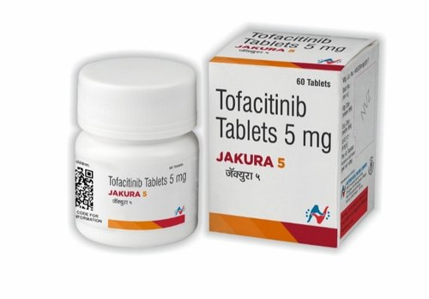
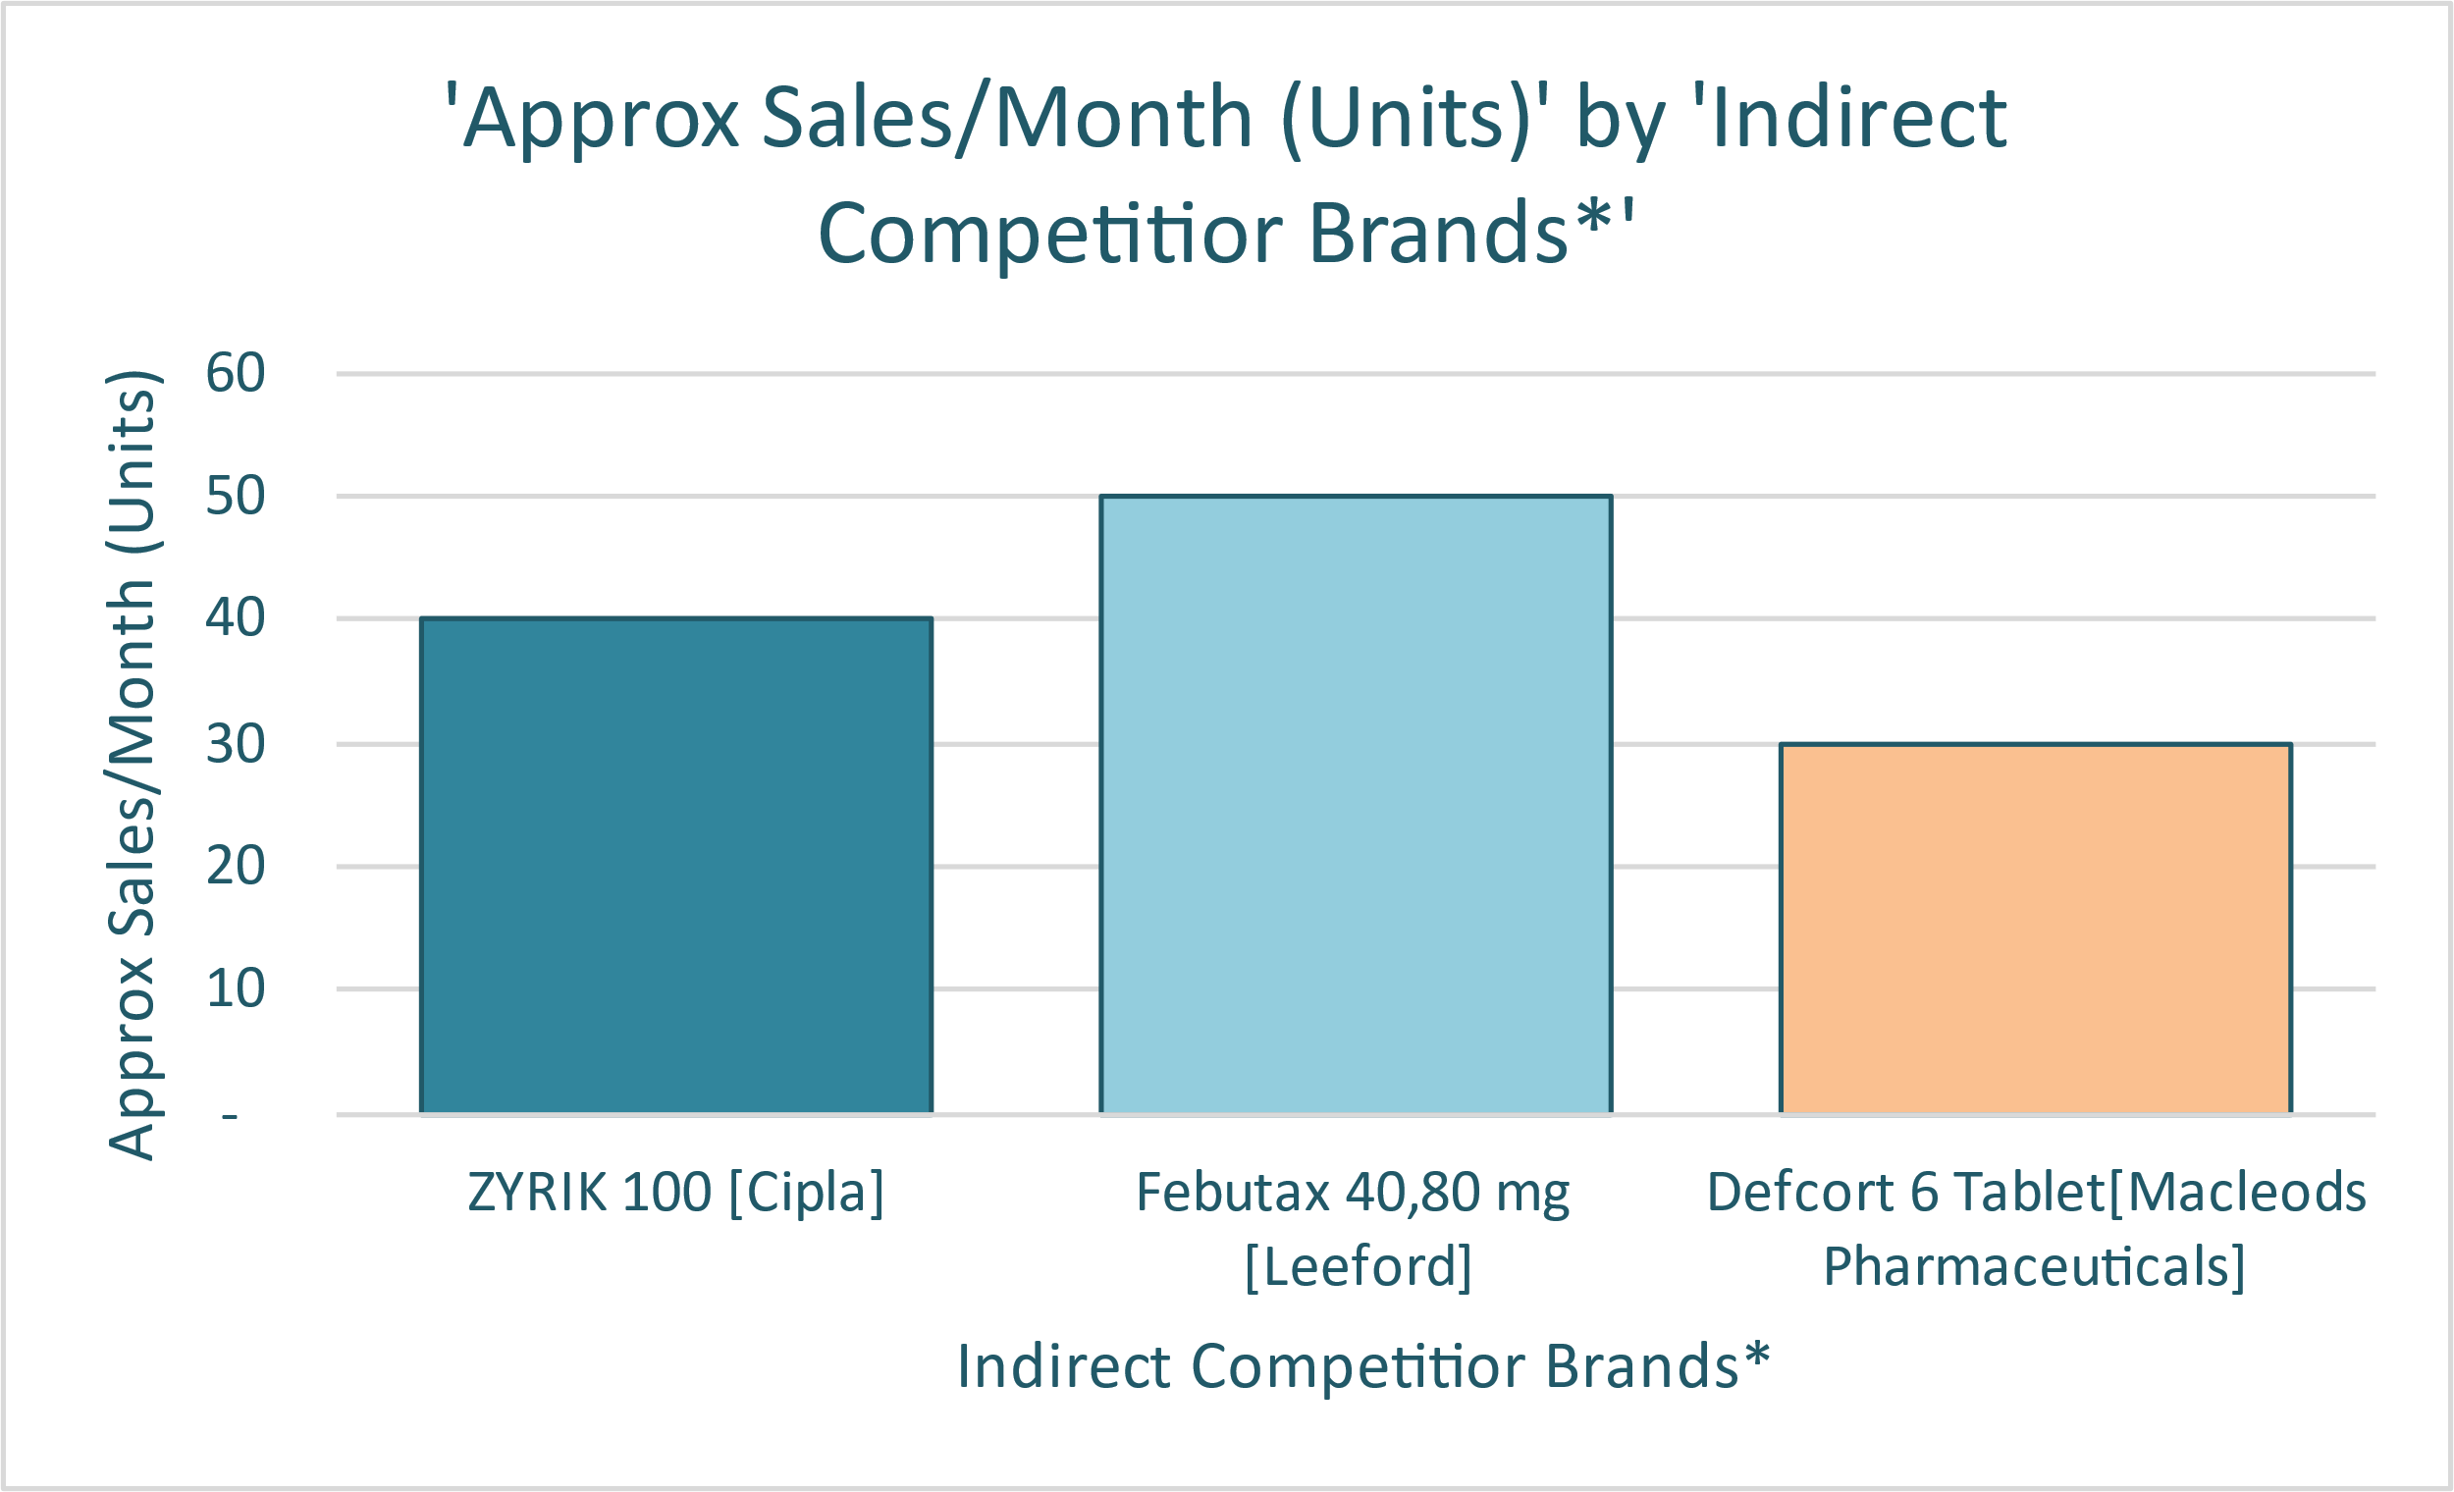
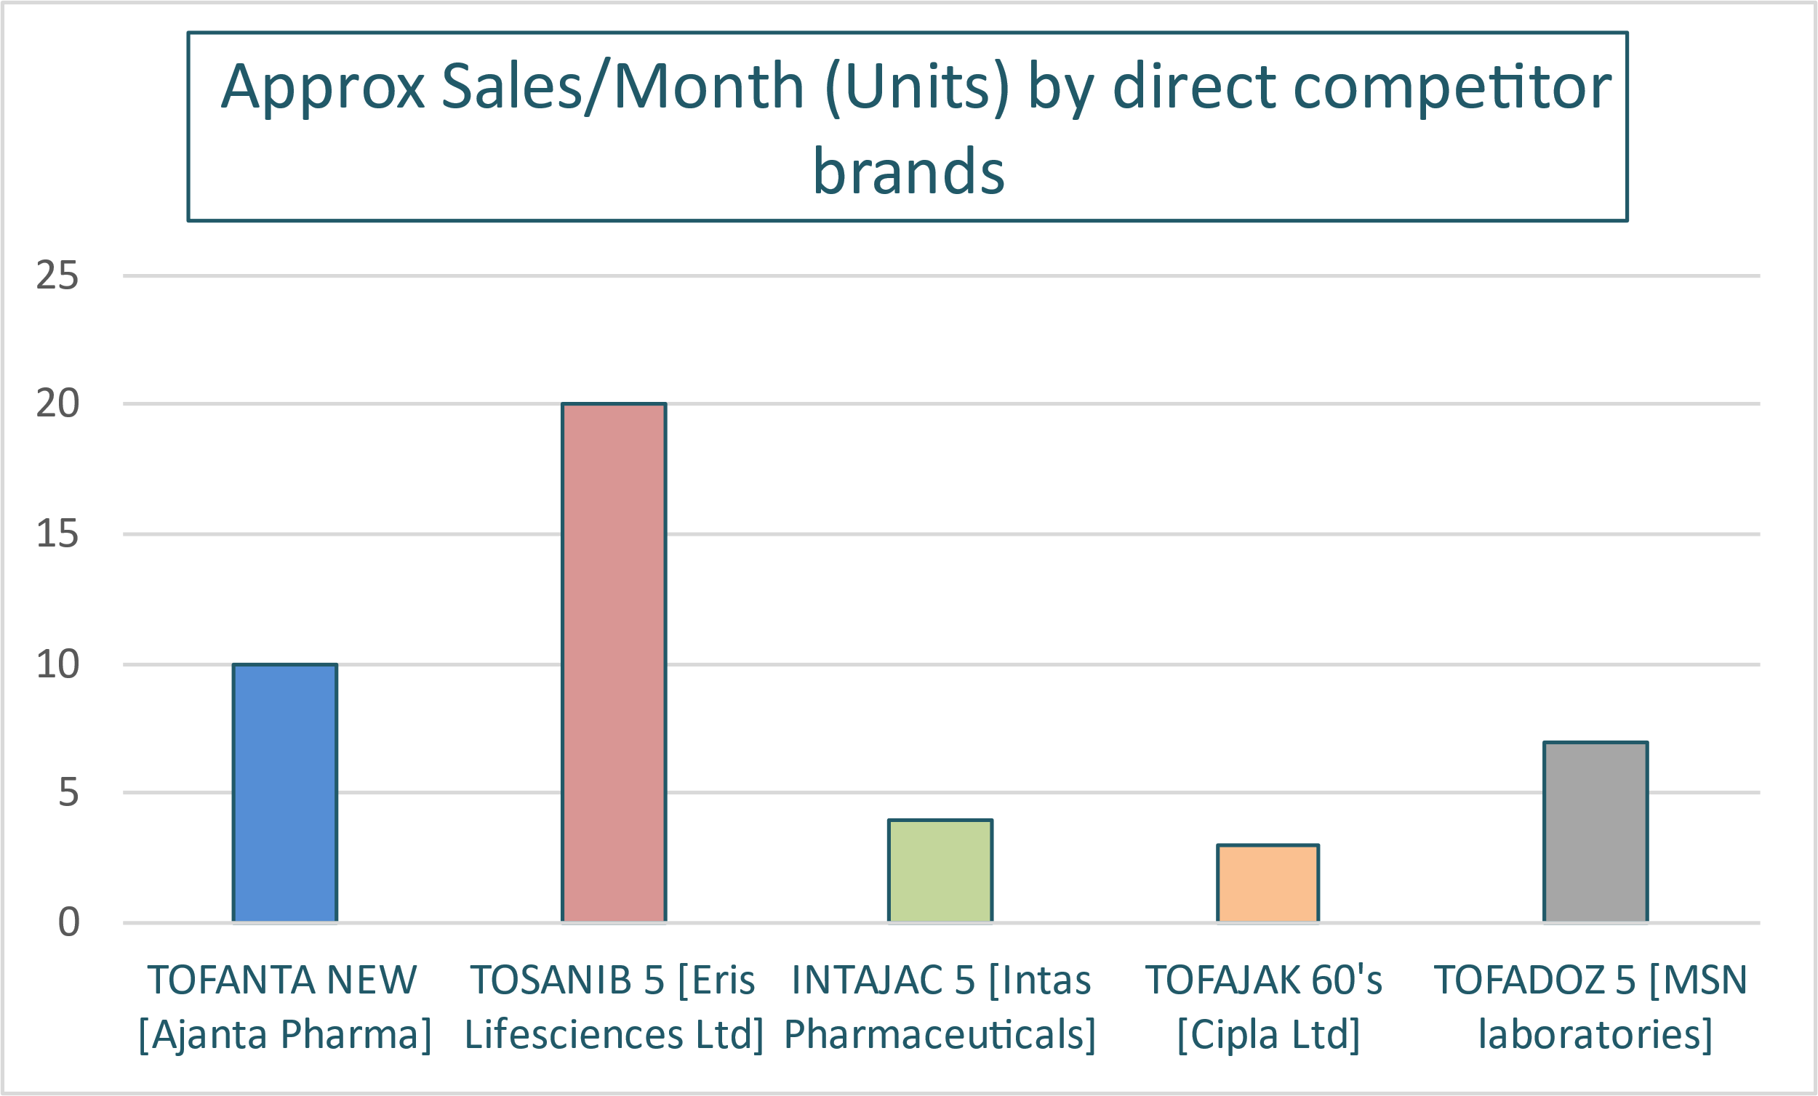
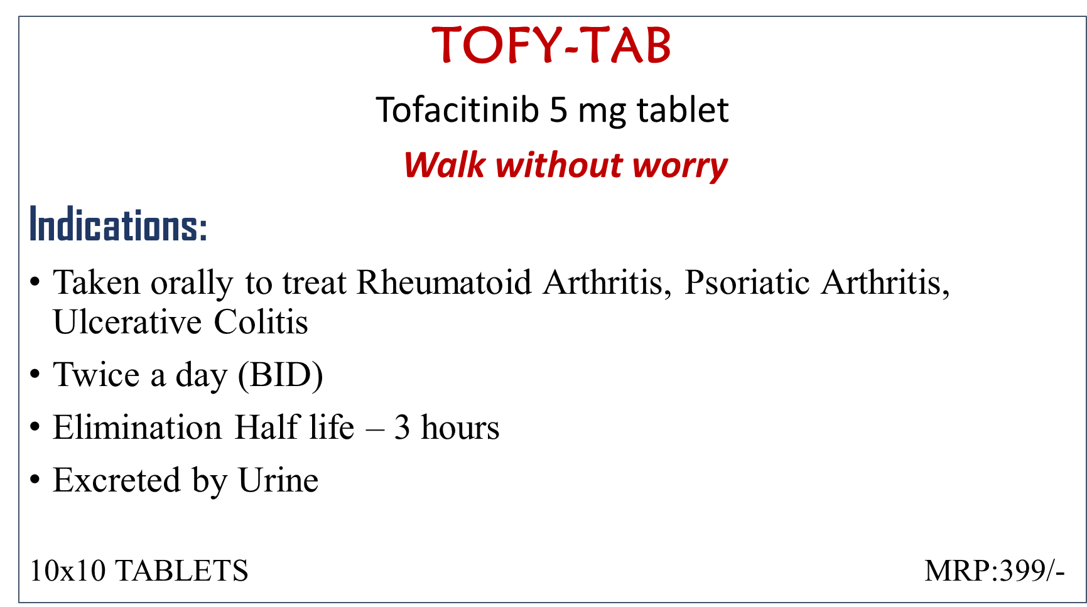
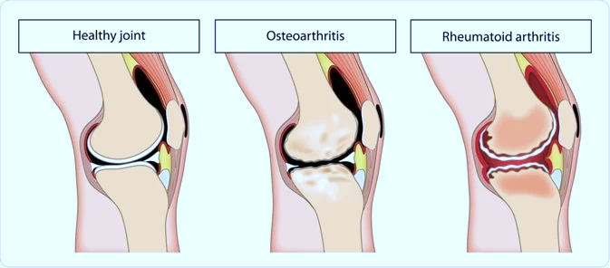

BRAND PLAN OF Tofacitinib-5mg
Presented by: Venkata Naga Sai Sudeepti Guntupalli/ 0354/MBA PM-13/ SPM Faculty Mentor: Dr. Sudhinder Singh Chowhan Industry Mentor: Tavinder Jit Singh Vasudeva
MICRO LABS Ltd
Micro Labs is a multifaceted healthcare organization with a proficient marketing team whose major products are Dolo-650, Amlong, Lubrex, Diapride, Vildapride, Olmat, Avas, Tripride, Bactoclav, Tenepride-M & Arbitel. Micro Labs is supported by 14 world-class manufacturing facilities approved by USFDA, UK-MHRA, Health Canada, WHO, TGA Australia, MCC-South Africa & Medsafe New Zealand, and 3 R & D centers in Bangalore and Mumbai with over 400 experienced scientists.
VISION: Micro Labs vision is to built around a desire to not just be the best, but a leader in the development, manufacture, and sales of premium pharmaceutical products. We wish to raise the flag of Micro Labs in India as well as abroad.
ASPIRATION: Micro labs aspires to deliver value through high-quality pharmaceutical products and to build brands across the therapeutic segments.
INDIAN PHARMACEUTICAL MARKET
India’s domestic Pharmaceutical Market was US$ 42 billion in 2021 and likely to reach US$ 65 billion by 2024
Top 10 Pharma Industry Trends:
• Artificial Intelligence • Big Data & Analytics • Flexible Production • Precision Medicine • Additive Manufacturing • Blockchain • Extended Reality • Real World Data • Digital Therapeutics • Curative Therapies
MARKET SURVEY – COMPETITORS
PESTEL OF TOFACITINIB-5mg
Political – There is a tight competition for Tofacitinib in generic market
Economical – the market of Rheumatoid Arthritis is known to be growing at the rate of 2.8% CAGR till 2027
Social – It improves the lifestyle of patients and promotes better healthcare
Technological – using potential software's to reduce Supply chain disruptions helps to track the potential problems
Environmental – there are studies stating that the interaction between dioxin(pollutant from vehicles) and the HLA gene variant activates events known to be associated with rheumatoid arthritis.
Legal – some pharmaceutical industries use highly sophisticated techniques to influence physician behavior and do not necessarily have the best interests of the patients in mind which is making therapy out of pocket for lower income population
BRAND PLAN
“A road map to achieve activities”
The market value of Rheumatoid Arthritis Drugs market in 2020 is $52,048.8 million
PATIENT FUNNELING
Almost 1.3 Cr people in India suffer from RA
Out of 1,00,000 people 71 are diagnosed with RA every year in US.
Women are 2 to 3 times more likely to get RA than men
FACTS AND STATISTICS
60% of people with inadequately treated RA are unable to work after 10 years of onset
RA may damage joints within 3-6 months of onset and the risk of Heart attack increases 60% after diagnosis
DISEASE PREVALENCE OF RA
In India is 1% of total population, which is almost 1.38 crore of total Indian population
The global rheumatoid arthritis drugs market size is projected to reach $62,935 million by 2027, registering a CAGR of 2.8% from 2020 to 2027.
By sales forecasting we can predict the number of units to be sold in next quarter or year ,the formulas used are:
Value = units x price
Units= sales/month *12
MARKET SURVEY – COMPETITORS
ZYRIK 100 - Cipla
Febutax 40,80 mg - Leeford
TOFANTA NEW - Ajanta Pharma
Defcort 6 Tablet - Macleods Pharmaceuticals
TOSANIB 5 - Eris Lifesciences Ltd
INTAJAC 5 - Intas Pharmaceuticals
TOFAJAK 60’s - Cipla Ltd
TOFADOZ 5 - MSN laboratories
PRODUCT PROFILE
UNDERSTANDING Tofacitinib -
It is an Immuno modulator used for severe cases of Rheumatoid Arthritis who are not responding to Methotrexate, which is an immune suppressant.
THERAPY:
Used in the treatment of certain types of Arthritis like active psoriatic arthritis (PsA), Rheumatoid Arthritis, Ulcerative Colitis, Ankylosing Spondylitis etc.
First Janus Kinase Inhibitor, used twice a day (BID)
MOA:
Inhibits JAK-1, JAK-3 and influences DNA transcription
Rapidly improves disease by inhibiting the production of inflammatory mediators and suppressing STAT1-dependent genes in joint tissue.
BRAND POSITIONING
Brand : Tofacitinib 5mg
Market: Rheumatoid Arthritis, Psoriatic Arthritis, Ulcerative Colitis
Category: Anti- Rheumatic agent
Target: Orthopedic Surgeons, Rheumatologists, General Physicians
Supporting evidences: The tolerability profile of tofacitinib was generally like that of biological DMARDs (bDMARDs), with infections and infestations as the most common adverse events (AEs) in Tofacitinib recipients.
Key message: Tofacitinib targets a distinct biochemical pathway that is unique in comparison with available biologic treatments for RA
MY BRAND NAME
SWOT
STRENGTH | WEAKNESS
Used for various orthopedic disorders | It is contraindicative with lot of drugs, has many side effects
OPPORTUNITY | THREATS
Market share is estimated to grow by 2% by 2027 | There are a lot of brands which offer the same indication, hence its difficult to sustain in this therapeutic region
CHALLENGES FACED:
The most difficult challenge was Market Survey, where the pharmacies denied to share the information required about the sales and prices of the products.
The molecule was not well known in the retail pharmacies which made it difficult to describe the product each time during Market Survey.
MARKETING CAMPAIGN
CONVEYING TO PHYSICIANS:
Brand Campaigns including sessions for Yoga, Walking, Weight training.
Access to articles on updates of various therapeutic regions
Customized inputs
DIFFERENCE BETWEEN THEORETICAL AND PRACTICAL
AND THEORETICAL EXPOSURE
Practical knowledge gives hands on experience and opens doors to various ideologies since we get exposed to different scenarios
Theoretical exposure may limit us to understand certain concepts according to others perspective while practical exposure will make us understand things based on our experience
Practical exposure helps us to prioritize different works which might be a limit in theoretical exposure and understand different dynamics of work
SUGGESTION
Work from home internship provided a platform for learning, but it would be more efficient if we got to learn by being present in the organization.
It would be great if the organization allowed the interns a bit more into their running project’s which could be fruitful for both parties
It would be more competitive, and it will get more out of interns if the organization puts rewards on completion of each task
USEFULNESS OF INTERNSHIP
Working as an Intern made me learn about the vital aspects of Branding, Marketing, Business Development which I’ve always wanted to learn, and I have also got to know about the importance of Etiquettes which could be applied in organizations.

