Slide 1

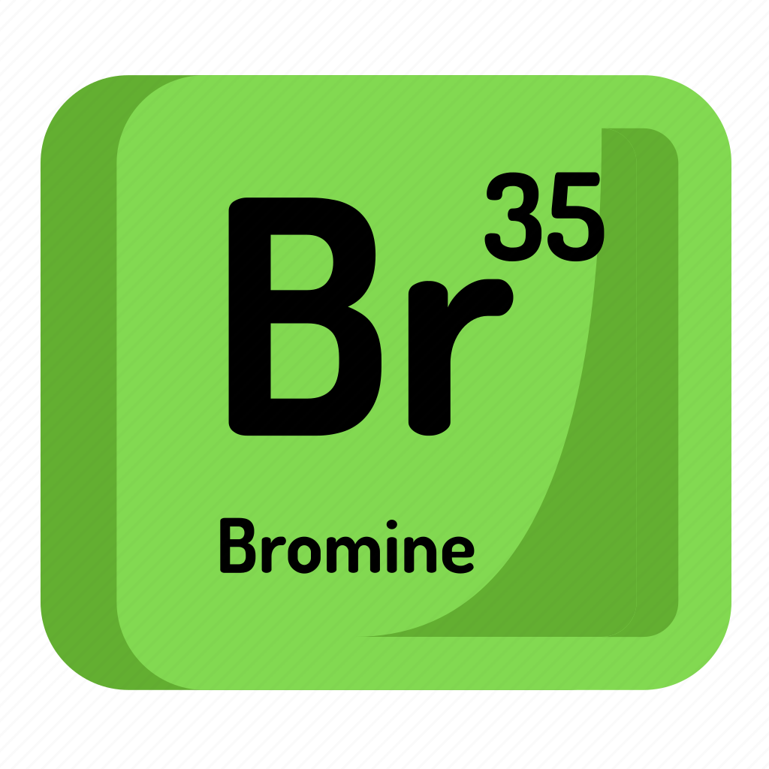

SUMMER TRAINING AT HAARTZ ORGANICS PVT. LTD.
Yashpal Singh Solanki
MBA PM-13
Mentor- Mr. Rahul Sharma
Areas of Operation
Learnings & Challenges
My internship was in management domain, I worked under my mentor who was the manager of the factory and I worked under him in day-today operations of the factory. I had to regularly check for the prices of the raw materials that were used in the manufacturing process such as Chlorine Gas cylinders, Coal, Sulfuric acid. Since the prices keep changing and if the price go down I sometimes even had to call the sellers and ask for a credit note for future purchases. I also had to place orders for these materials over email according to the production. In my internship my communication and negotiation skills were brushed.
With practical experience we learn the actual situation of the business like when ordering these materials the seller asks for past payments and sometimes I even had to make things up to like the Internet banking server is down, etc.
I also had to manage the plant and workers.
The major challenge faced by me during this internship was the language barrier, the company is located in Maharashtra and I did not know Marathi so that was an issue sometimes.
About the company
Haartz Organics Private limited was established in 2013, It is the manufacturer of Liquid Bromine with the capacity to manufacture around 70 Metric tons per month. The company is situated in MIDC Mahad, Maharashtra which is 200 Kms away from Mumbai.
Bromine is a highly toxic element and is used for the process of “Bromination” in Active Pharma Ingredients and to manufacture other synthetic chemicals.
PRICE
One of the role was to find out the latest prices of the raw materials and the product of sales as they are very volatile.
PURCHASE
I was also responsible for getting quotes and making purchase orders for the materials also hardware equipment which are required on daily basis.
LABOUR
MANAGEMENT
The factory worked in 2 shifts day and night, so workers had to be managed accordingly as the workers keep changing frequently so existing workers needs to be swapped accordingly.
LOGISTICS
Transportation has to be arranged according to the sales and purchase of the company, being in contact with the driver and making sure the goods are in proper order.
Manufacturing Process
Distillation
The sodium bromide solution or any kind of solution little bromine content is first distilled at the temperature of 120 degree Celsius in Glass lined reactors to purify the solution.
Chlorination & Separation
The next process is separation of bromine gas by putting the bromide solution into glass column from above where chlorine gas is injected with steam, The chlorine gas reacts and liberates the bromine from the liquid solution to bromine gas
Condensation
The bromine gas is moved to the condenser through the glass column tower where the gas is condensed and turned into liquid with the help of steam later the Liquid bromine is collected in receiver and packed in glass bottles the effluent waste is treated and neutralized with caustic water in scrubbers.

