Slide 1




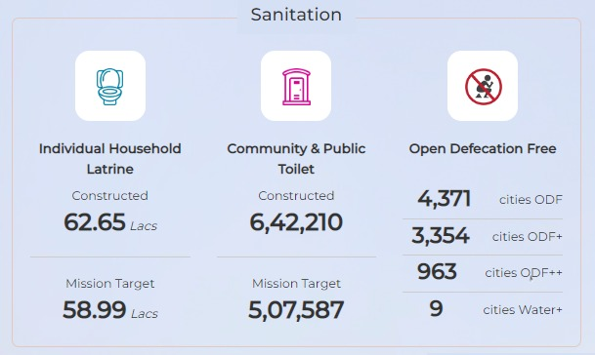
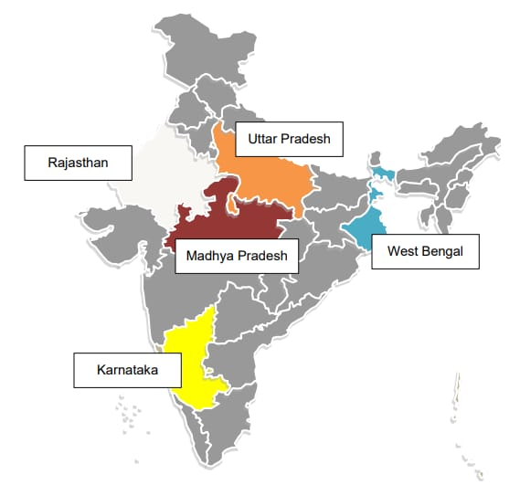
QUALITY CONTROL OF OPEN DEFECATION FREE
About “IQVIA”
IQVIA is a global leader in human data science for over 60 years
IQVIA brings together to advance in data science, technology, and healthcare expertise to help customers make better decisions and ultimately improve patient outcome
IQVIA is the technical consultant for the swatch Bharat mission for conducting an on-ground assessment of star rating for ODF protocols
The SBM launched on 2nd Oct 2014 and has one of its stated objectives to achieve ODF status in all the ULB by Oct 2019. This is the best tribute the country can pay to the father of the nation, MAHATMA GANDHI
Name – Yogesh Kumar
Roll no. – 0360
Stream – MBA
( pharmaceutical management )
Faculty name – Rahul Sharma
Industry mentor - Anshul Sharma
SWATCH BHARAT MISSION
OBJECTIVES OF THE MISSION
Field visit by the assessors
Field Assessment
Verification of the documents provided by the assessors
PROCESS OF QUALITY CONTROL
Construction of individual, cluster, and community toilet
To eliminate or reduce open defecation
Public awareness
Villages to be kept clean with solid and liquid waste management
To provide toilets in school
To provide toilets to all Anganwadi
SWOT Analysis of SBM (ODF)
SWOT
Toilet construction
Individual household latrines
Unfair practices during the field visits
SBM (ODF) program help India to become open defecation free
The work under the SBM is carried out at the moment of inspection
Learning and value addition during internship
Quality control of ODF
Exposure of MOHUA
Challenges faced during internship
STRENGHT
WEAKNESS
Time management (completing the task in time)
Co-ordinate with assessors via call
OPPORTUNITY
THREAT
Usefulness of internship
Knowing the corporate sector
Development of management skills
Suggestion:-
Prioritizing the thoughts of interns and employees and sticking to the mentioned working hours.

